Slide 1
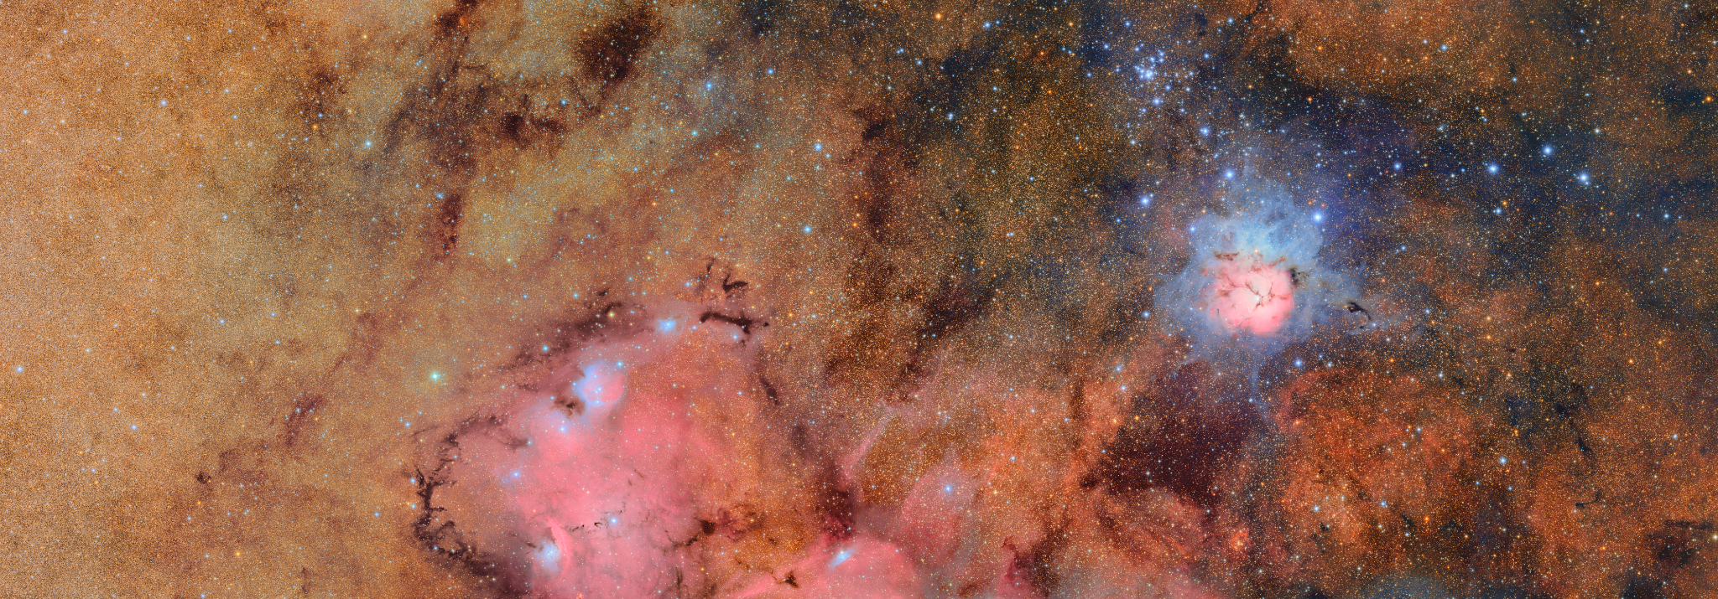


Variable Stars with Rubin Observatory
Rachel Street
With thanks to Rubin Science Collaborations Transients and Variable Stars, Stars Milky Way and Local Volume
Work supported by the US National Science Foundation under Grant No. 2206828 Image credits: Rubin Observatory/NSF/AURA.

Slide 2
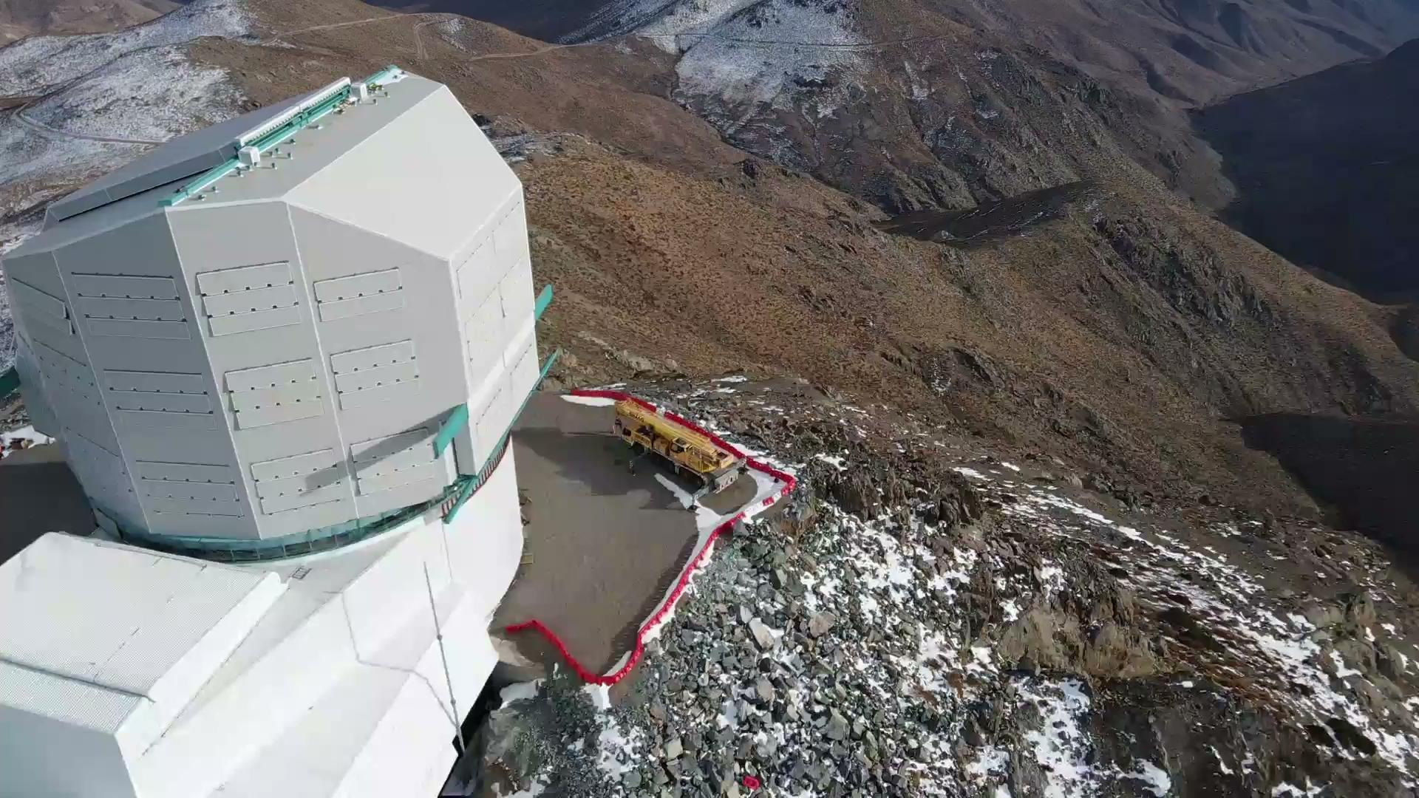
Rubin Observatory
8.4m optical telescope in Cerro Pachón, Chile
Effective aperture: 6.423m
Field of view: 9.6 sq.deg.
Pixel scale: 0.2 “/pixel
SDSS-u,g,r,i,z,y passbands
In early operations phase
Credit: Rubin Obs/NSF/AURA
lsst.org

Slide 3
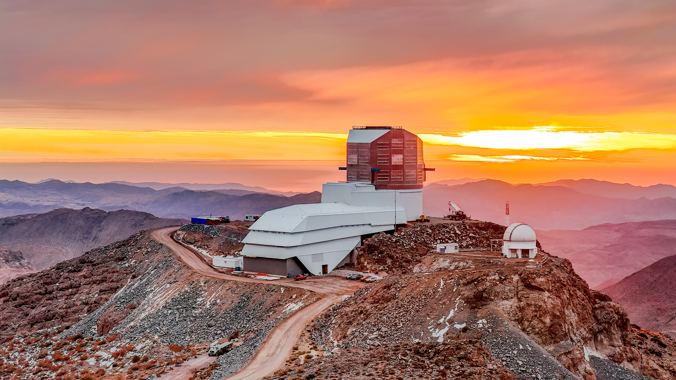
Rubin’s Legacy Survey of Space and Time (LSST)
Timeseries ugrizy imaging of the whole Southern sky for 10yrs, starting ~fall 2025
Rapid discovery alerts
Limiting magnitudes in 30s:
u : 23.9 g : 25.0
r : 24.7 i : 24.0
z : 23.3 y : 22.1
[Ivezić, Z., et al., 2019, ApJ, 873, id.111]
Science Pillars:
Understand Dark Energy and Dark Matter
Catalog the Solar System
Explore the changing sky
Milky Way structure and formation
Olivier Bonin/SLAC National Accelerator Laboratory

Slide 4
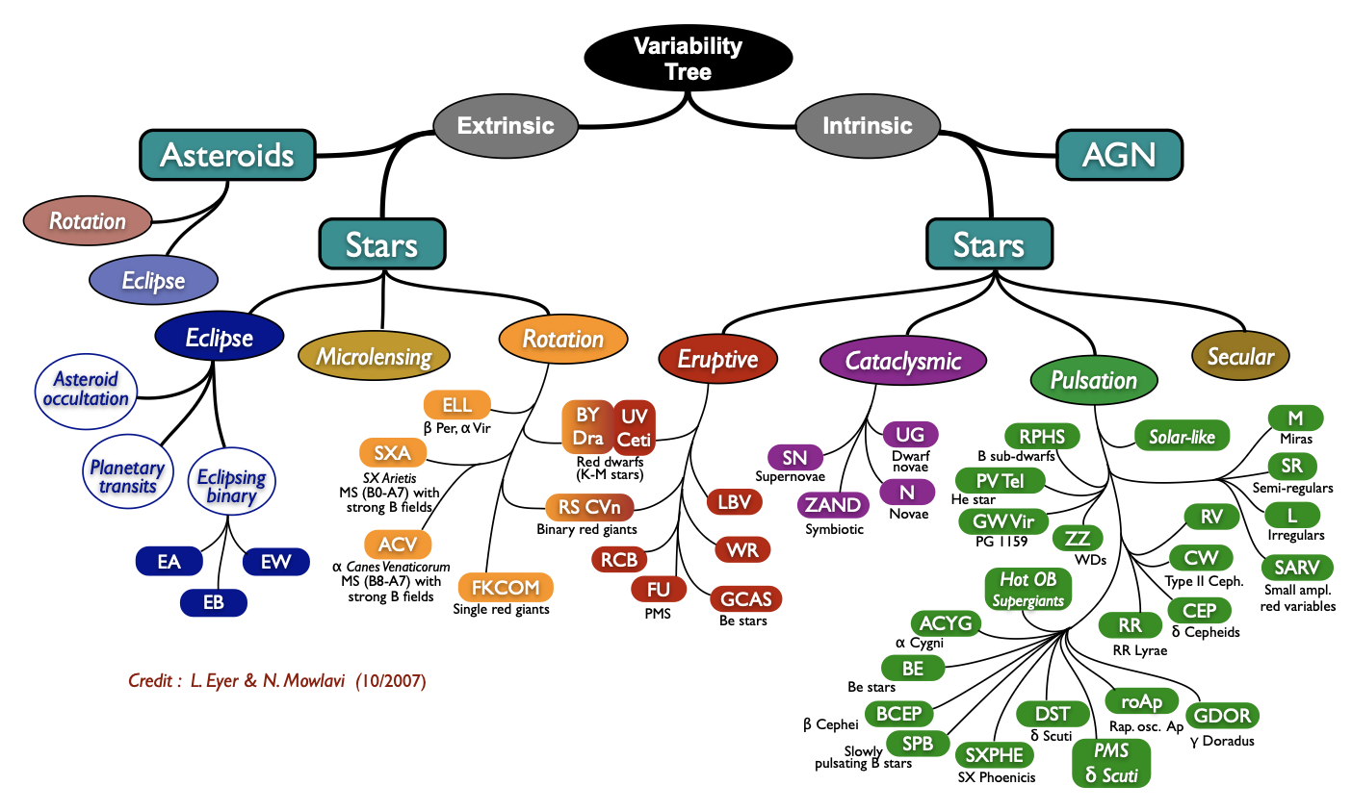

Slide 5
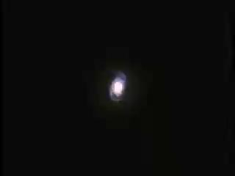
Pulsating Stars
Cephieds, RR Lyrae, LPV are the foundation of the distance scale
Independent constraint on Hubble constant
Can infer age and chemical composition of their host stellar population
Define the 3D distribution of stellar systems.
Stable relations between period-luminosity-color and metalicity
Coefficients for relations not well constrained
Credit: Grag Bacon, STScI

Slide 6
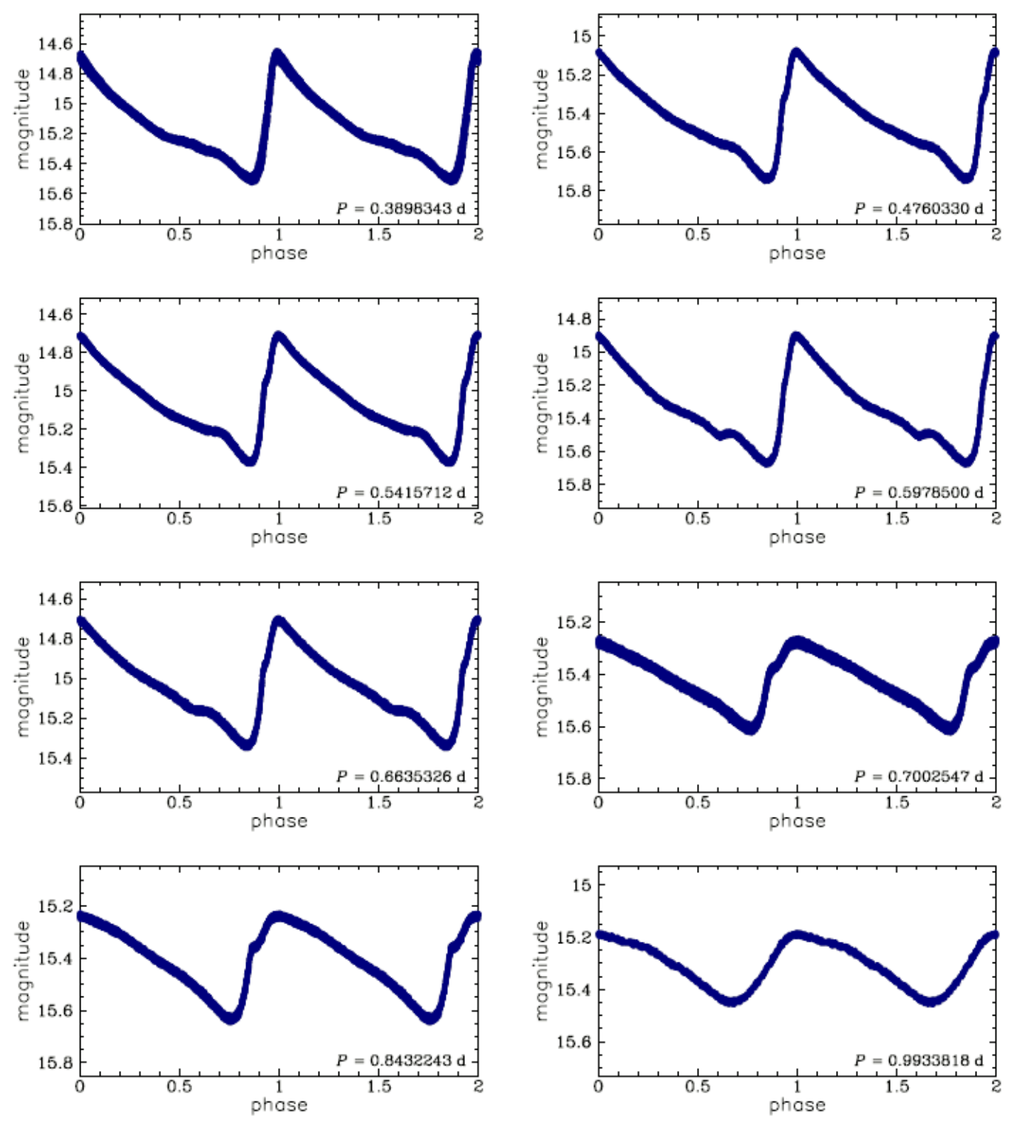
Pulsating Stars - observational requirements
Periods from <1 to >100 days
Amplitudes from millimags to ~mag
UV, optical, NIR and MIR timeseries photometry
LSST’s long baseline will detect pulsators
Roman GP survey will measure shorter periods but only within time-domain fields
+Gaia astrometry to calibrate relations, kinematics
+Spectroscopy can measure elemental abundances and constrain metalicity gradients; calibrate photometric metalicity measurements
E.g. Bono et al. (2026), ApJ, 998, 86 / Ngeow & Bhardwaj (2026), AJ, 172, id.3
RR Lyrae stars observed by OGLE [Soszyński et al., 2019]

Slide 7
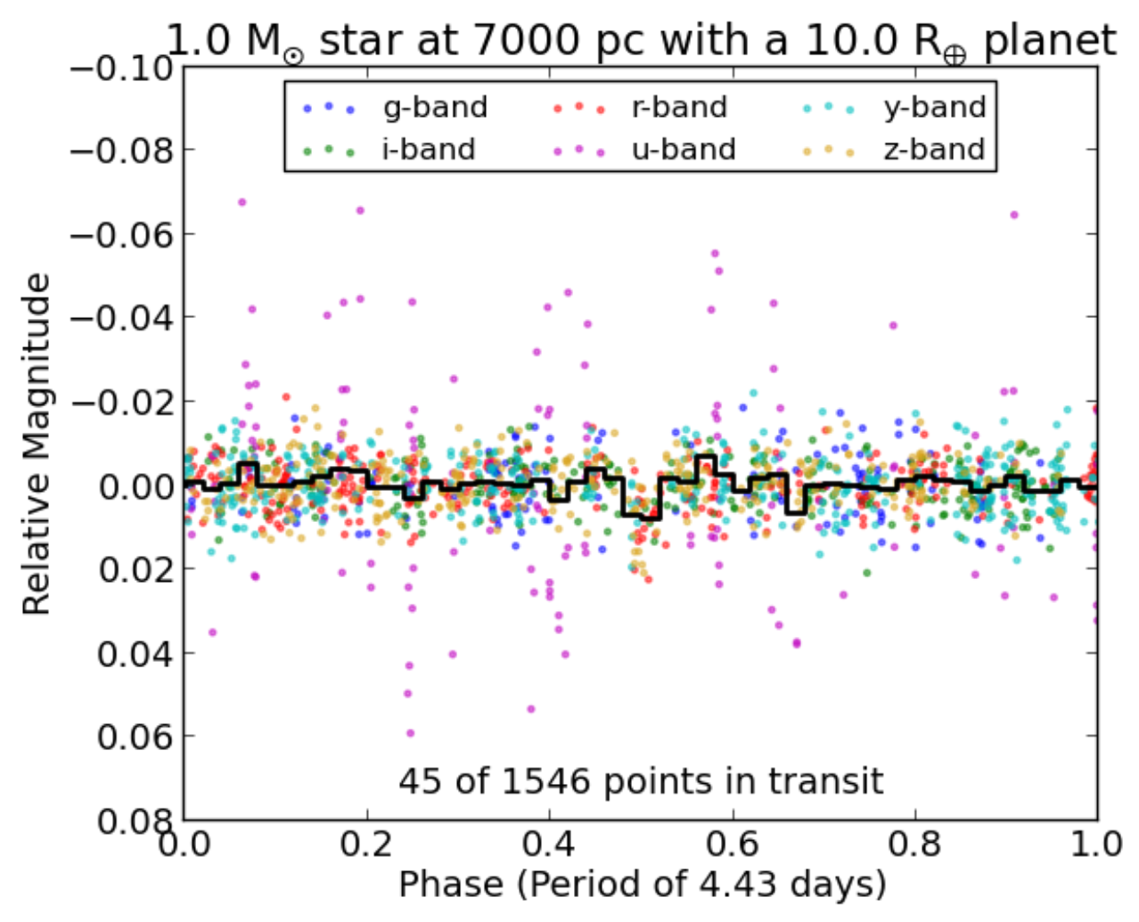
Exoplanetary systems
Rubin’s deep imaging and wide-area survey will detect Hot Jupiters among different populations:
very late type stars,
white dwarfs,
stars in the galactic bulge,
stars in clusters
Needs:
Spectroscopy of brighter objects
Lund, Pepper & Stassun, AJ, 149, id.16

Slide 8
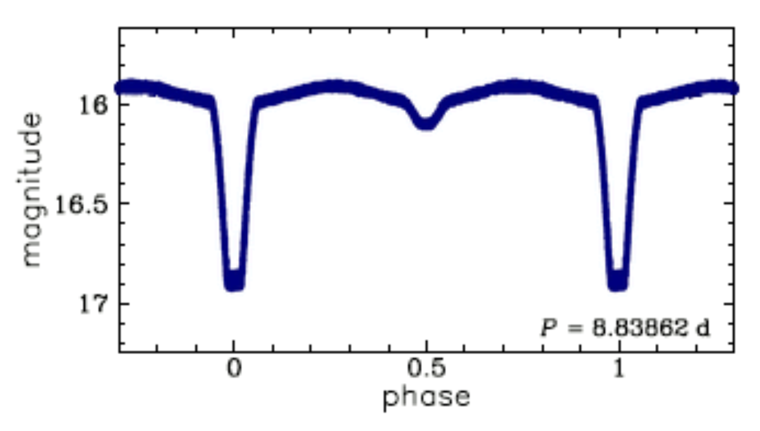
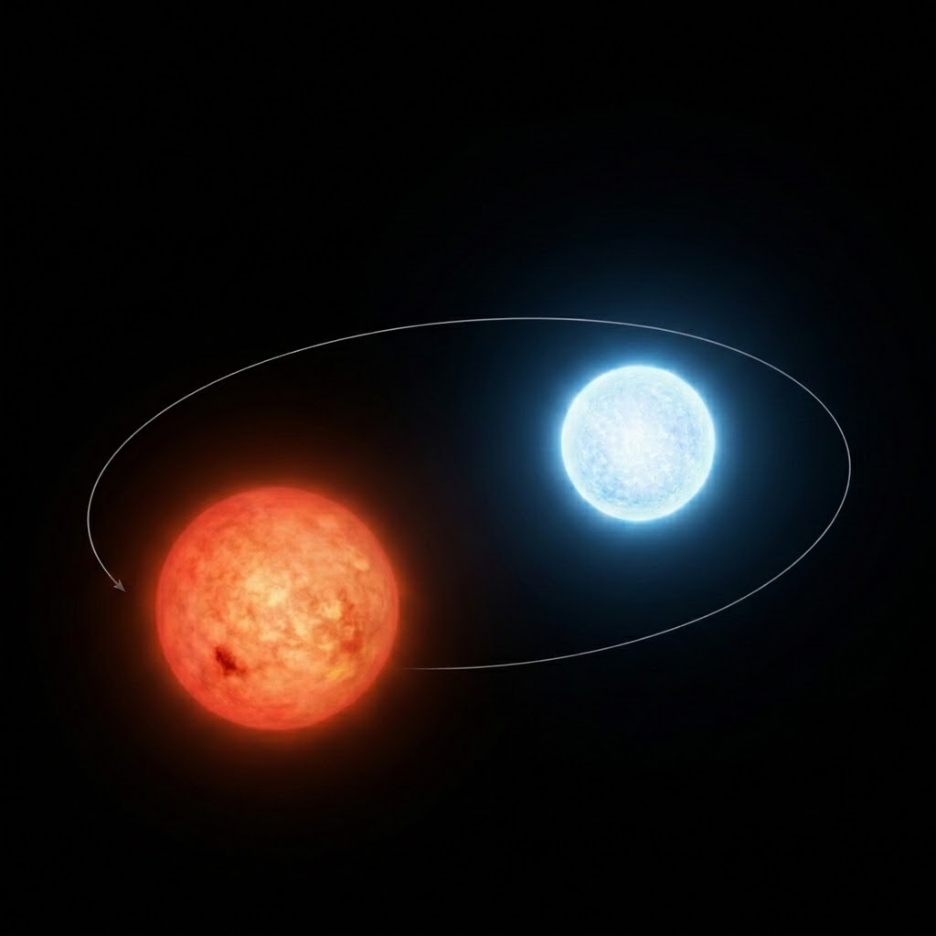
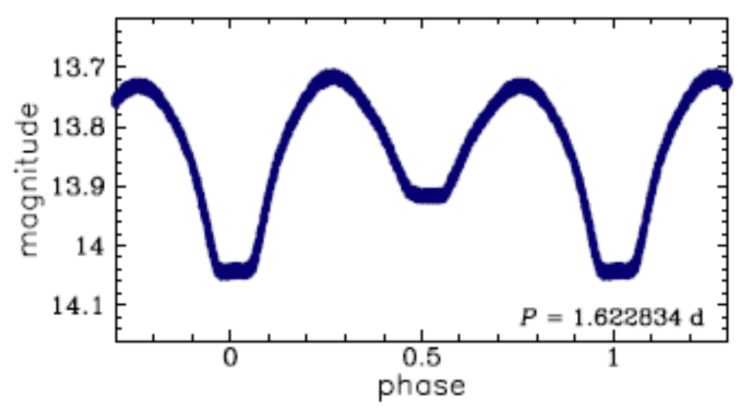
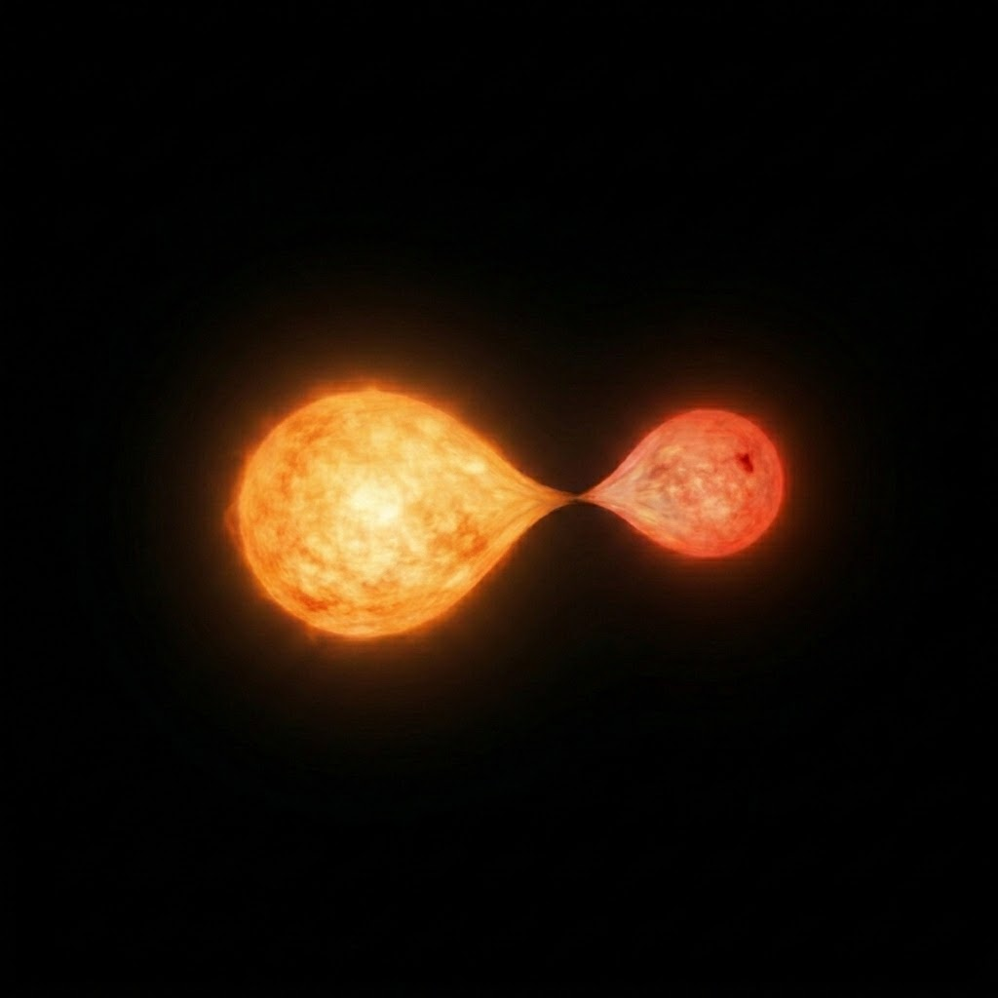
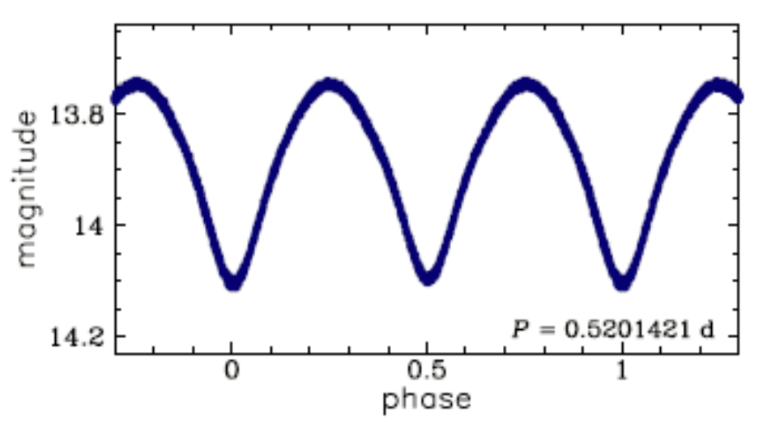
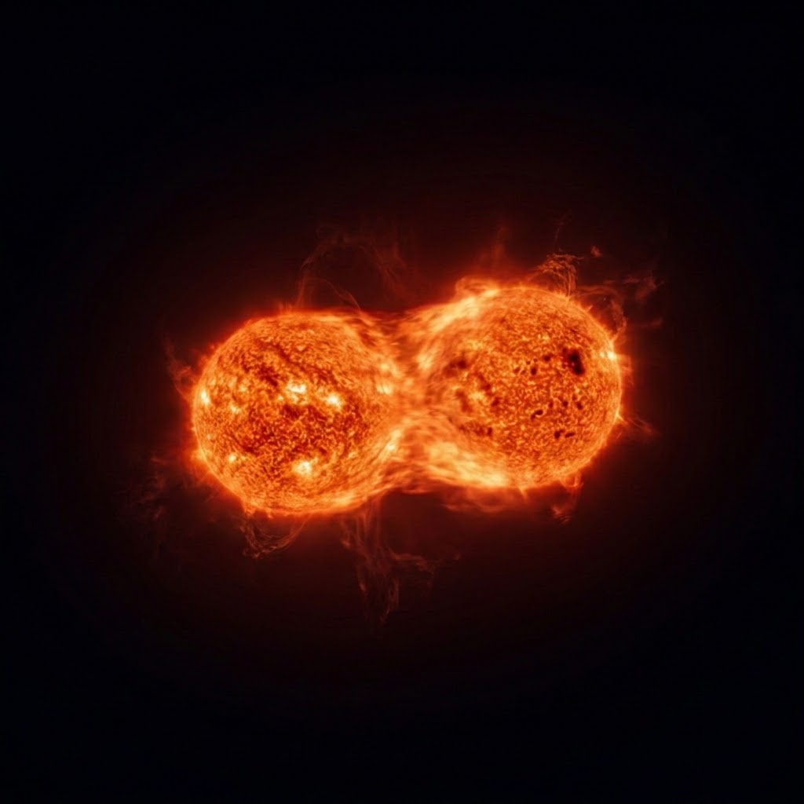
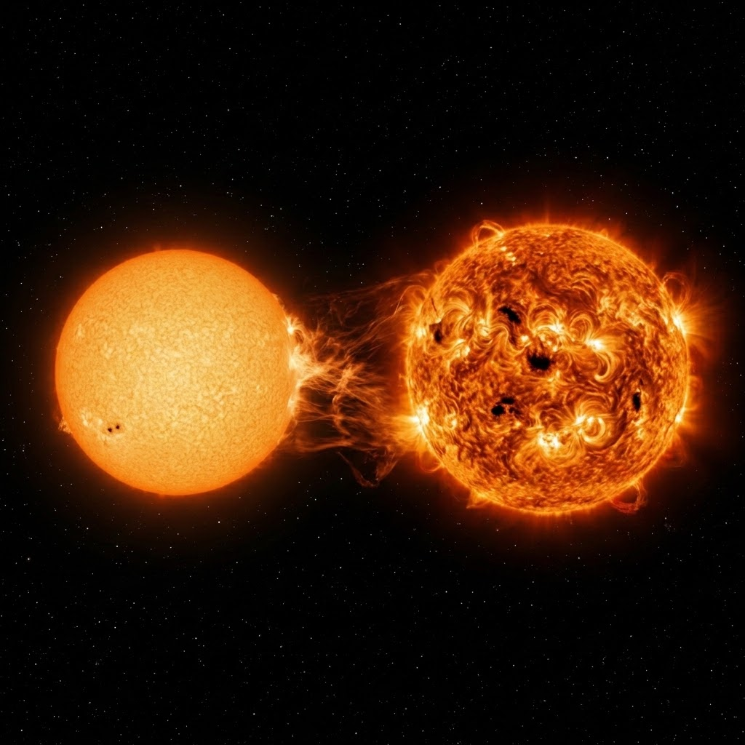
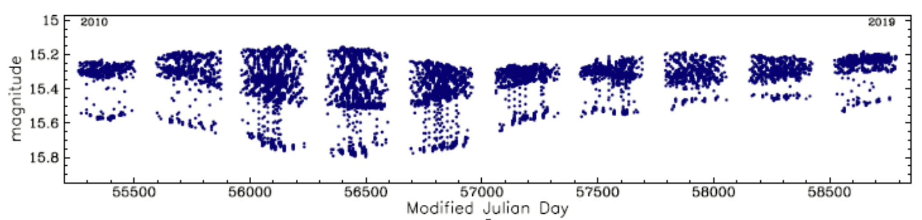
Eclipsing stellar / brown dwarf systems
Enable us to accurately measure fundamental stellar properties
Constrain mass, radius, temperature relations to substellar masses
Detect non-conservative mass-loss in contact systems
Requires timeseries photometry + spectroscopy/astrometry
Algol-type
Beta Lyrae -type
W Ursa Majoris- type
RS CVn type
OGLE Variable Star Catalog, Soszyński et al., 2016b, Acta Astron. 66, 405

Slide 9
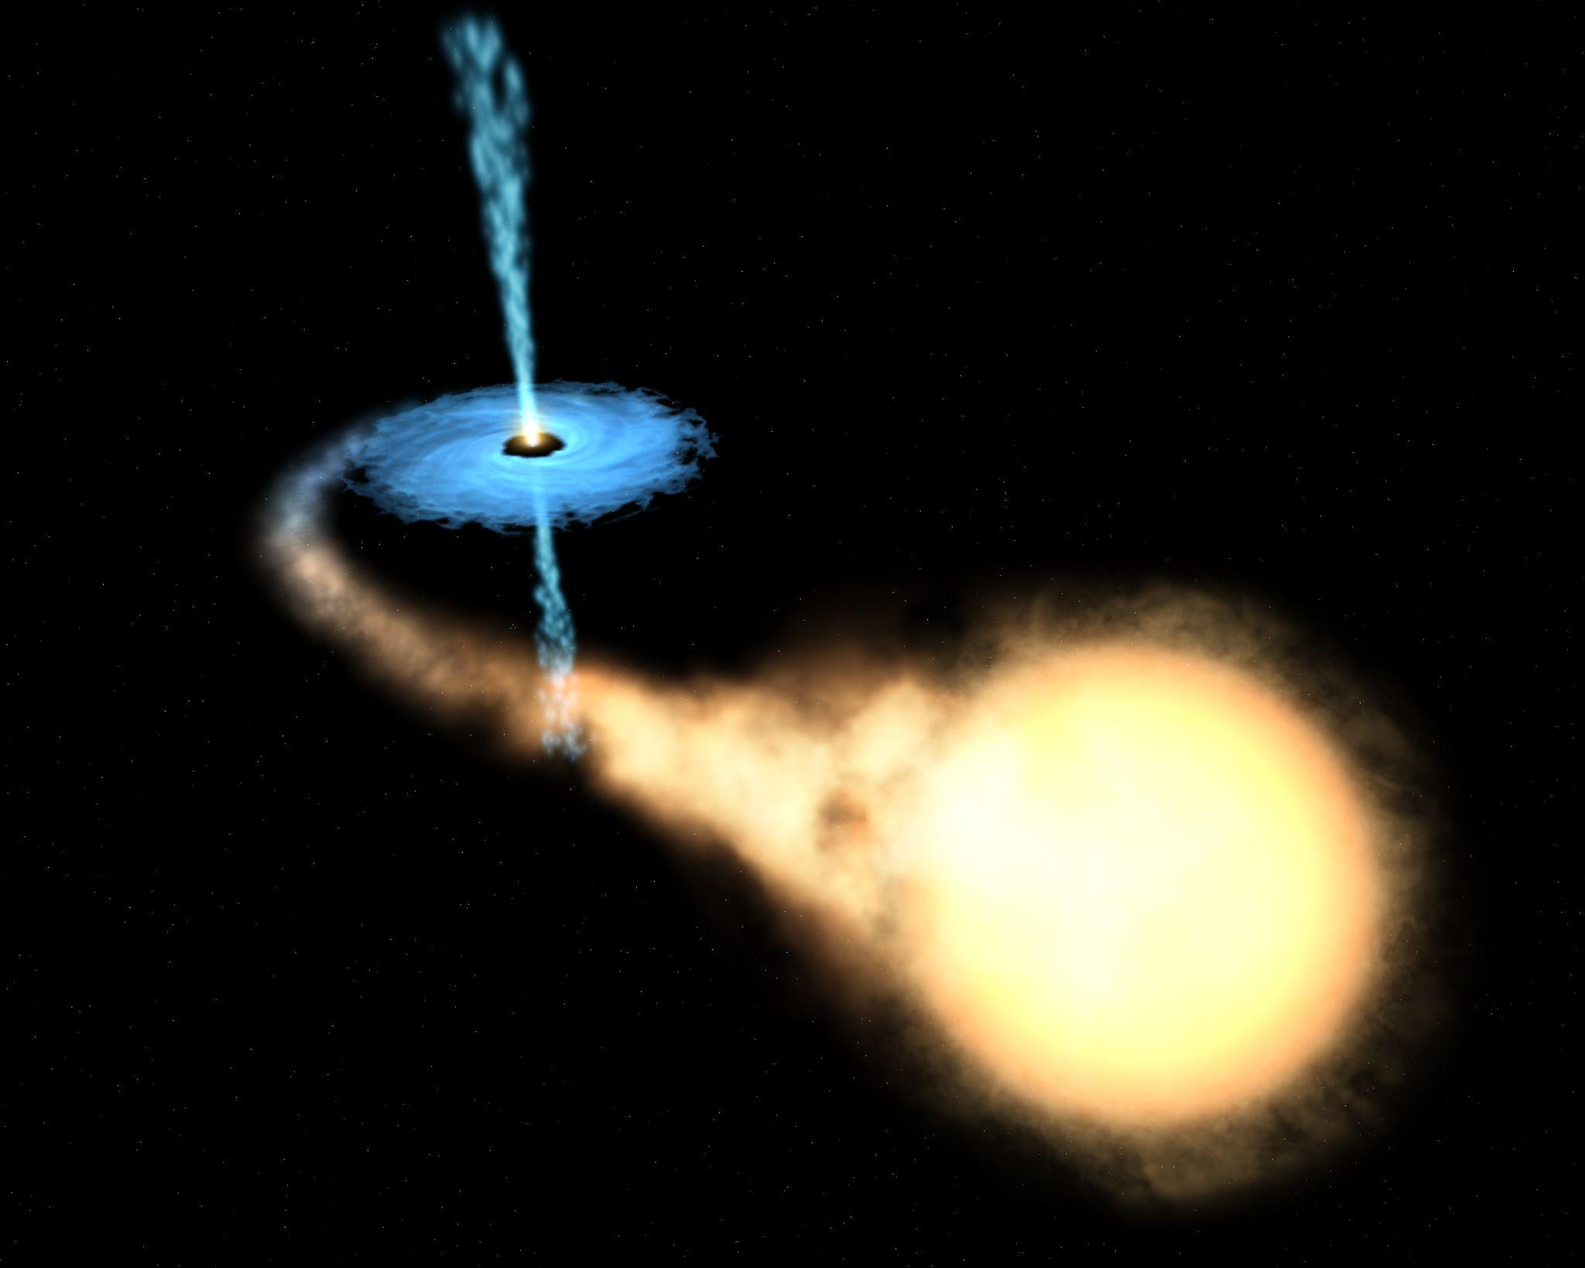
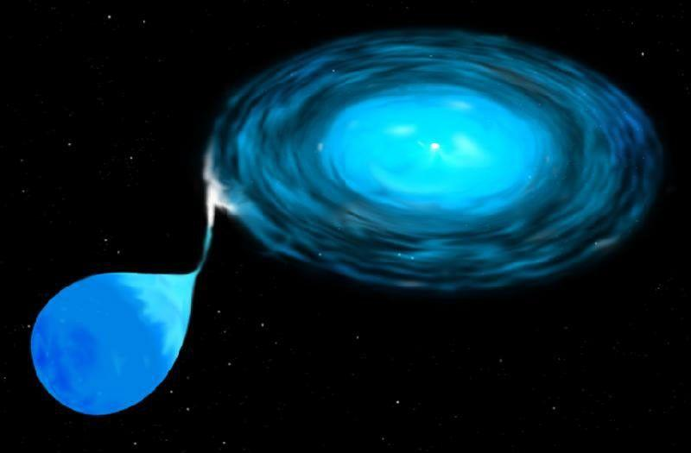
Compact binaries
Stellar remnants accreting from a close companion
Cataclysmic Variables (white dwarf + companion)
Low-mass X-ray binaries (neutron star + companion)
Black Hole X-ray binaries
Image credits: ESA/Hubble, STScI

Slide 10
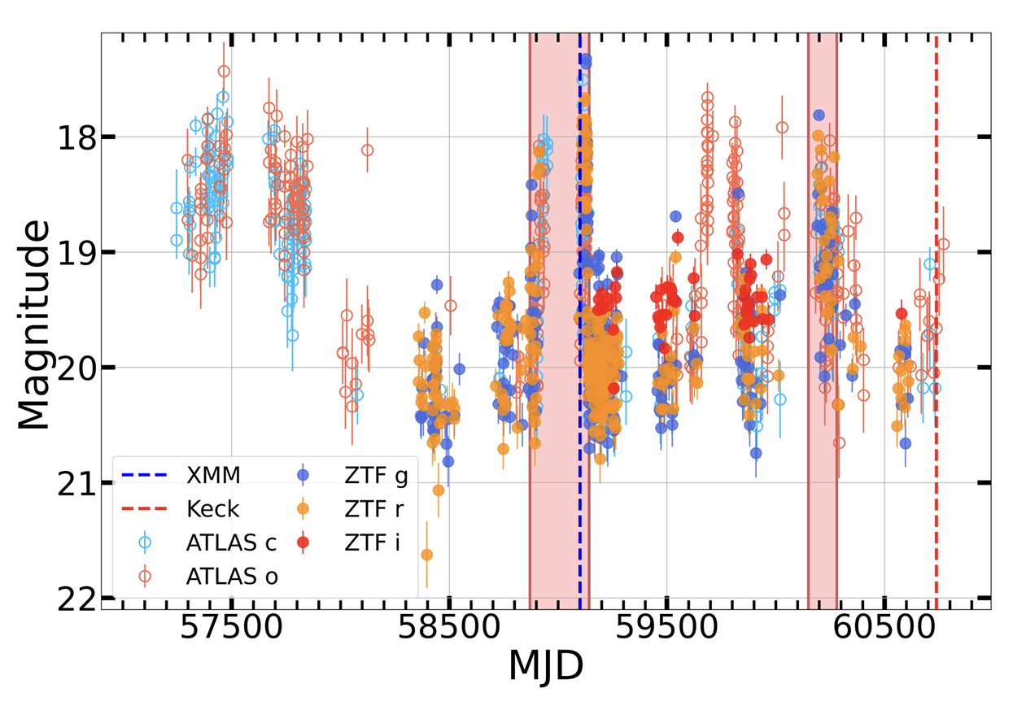
Cataclysmic Variables
White Dwarf accreting from close companion
Novae with 10–15 magnitude outbursts caused by thermonuclear runaways on the white dwarf
Dwarf novae with 2–9 mag outbursts caused by disk instabilities;
Nova-likes which have high and low states of accretion
AM CVn have two white dwarfs with accretion
Detached white dwarf binaries (pre-CVs)
Galiullin et al. (2026) PASP, 138, 054201

Slide 11
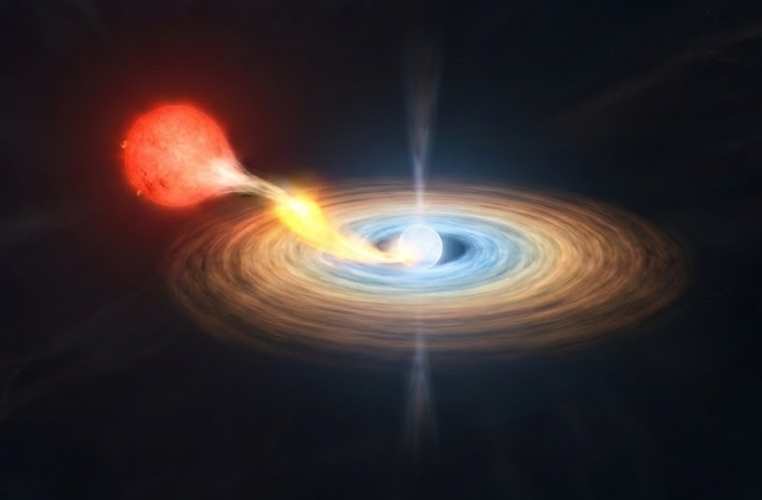
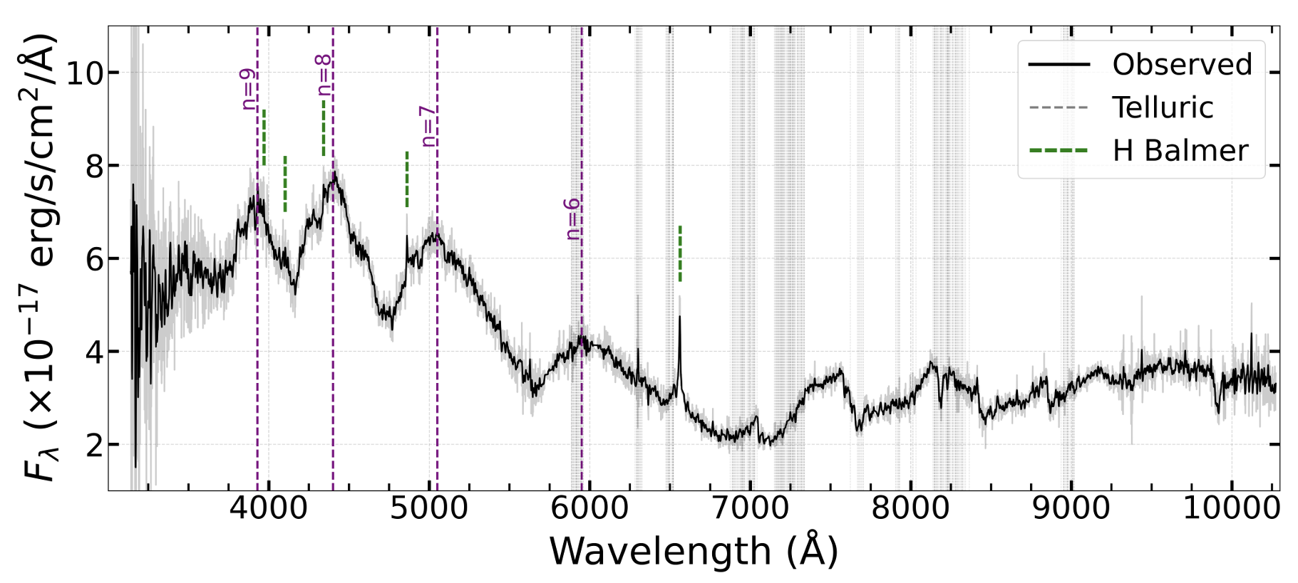
Multiwavelength characterization of accretion
Optical lightcurve measure variability and detect outbursts
Optical spectra measure emission lines, cyclotron humps
Optical
Galiullin et al. (2026) PASP, 138, 054201

Slide 12
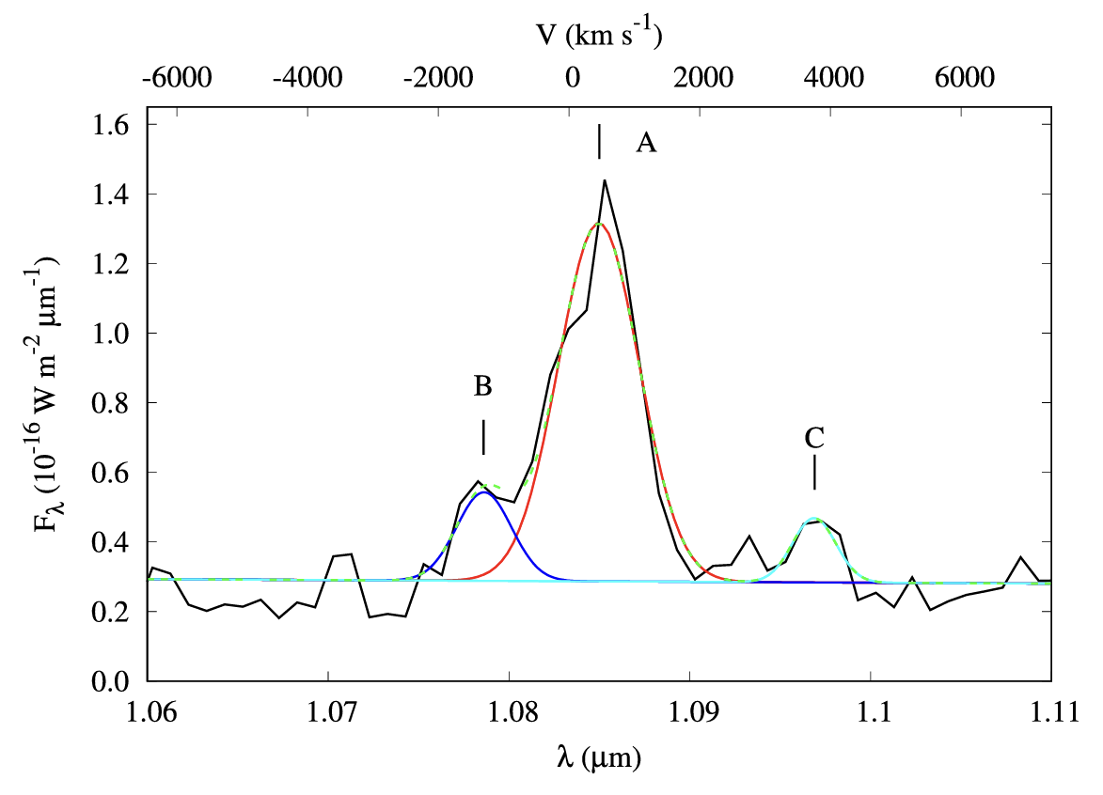
Multiwavelength characterization of accretion
IR imaging and spectra detect ejecta, companion, outer disk
NIR
Galiullin et al. (2026) PASP, 138, 054201

Slide 13
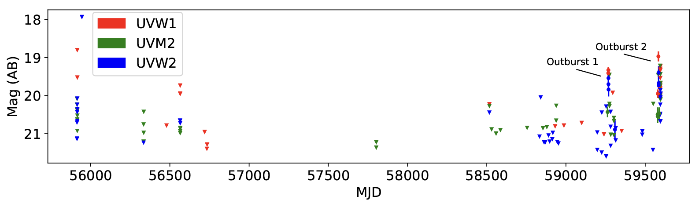
Multiwavelength characterization of accretion
UV lightcurve traces emission from the inner disk and white dwarf boundary region
UV
Modiano et al. (2022), A&A, 664, A165

Slide 14
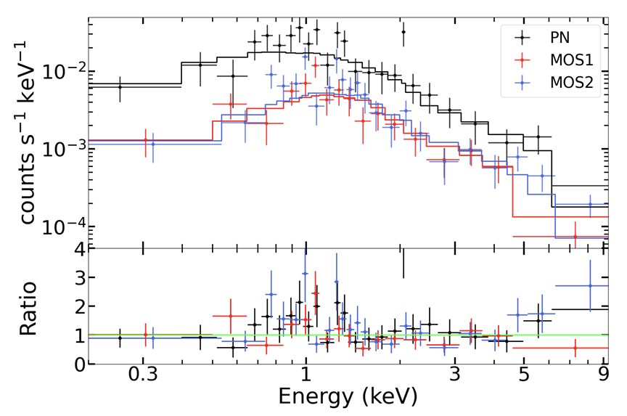
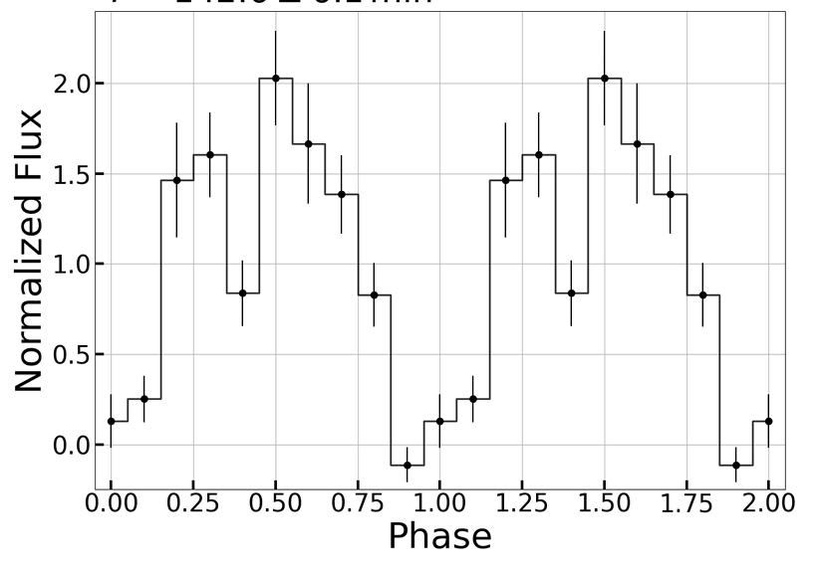
Multiwavelength characterization of accretion
X-ray lightcurve and spectra and γ-ray detections explore boundary layer between white dwarf and disk
X-ray, γ-ray
Galiullin et al. (2026) PASP, 138, 054201

Slide 15
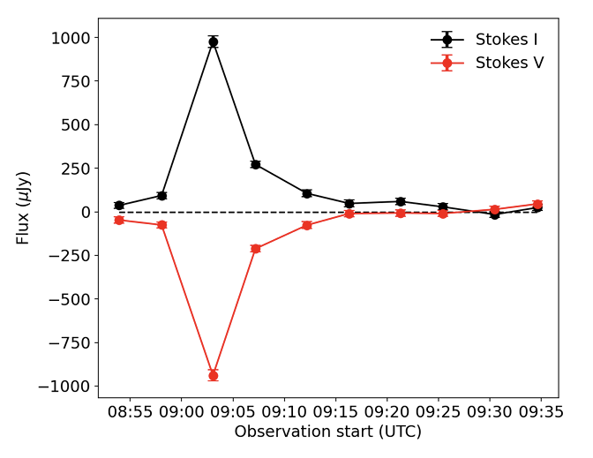
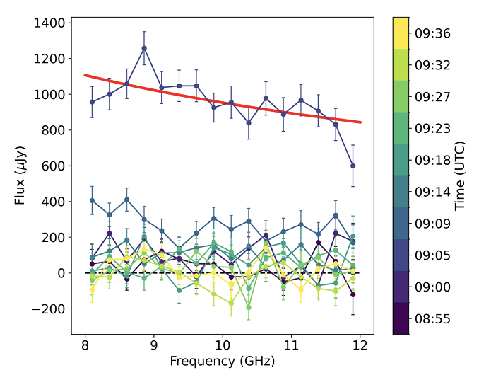
Multiwavelength characterization of accretion
Coherent and incoherent radio emissions (2--4 GHz and 8--12 GHz) lightcurve and SED
Radio
Ridder et al. (2026) arXiv:2603.03209

Slide 16
Observing Compact Binaries
Rubin will detect compact binaries which are often faint in the optical
IR/optical Rubin, large aperture ground-based telescopes, Roman
Radio VLASS, ASKAP, VLA..
UV, Swift, ULTRASAT
X-ray Swift, Chandra, XMM-Newton
γ-ray Fermi
Archival data valuable

Slide 17
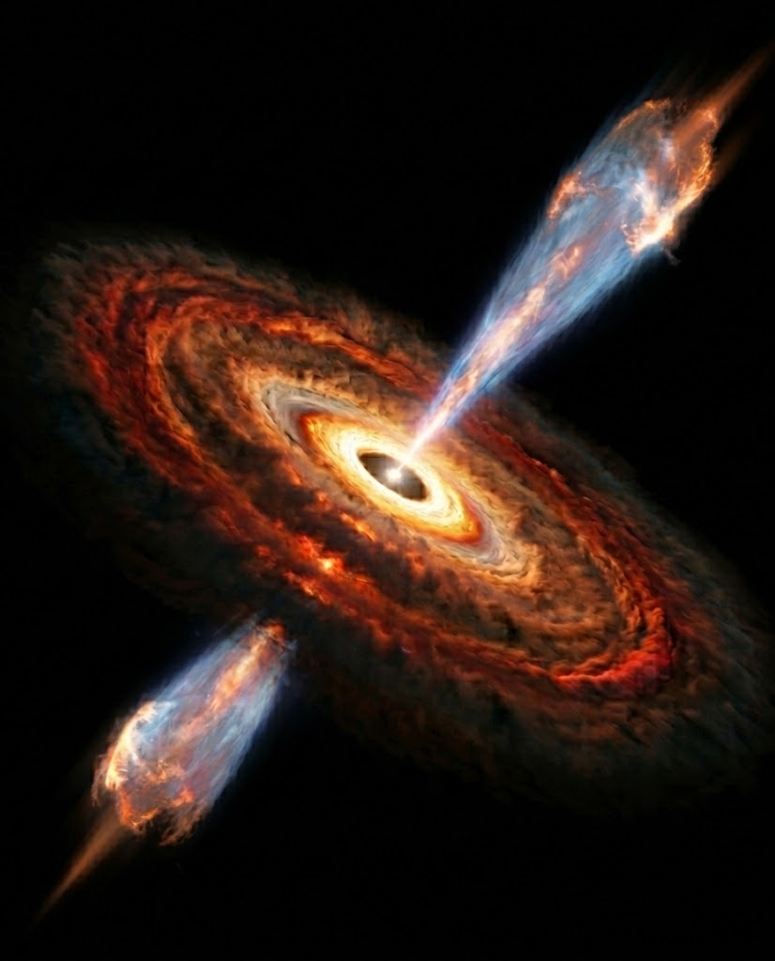
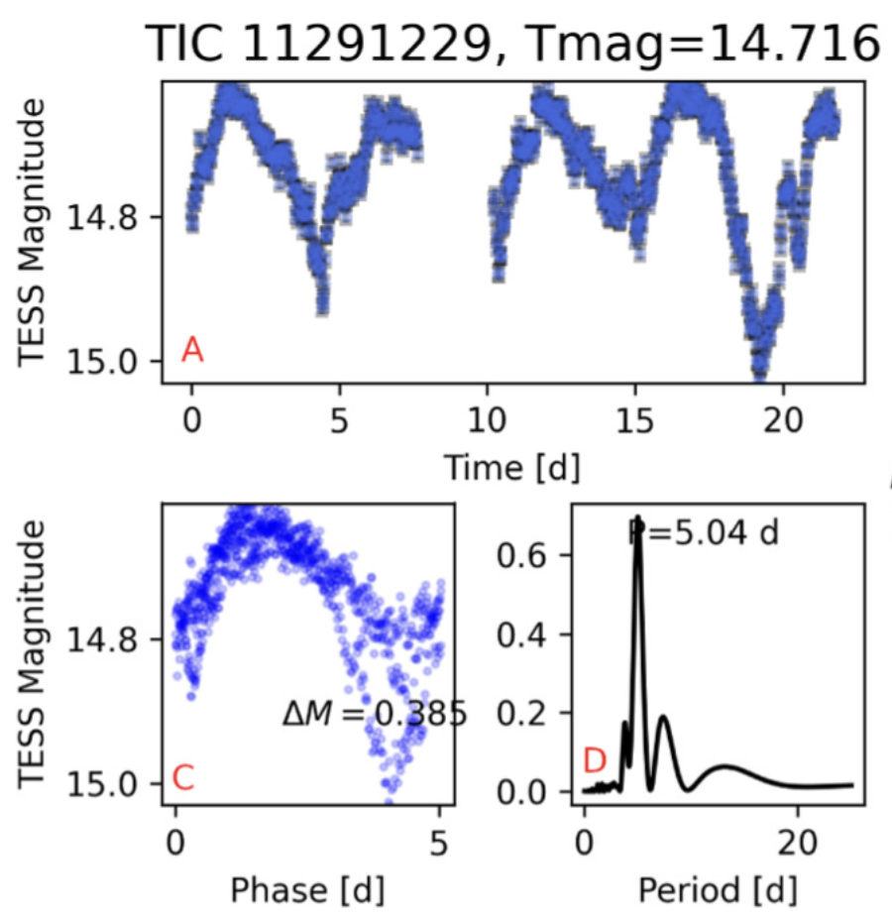
Protostars
Irregular variability signatures from accretion disks
Episodic accretion causes eruptive outbursts
Affects disk evolution and planet formation
FUOr: long outbursts, high accretion, absorption lines
ExOr: short, repeating outbursts, low accretion, emission lines
[T. Giannini, R.Bonito, S. Antoniucci, TVS Roadmap, arXiv: 2208.04499]
TESS lightcurve of Classical T Tauri Star
Serna et al. (2024), ApJ, 968, 68

Slide 18
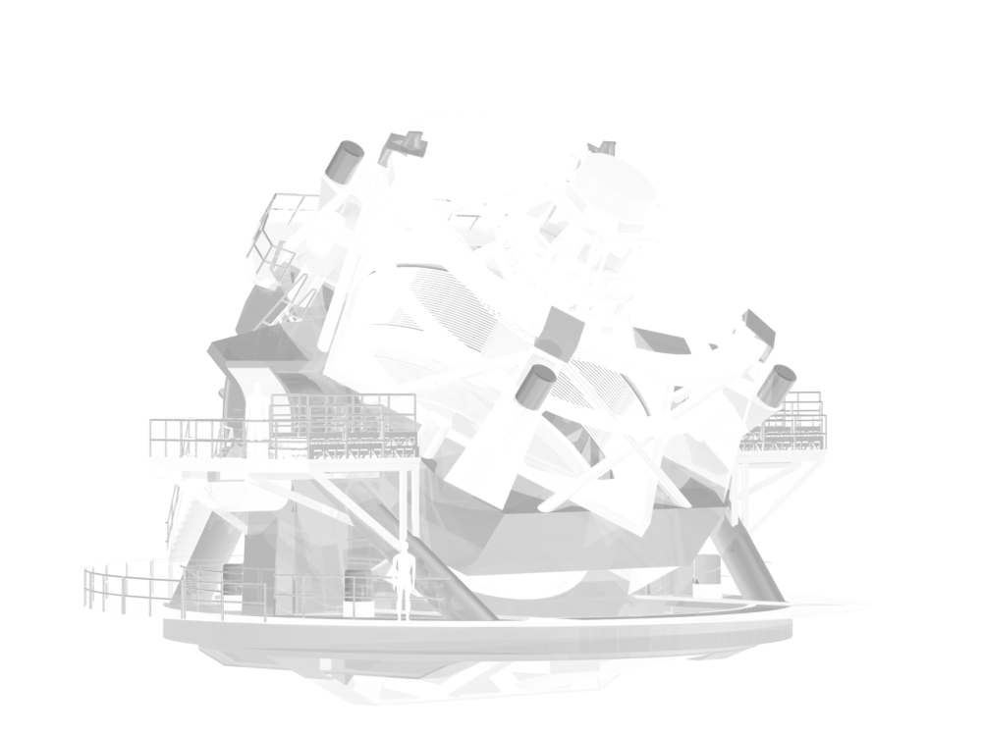
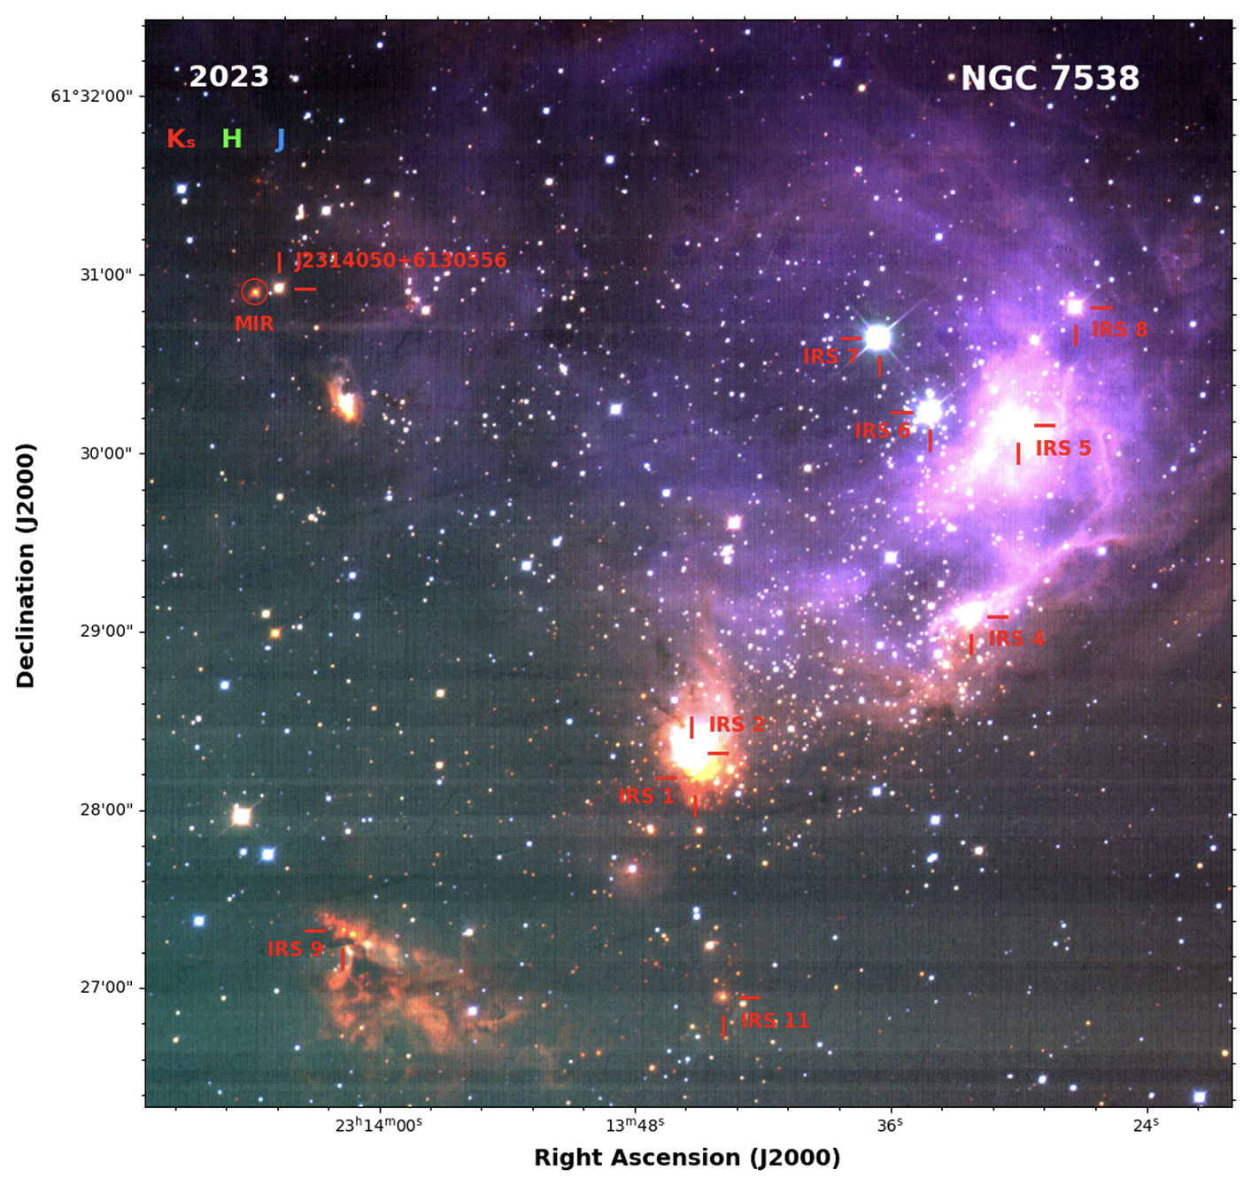
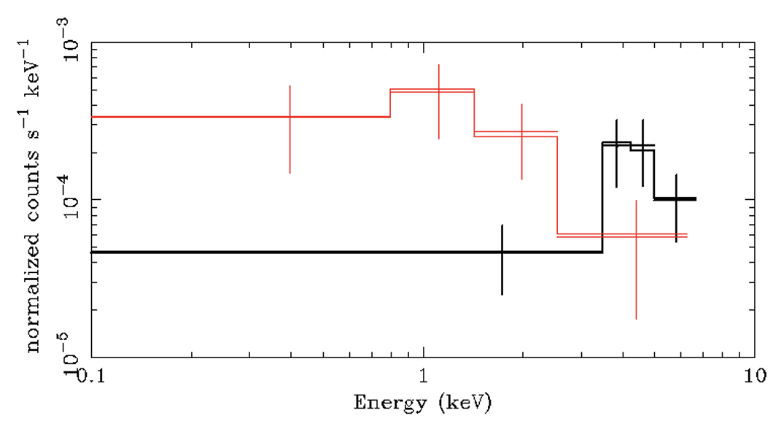
Protostar observations
Long-baseline, wide-area, multiband optical photometry from Rubin will significantly increase the known sample of eruptive protostars and detect outbursts
UV photometry ideal (though extincted)
NIR/MIR timeseries photometry and spectroscopy
X-ray spectra
Image credits: Rubin Obs, Fang et al. (2026), RAA, Volume 26, Issue 8, id.085004, Leibhart et al, (2014), A&A, 570, A11

Slide 19
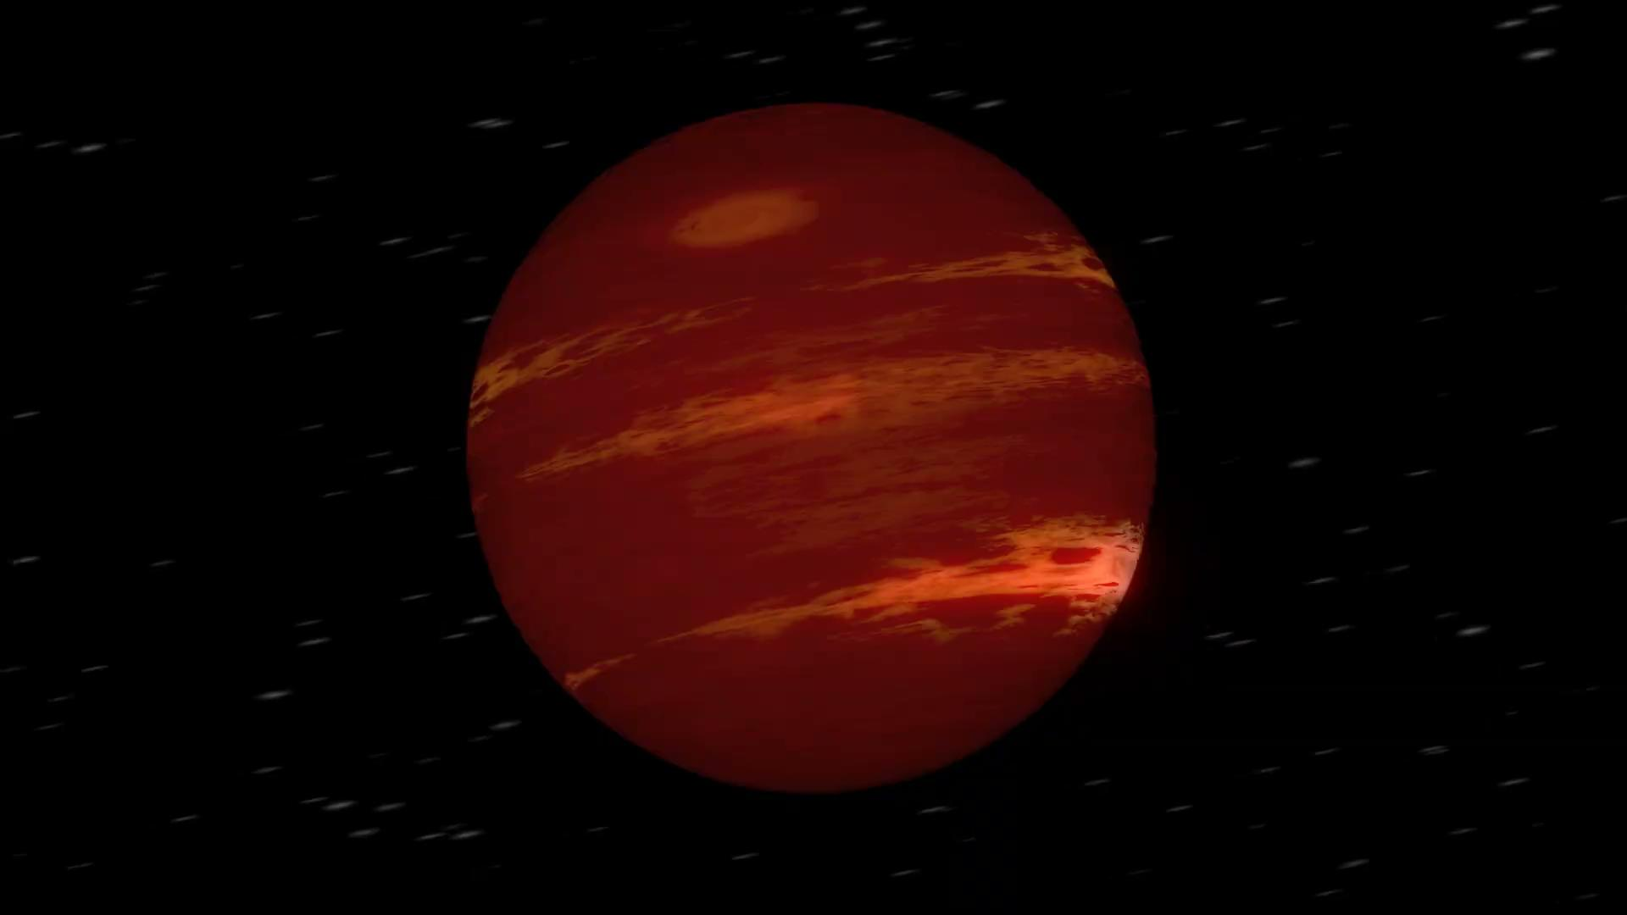
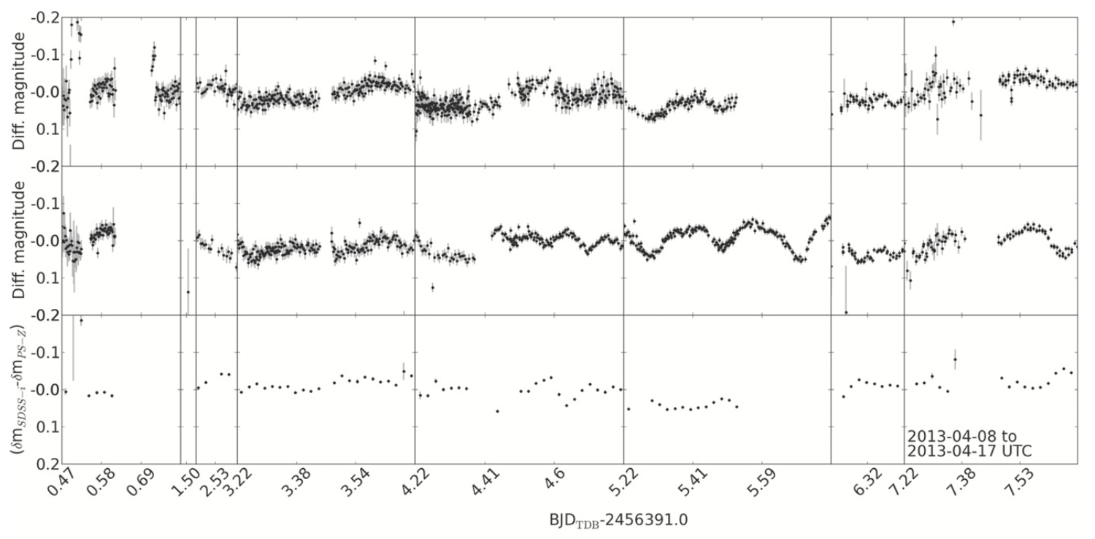
Brown Dwarfs
Sub-stellar mass objects (13-80M_{Jup})
T_{eff} range from <600K to 2100K
Complex atmospheric structures
Expand sample beyond 20pc
Monitor weather and map atmospheric structure
Distance and parallax
Movie credit: NASA
Street et al. (2015), ApJ, 812, 161

Slide 20
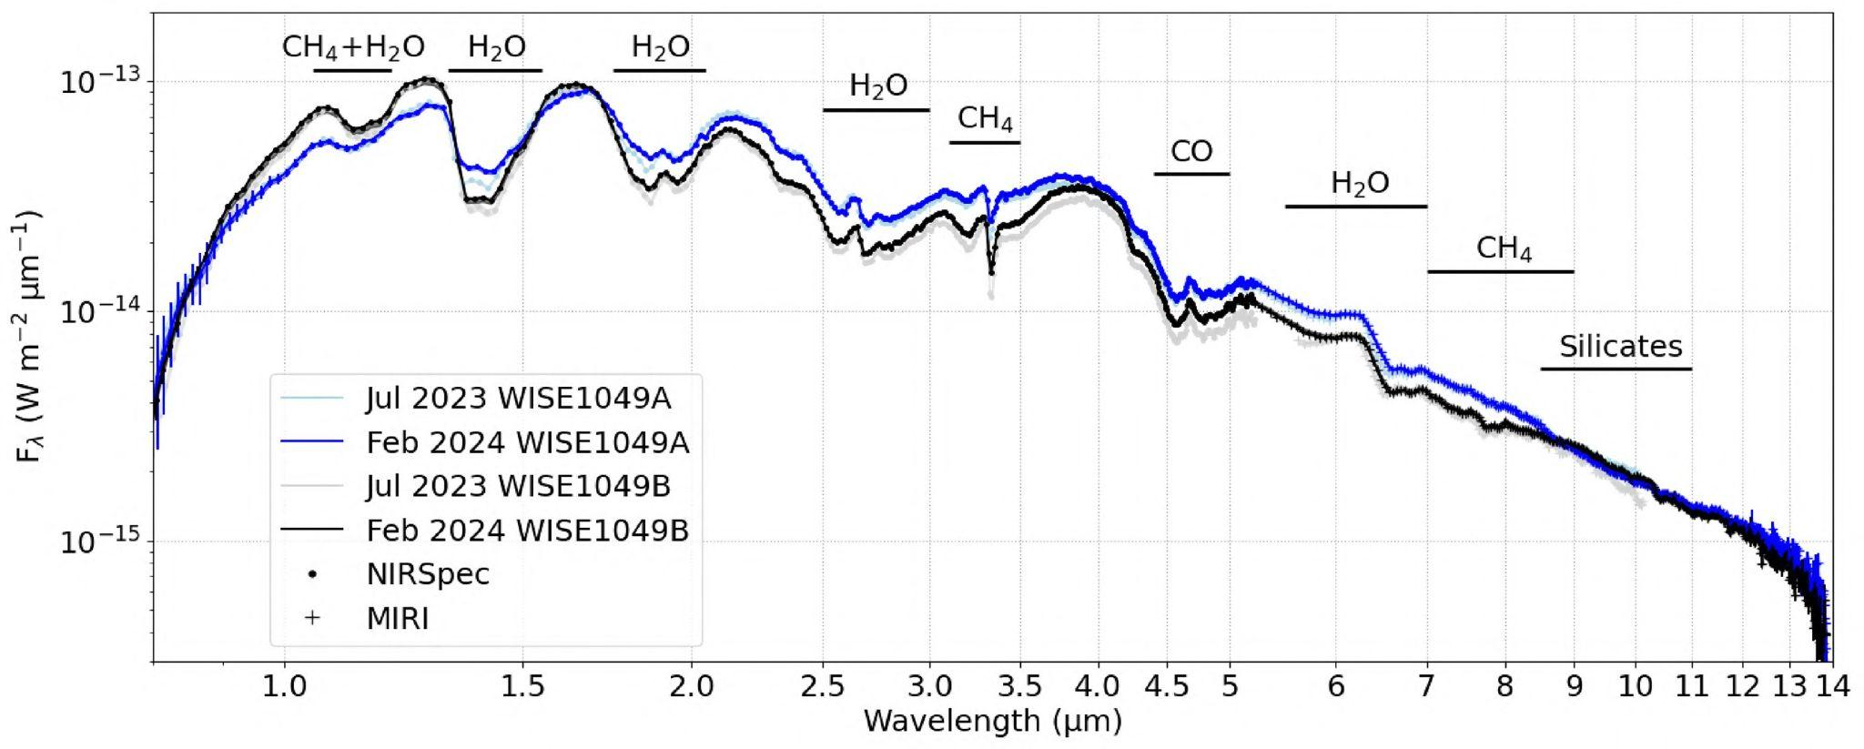
Brown Dwarfs
Chen et al. (2025), MNRAS, 539, 3758
Timeseries NIR spectroscopy
Red-optical + NIR timeseries imaging

Slide 21
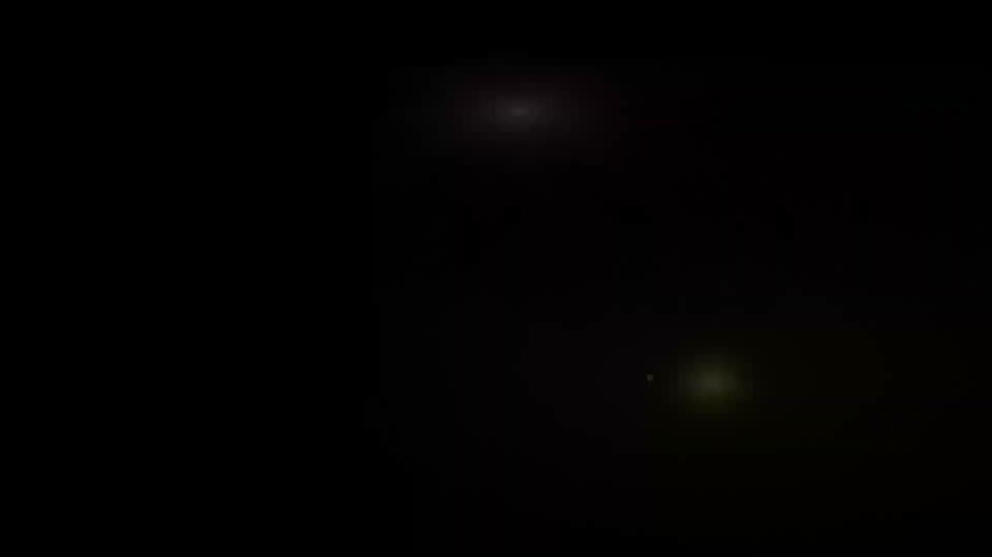
Microlensing
Mass, distance measurements of
bound planets
free-floating planets
isolated stellar remnants
Rubin will detect thousands of lensing events in a broader range of stellar environments

Slide 22
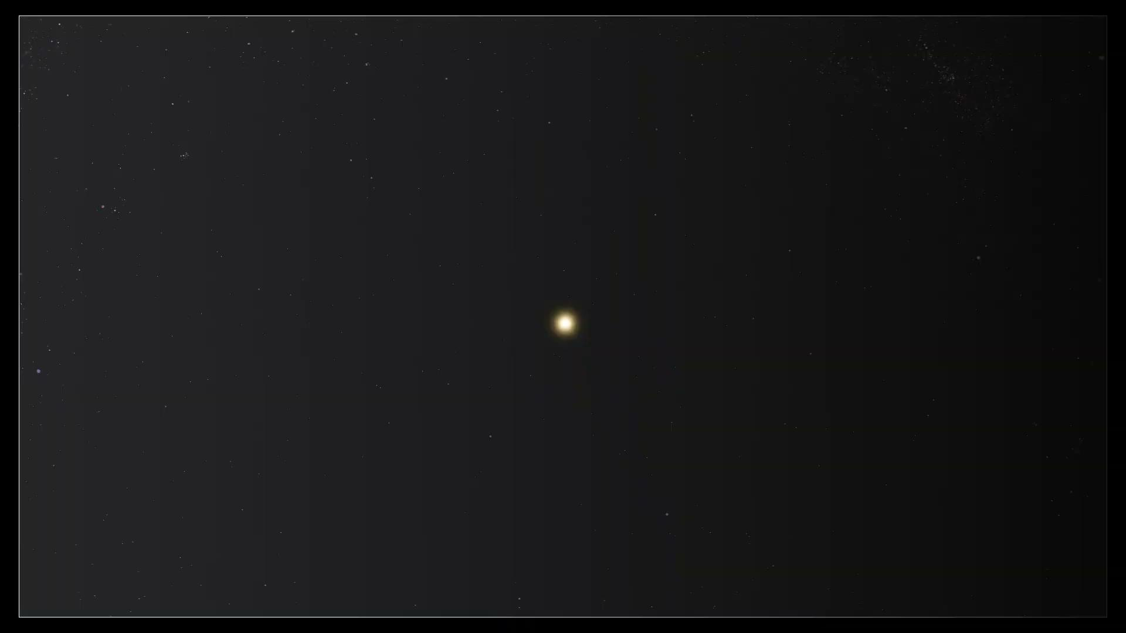
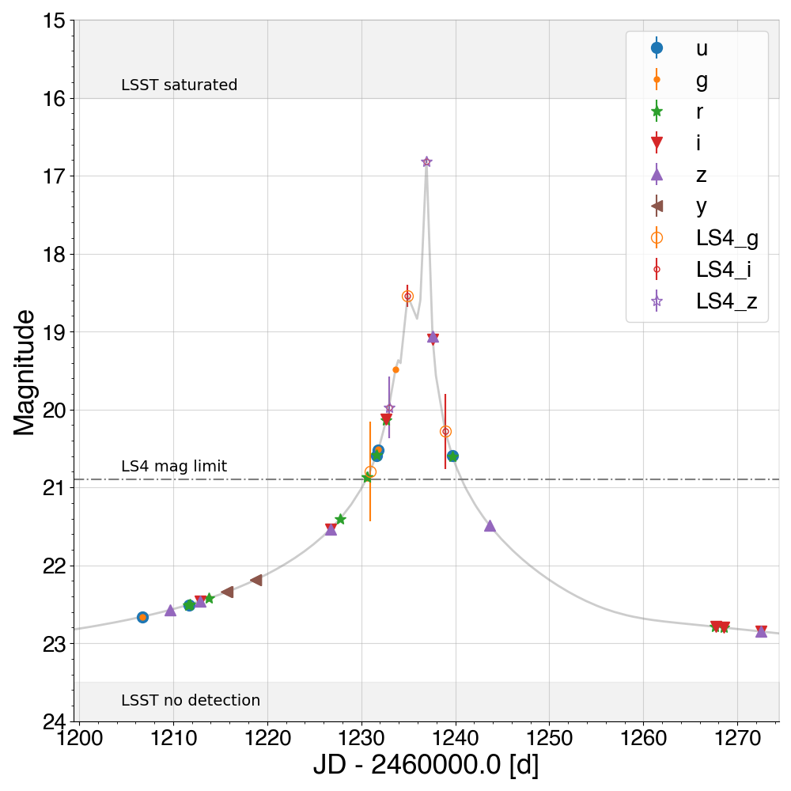
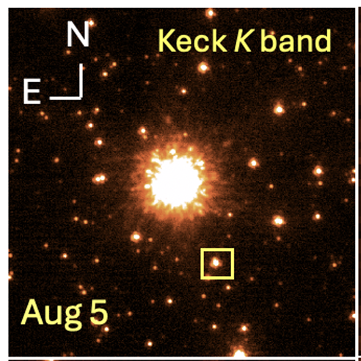
Microlensing characterization
High cadence lightcurves to measure lens model parameters
Multiband optical/NIR photometry determines source radius and distance
Optical/NIR high-resolution imaging
Timeseries astrometry
(Rarely) NIR interferometry
Credits: NASA's Goddard Space Flight Center/CI Lab,
Vanrorou et al. (2025), AJ, 170, 210

Slide 23
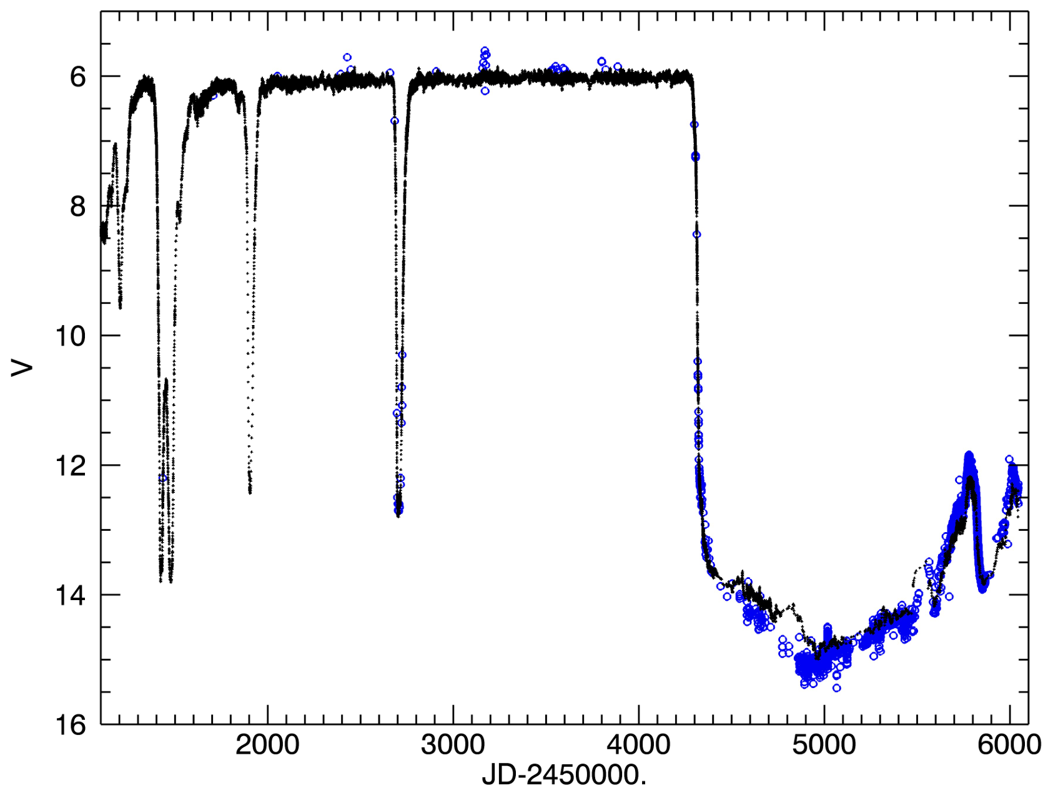
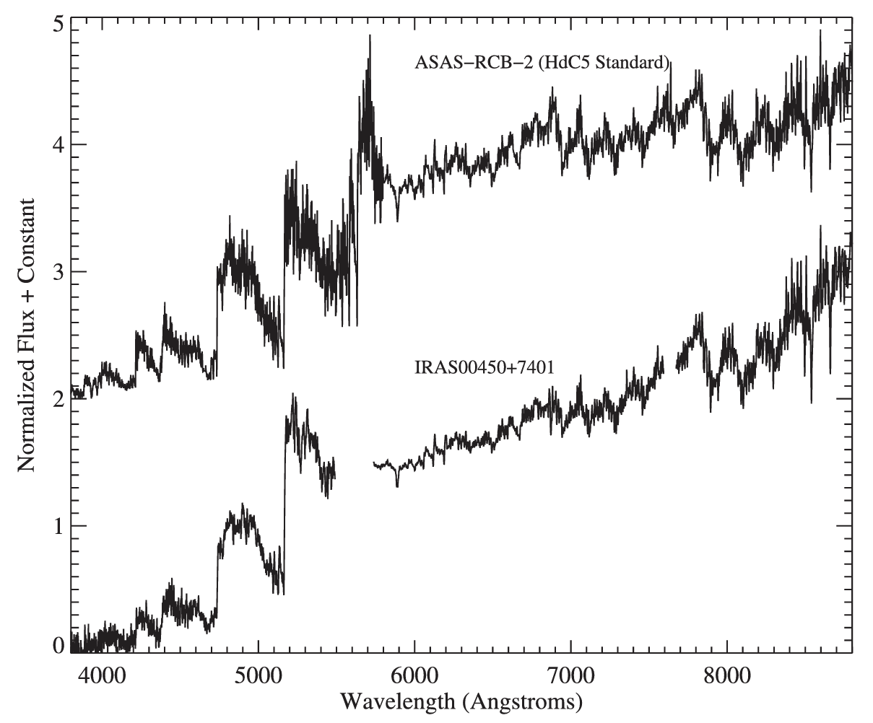
R Coronae Borealis Stars
Rare, hydrogen-deficient, carbon-rich supergiants
Dramatic drops in brightness at irregular intervals
Atypical stellar evolution pathway?
Long-baseline optical/NIR photometry + spectra
Clayton (2012), JAVSO, 40, 539,
Burris et al. (2023), AJ, 166, 40

Slide 24
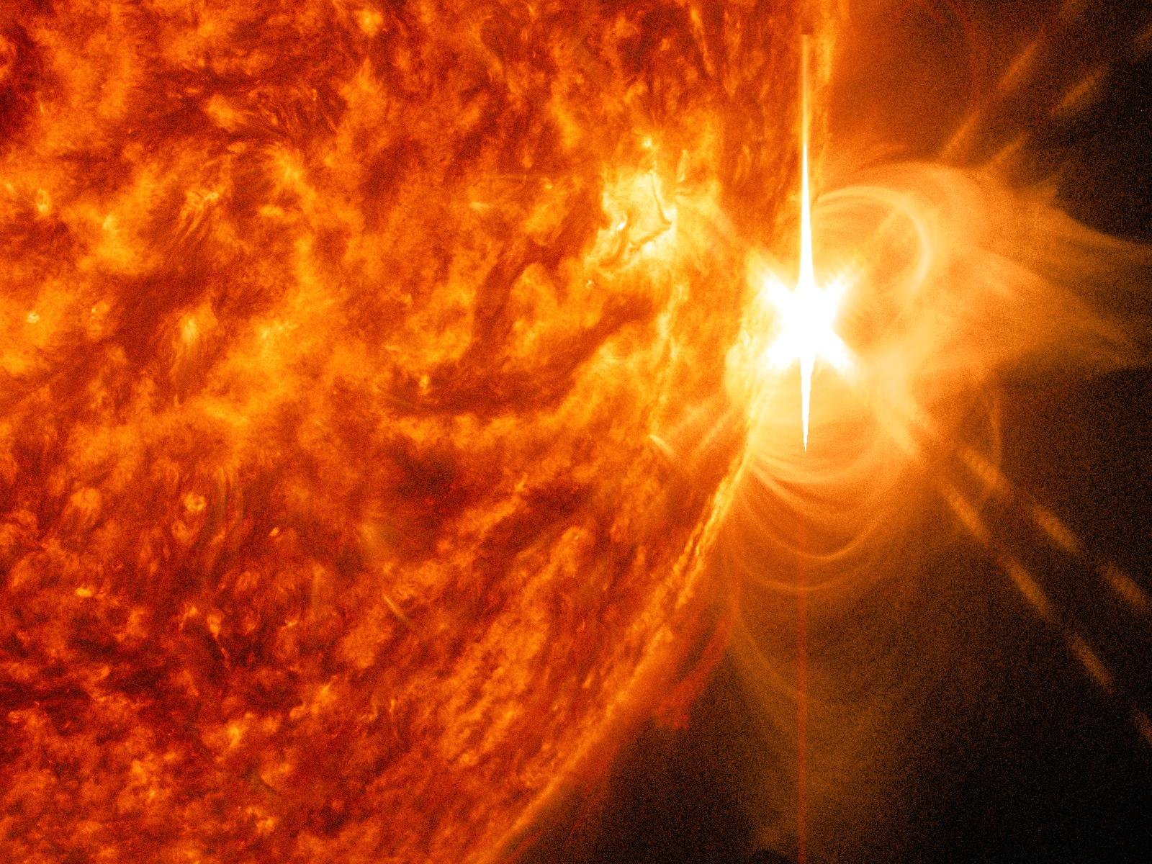
Unknown unknowns
Rubin’s most exciting discoveries will be the forms of variability we don’t know about.

Slide 25



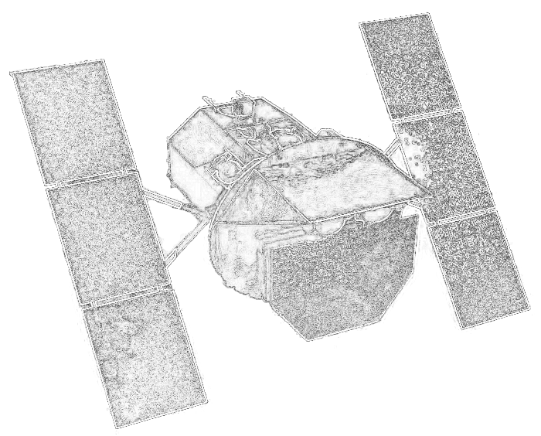

Multiwavelength characterization
Variable stars require imaging and spectra at all wavelengths
Ground + space-based facilities
Accretion outbursts require rapid response
Coordinated, contemporaneous survey coverage optimal
Image credits: Rubin Obs., NASA, Gemini Obs, Greenbank Obs

