Slide 1
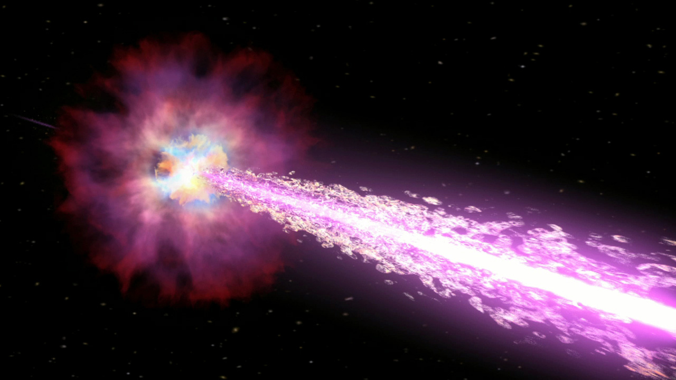
Gamma-Ray Burst Science Present and Future
Judy Racusin
NASA Goddard Space Flight Center
Kavli-IAU Time-Domain Coordination Workshop – June 2026

Slide 2
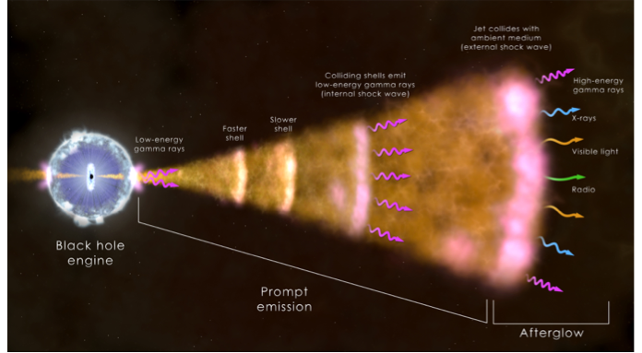
What are Gamma-ray Bursts?
A powerful central engine accelerates particles to relativistic speeds in bipolar jets
Two phases
  prompt emission - material moving at slightly different speeds crashes into each other producing gamma rays
  afterglow - the shock wave interacts with the environment around the star producing the long-lived multiwavelength afterglow
Distances - 0.01≲z ≲ 9.4
Gamma-ray energies ~ M☉c²~2x10⁵⁴ erg
Jetted outflow ~10° half opening angle (reduces energy by ~ 1/100)

Slide 3
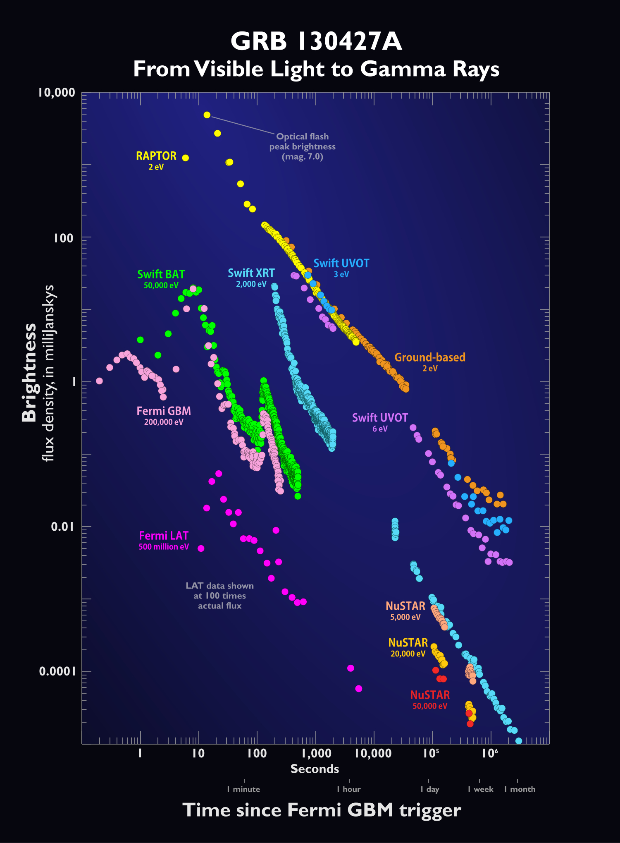
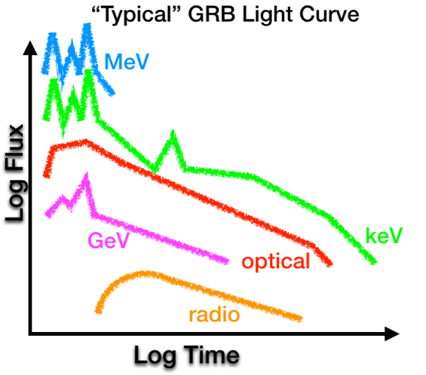
Broadband Observations of GRBs

Slide 4
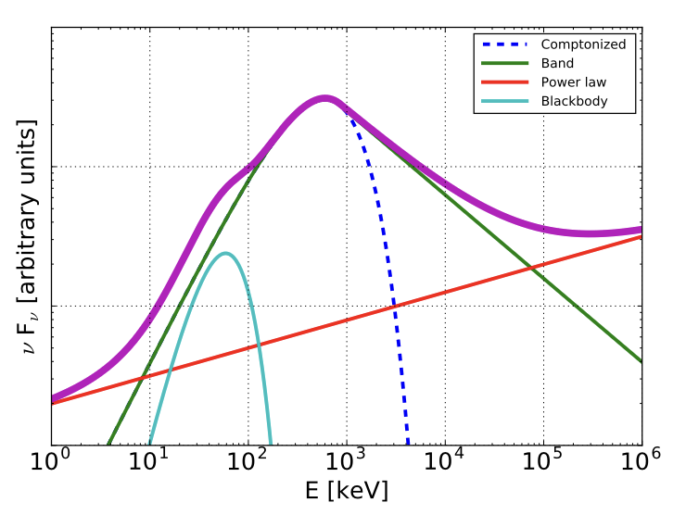
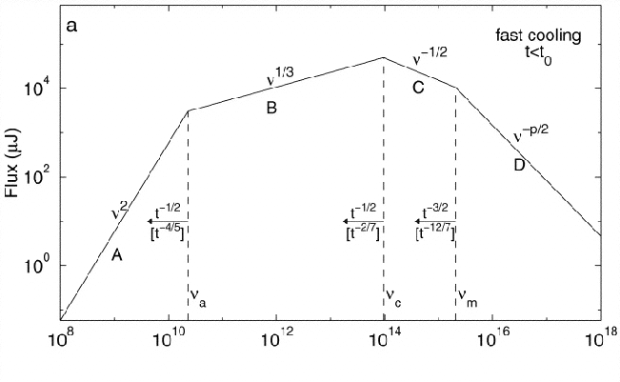
GRB Spectra
Prompt Empirical Spectra
Afterglow Synchrotron Spectra
Sari 1998
Smoothly connected power laws
Slower variation than light curves
Sometimes additional components (black body, extra power law)
Synchrotron doesn’t usually fit
Broadband afterglows follow synchrotron evolution
Light curve behavior depend on relative position on spectrum

Slide 5
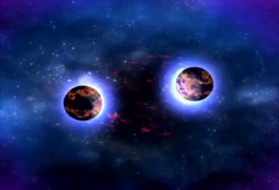
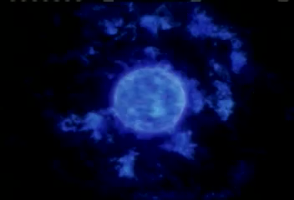
GRB Formation
Newly-formed
short-lived magnetar?
Binary Neutron Star Merger
Internal Shocks?
External Shocks
Massive Star Collapse

Slide 6
Prompt Emission Models
Internal Shocks
Unsteady outflow, high bulk Lorentz factor, requires magnetic field, synchrotron emission
Pro: explains variability and nonthermal spectrum
Con: low efficiency, spectra aren’t consistent with observations, predicts E_{peak} clustering that isn’t seen
Photospheric Emission
Gamma-rays from optical depth 𝝉≈1
Pro: explains E_{peak} clustering
Con: observed spectrum too broad, must have dissipation below photosphere
Magnetically Dominated or Poynting Flux Dominated
Powered by magnetic reconnection or current-driven instabilities
Pro: avoids baryon loading choked jets, explains ultra-relativistic speeds, collimation, non-thermal spectra
Con: lower efficiency than observed, predicts strong polarization, slow variability

Slide 7
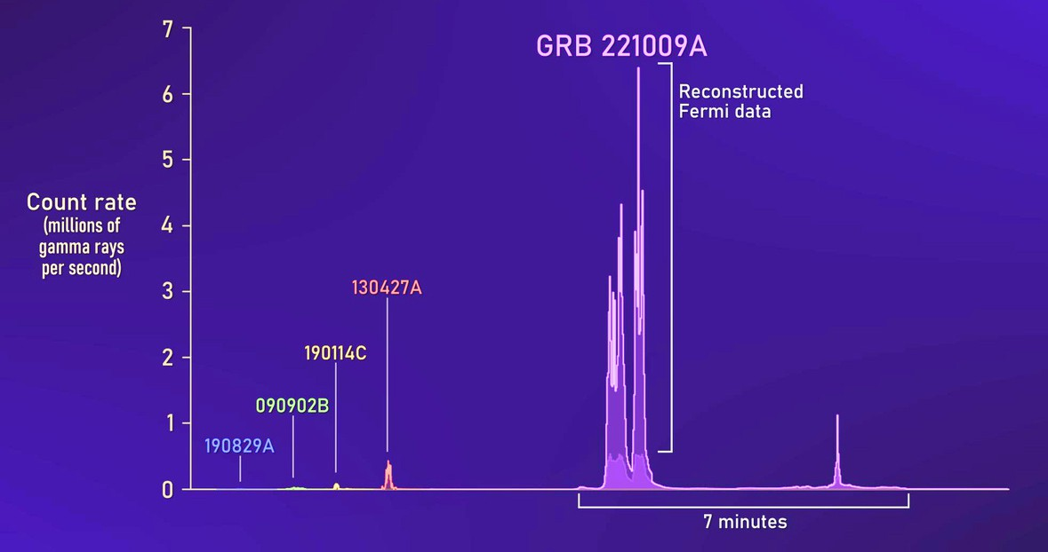
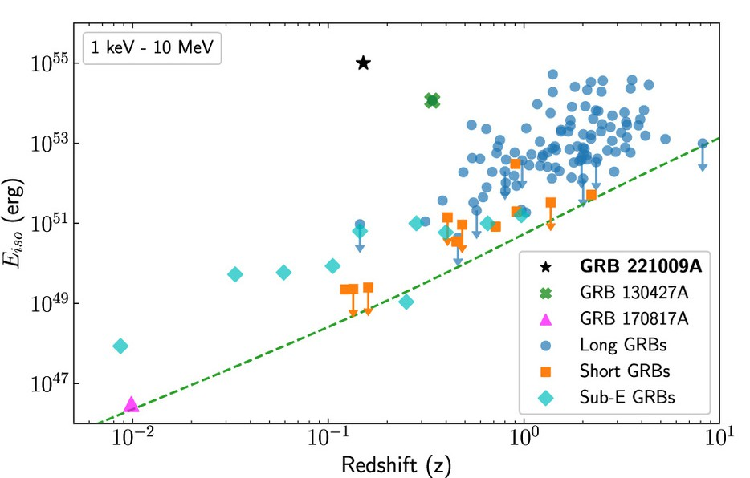
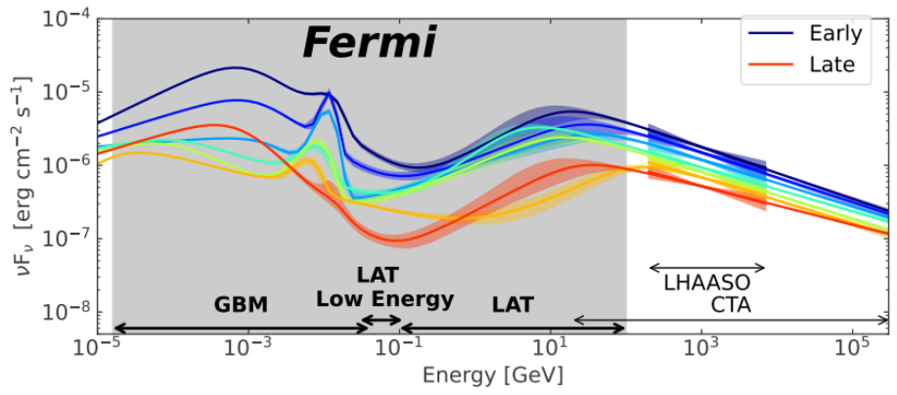
GRB 221009A: “The BOAT”
Brightest GRB to trigger Fermi-GBM and other instruments
Ionized upper layers of Earth’s day-side atmosphere (Hayes and Gallagher 2023)
Blue-shifted 511 keV line?
LHAASO detection of photons up to ~7 TeV (LHAASO Collab et al. 2023)
Requires SSC component in prompt emission at high energies
Axelsson et al. 2025
Lesage et al. 2023

Slide 8
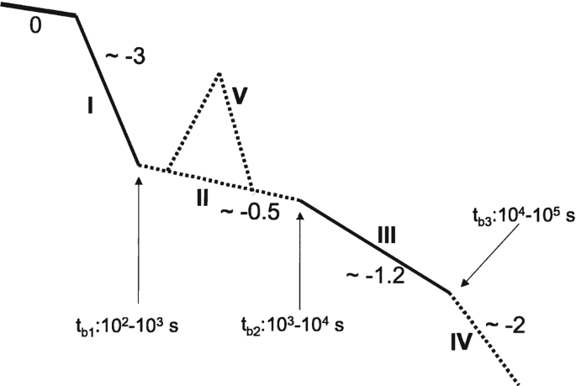
What can we learn from GRB Afterglows?
How the prompt emission imparts kinetic energy into the afterglow and the central engine continues activity
  X-ray flares, high-latitude emission, plateaus
Circumstellar environment getting swept up by the jet
Structure, size, and geometry of the jet
  jet breaks infer physical collimation angle - requires late-time (days-weeks) observations
  slopes and smoothness of light curve breaks depends on structure (power law, gaussian, etc.)
  viewing angle within a structured jet affects evolution

Slide 9
How do we make progress on emission mechanisms?
Need broadband radio→VHE gamma-ray observations in prompt & afterglow
  wide FoV or broadband co-observing
  rapid reporting, localizations, and follow-up observations
  polarization observations
  coordination
Exciting prospects now or on near-future horizon
  radio – SKAO & precusors
  optical/NIR surveys – ZTF, Rubin/LSST, Roman, etc.
  UV – UltraSAT, UVEX
  X-ray – Einstein Probe, MAXI
  Low/medium energy gamma-rays – Fermi-GBM, SVOM, COSI, Starburst
  High-energy gamma-ray – Fermi-LAT
  VHE gamma-ray – LHAASO, CTAO, SWGO

Slide 10
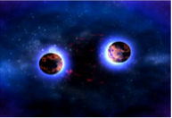
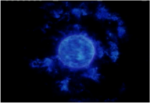
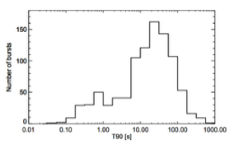
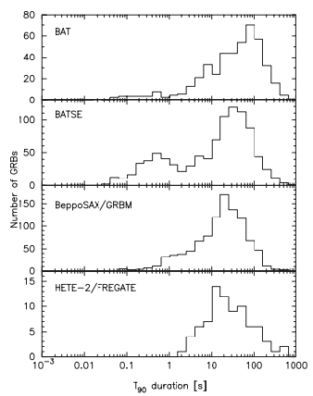
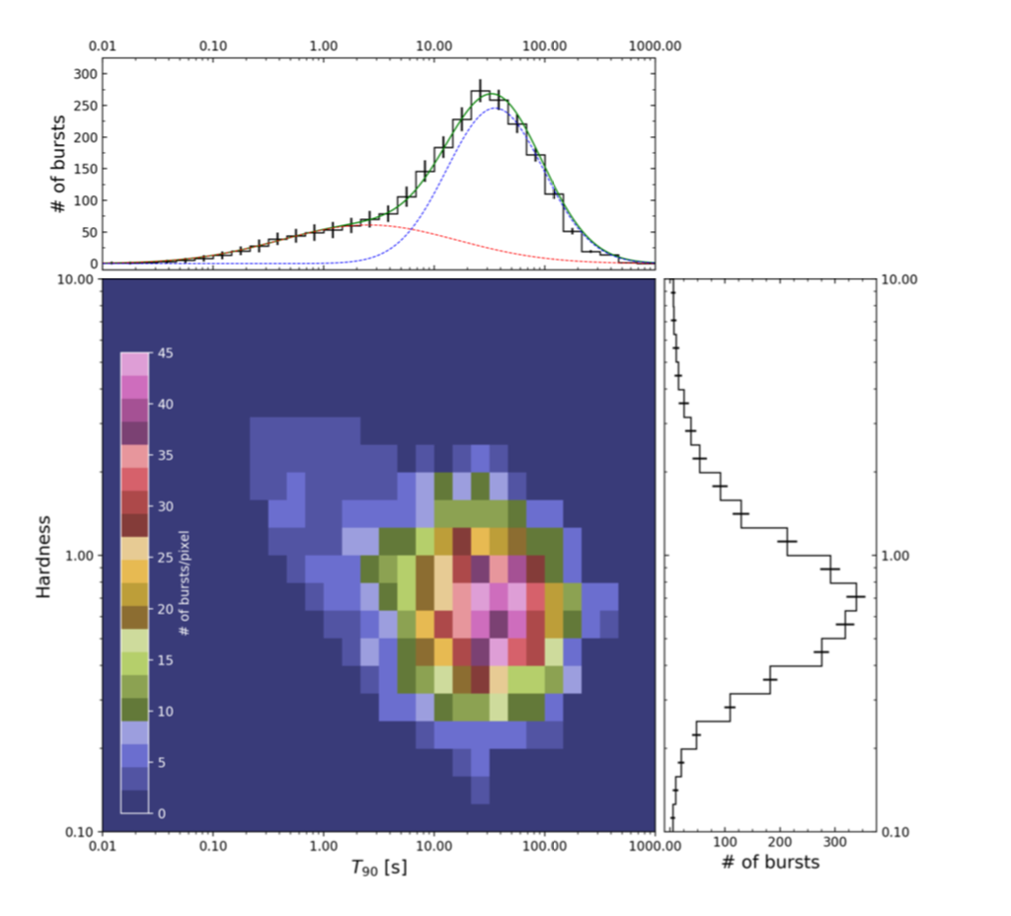
GRB Categories = Progenitors?
Long Soft GRBs
Short Hard GRBs
Harder Spectra
T₉₀ < 2 s
Associated with old stellar populations on outskirts of old galaxies
Consistent with
picture of Binary
Neutron star
merger or Neutron
star – black hole
merger
Softer Spectra
T90 > 2 s
Associated with young stellar populations in star forming regions
Consistent with picture of massive star collapsing into blackhole
Associated supernovae
Short/Hard
von Kienlin et al. 2020
Long/Soft
Sakamoto et al. 2011
von Kienlin et al. 2014

Slide 11
Progenitor Systems
Neutron Star Merger
Short Duration GRB
(Prompt gamma-rays
t < 2 seconds)
Massive Stars Collapse
Long Duration GRB
(Prompt gamma-rays
t > 2 seconds)
Gravitational Waves
Kilonova
Afterglow
Credit: NASA
https://svs.gsfc.nasa.gov/12740
Credit: ASTRON/ Benito Marcote (JIVE)
https://www.astron.nl/news-and-events/news/astronomers-observe-smoking-gun-orphan-gamma-ray-burst-afterglow

Slide 12
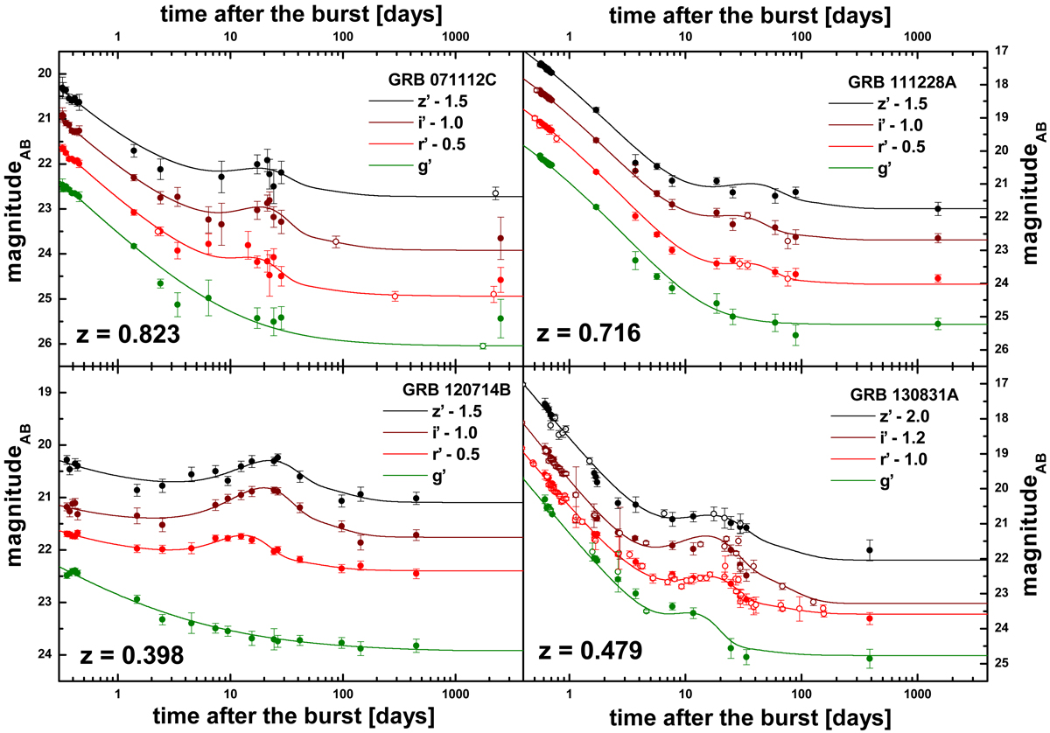
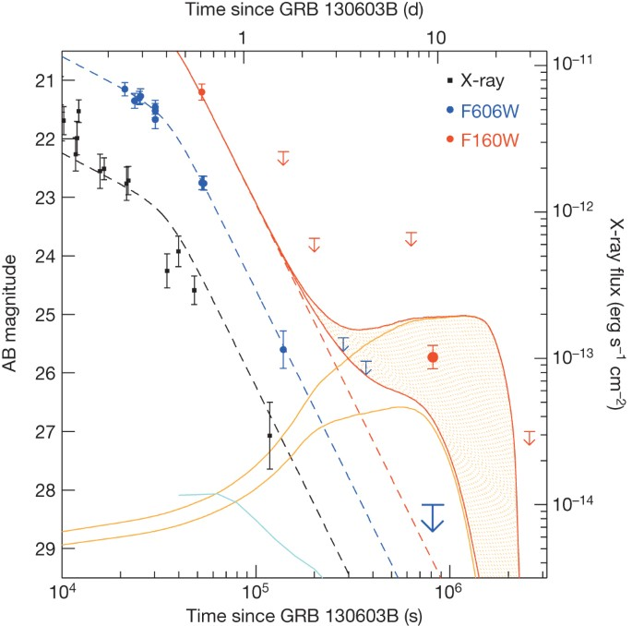
Supernova/Kilonova Bumps/Spectra Confidently Identify Progenitor Type
late-time bump in optional/IR afterglow light curves consistent with broadline SN Ic -> Collapsar
late-time bump in optional/IR afterglow light curves consistent with KNe -> BNS merger
Klose et al. 2019
Tanvir et al. 2013

Slide 13
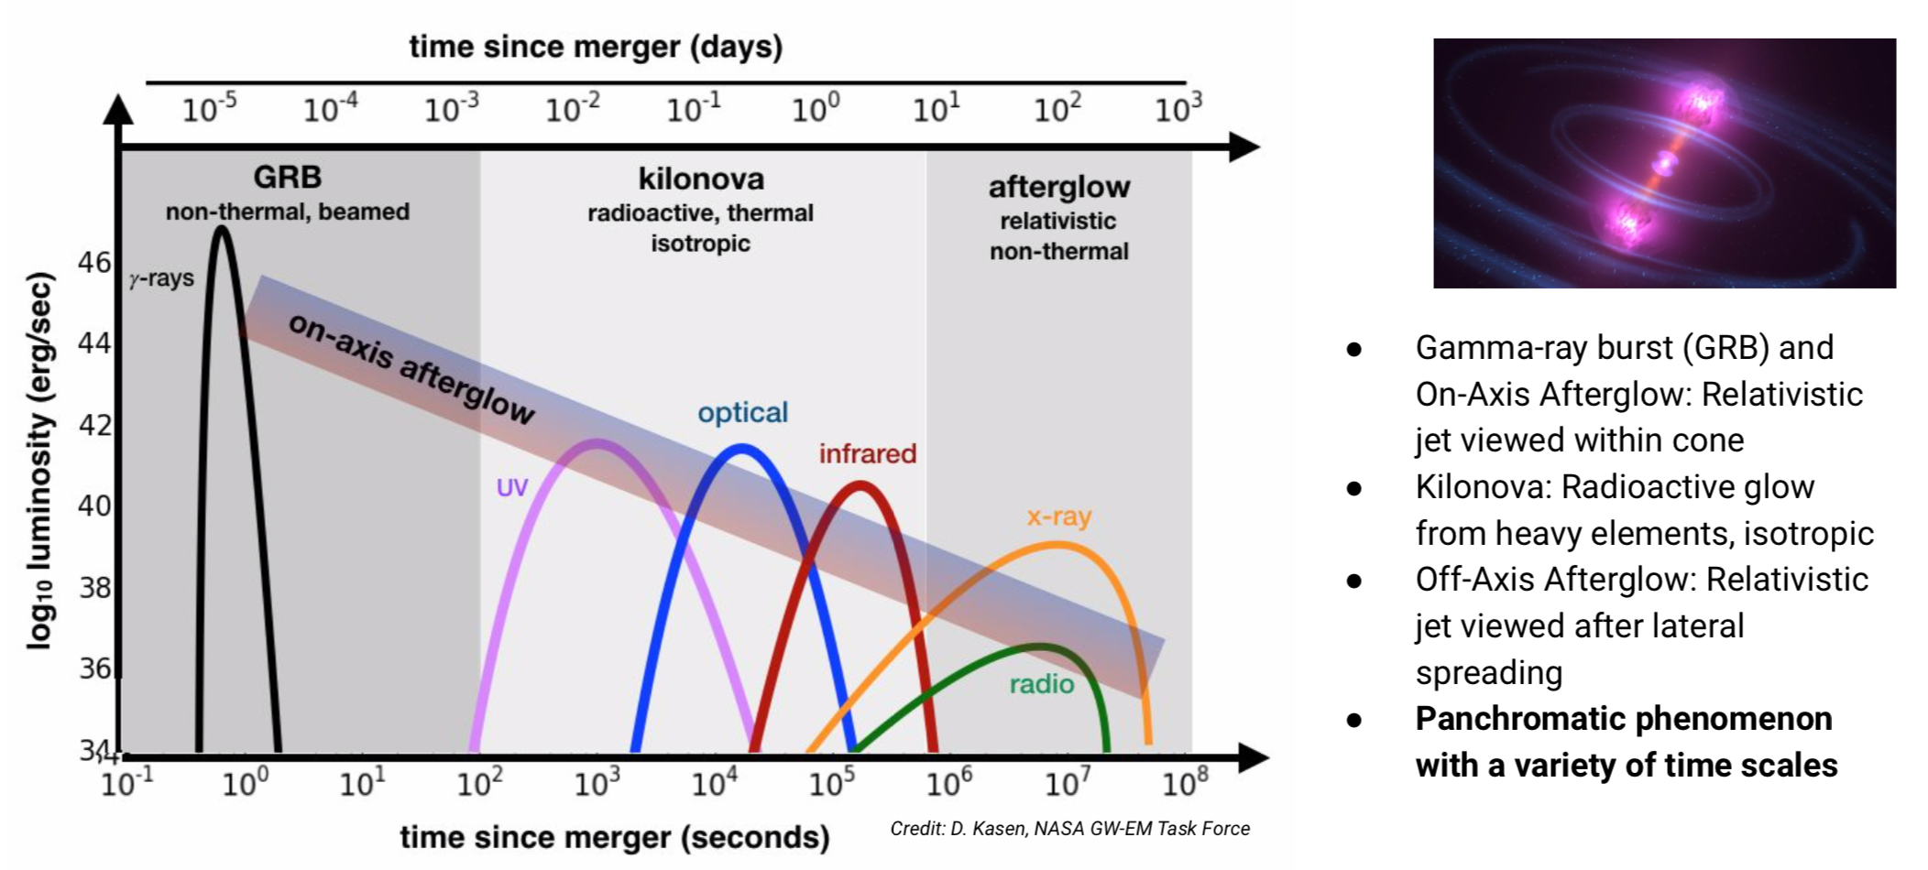
Neutron Star Merger Counterparts
Borrowed from NASA GW-EM Task Force Report - https://pcos.gsfc.nasa.gov/gw-em-taskforce/gw-em-taskforce.php

Slide 14
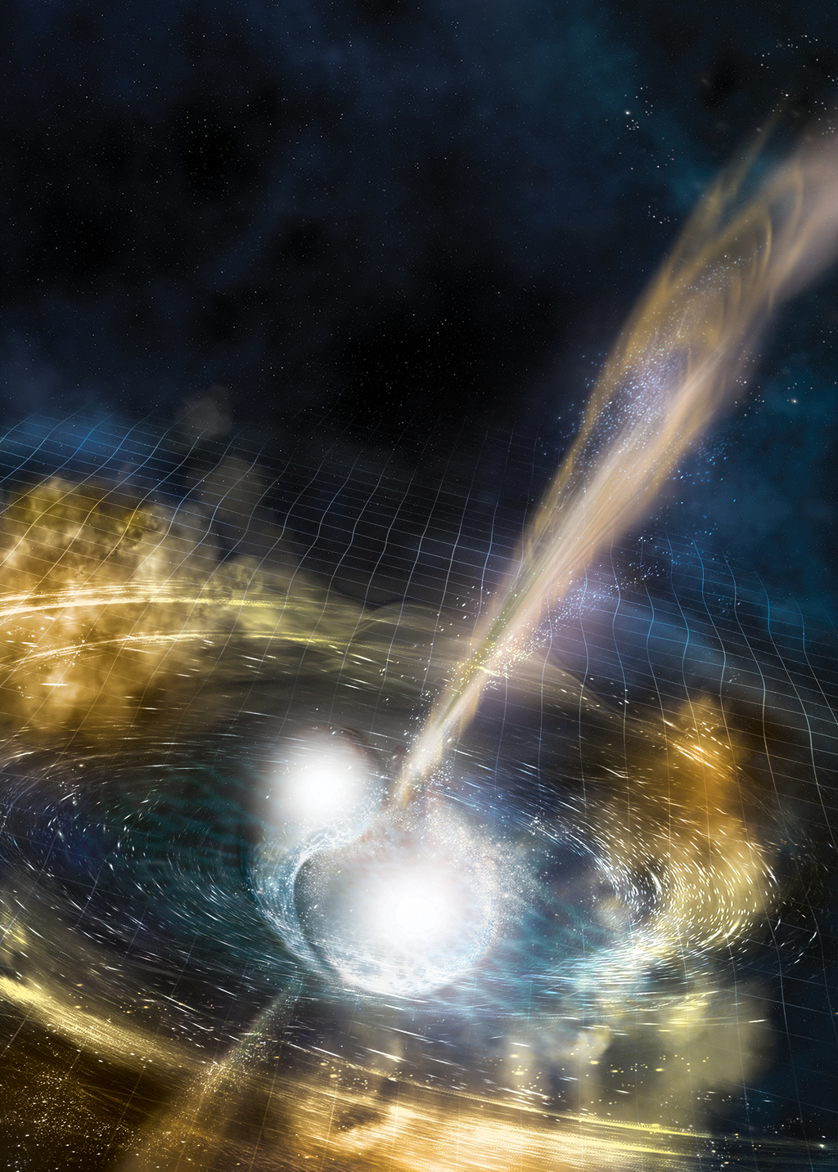
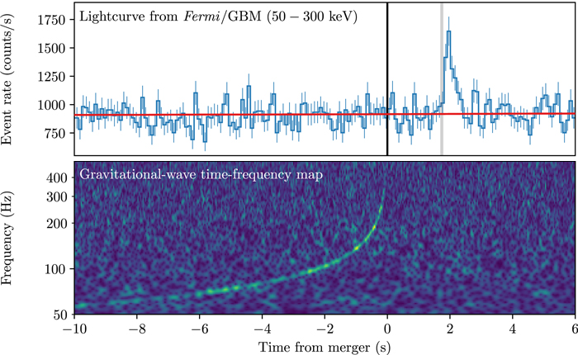
Gravitational Waves and Light:
GRB 170817A/GW 170817
This event revealed:
Some sGRBs are from BNS
R-process nucleosynthesis
Jet Structure
Speed of gravity
Neutron star merger and black hole formation
Hubble constant
Abbott et al. 2017, ApJL, 848, 2

Slide 15
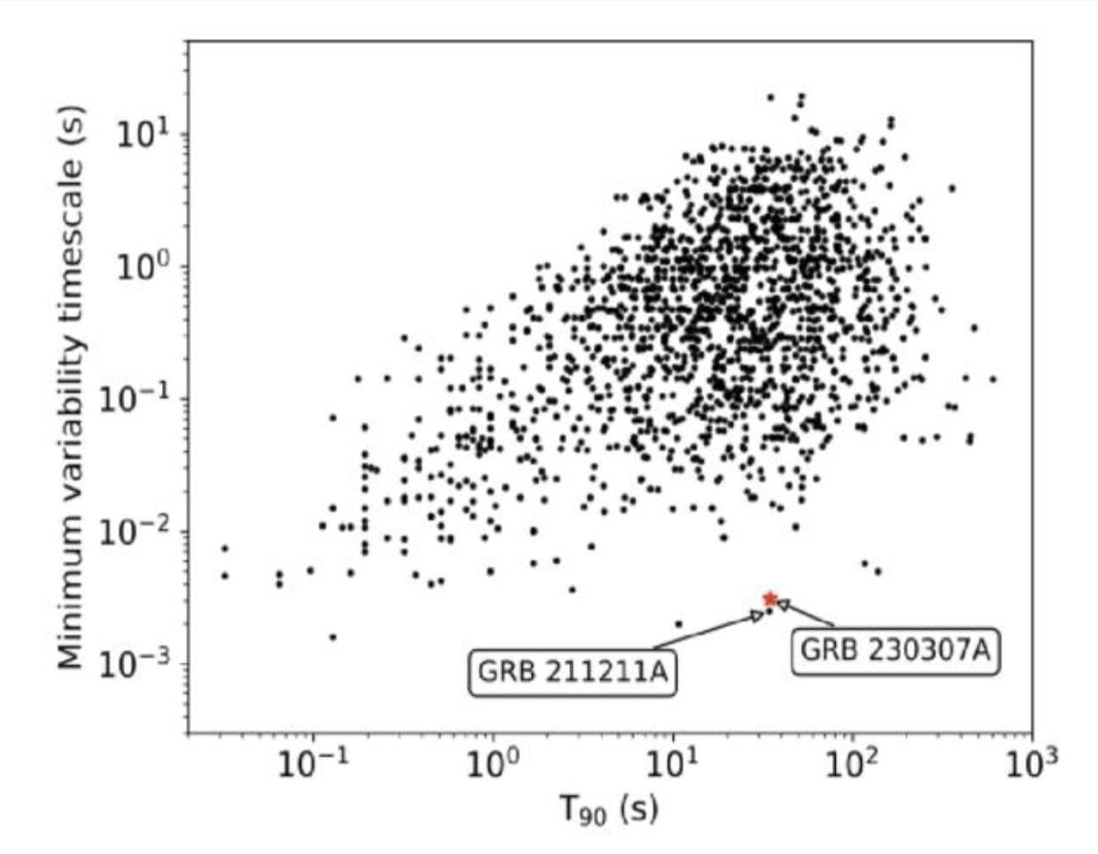
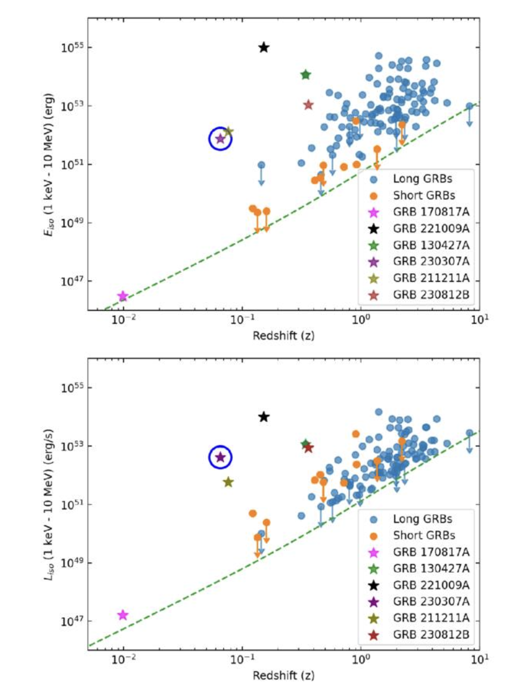
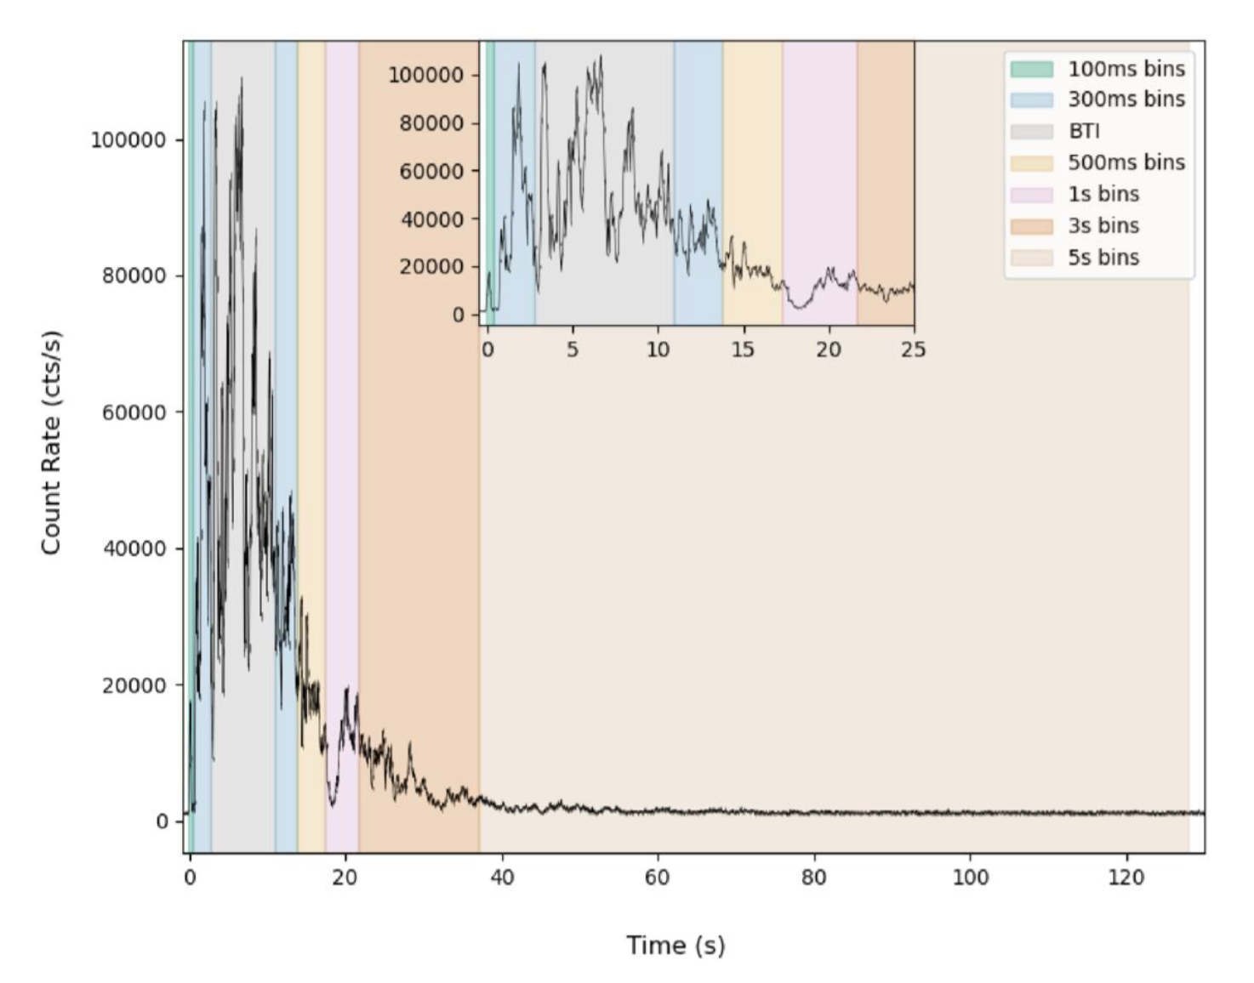
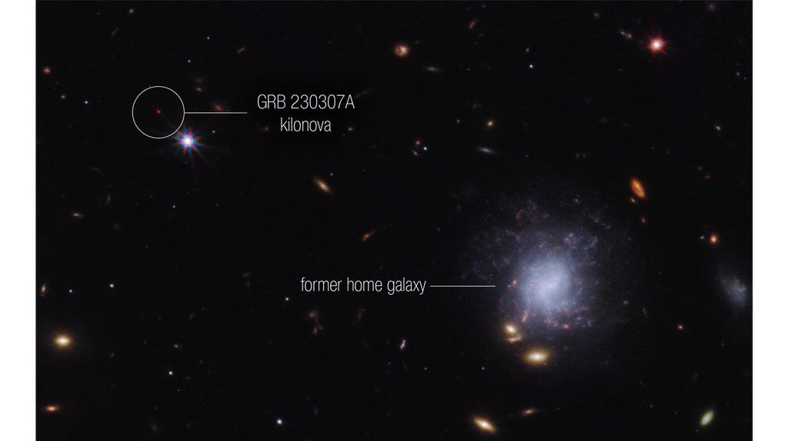
GRB 230307A: Long GRB with a confirmed kilonova
MVT = 3.1 ± 0.7 ms
T90 ~ 35 s
Long by duration
Dalessi et al. 2025
Tellurium feature
R-process heavy element production
JWST IR counterpart at 29 & 61 days
kilonova (Levan et al. 2023)

Slide 16
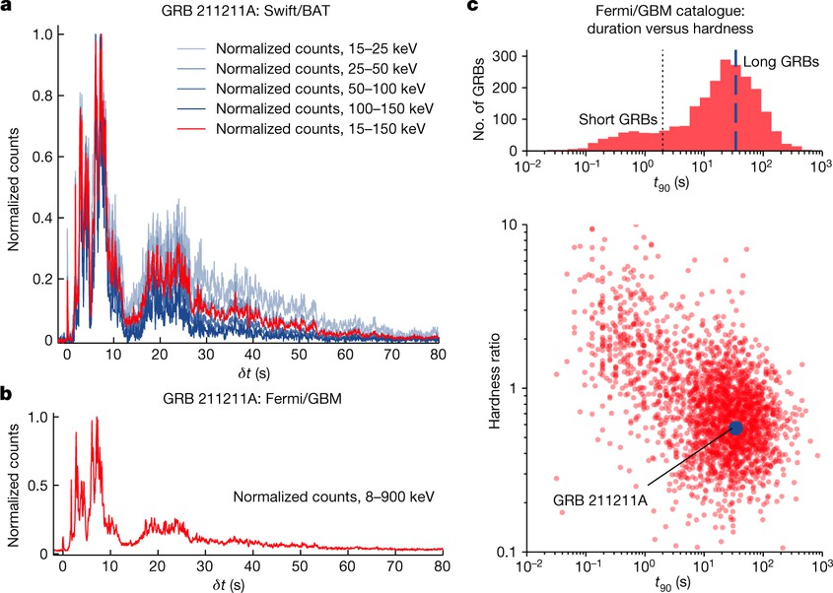
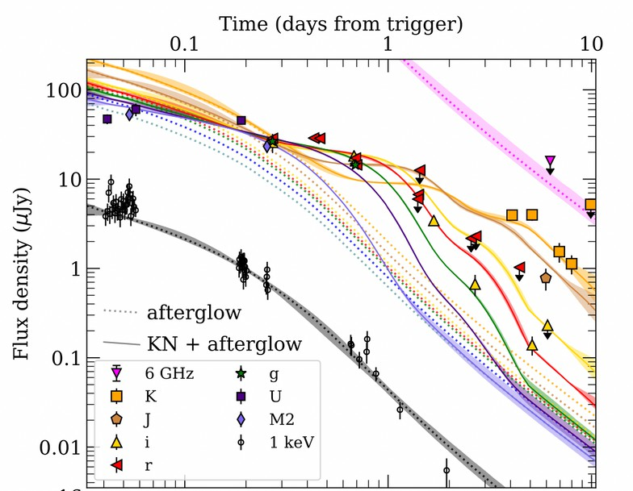
GRB 211211A: Another long GRB with potential kilonova
Rastinejad et al. 2022
T90 ~ 50 s with similar morphology to short GRBs w/ extended emission
Afterglow more consistent with kilonova than afterglow-only model
At distance of ~350 Mpc, a supernova would likely have been detected
Possible magnetar central engine

Slide 17
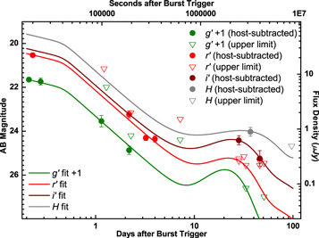
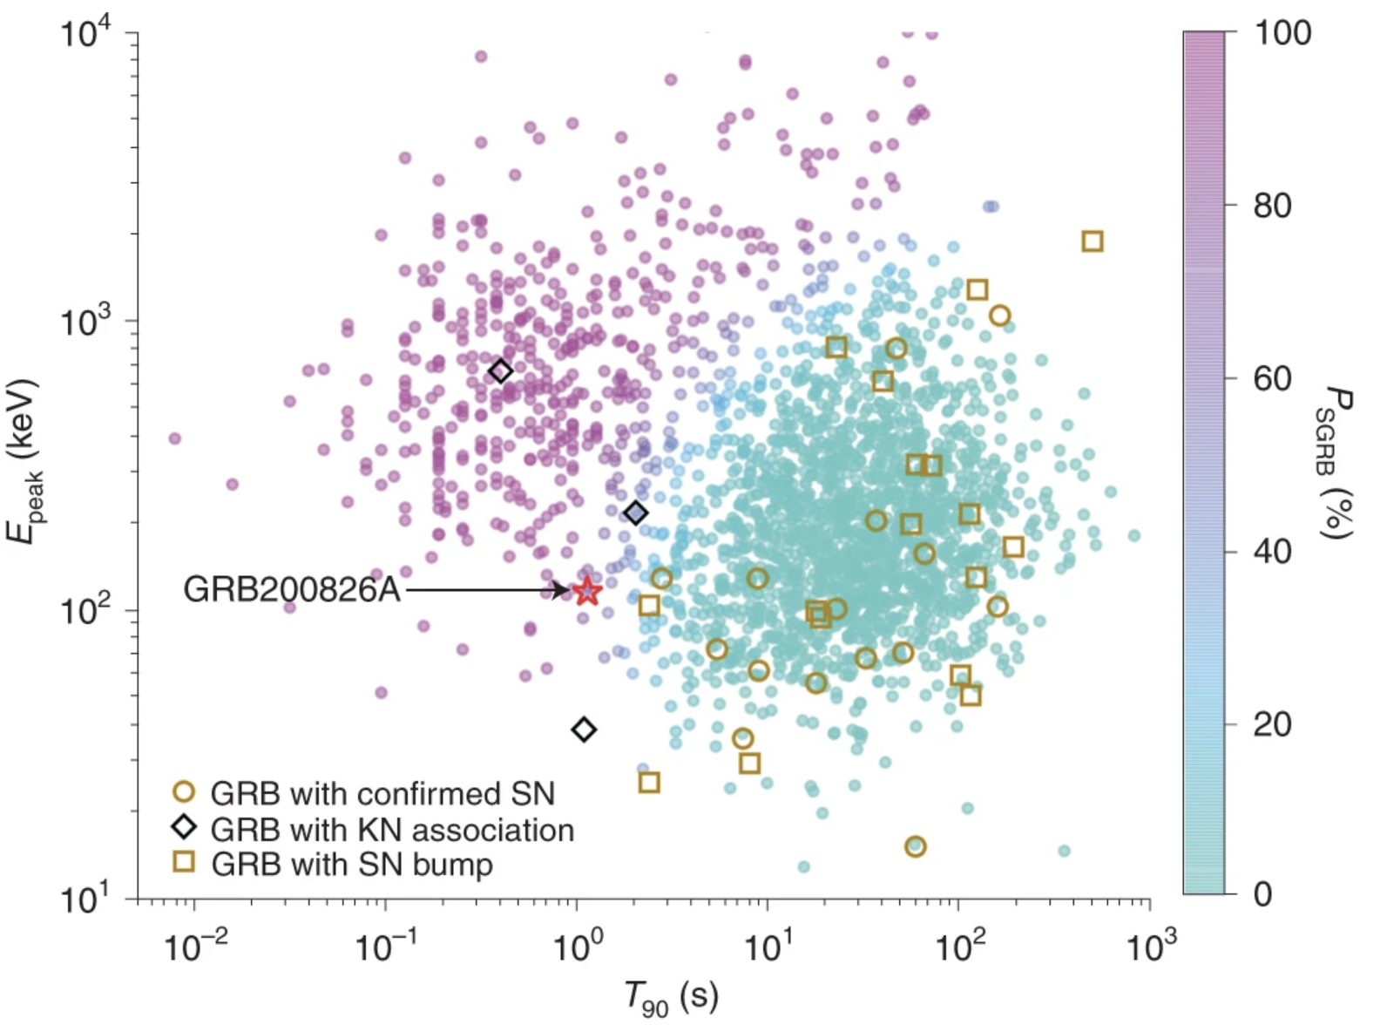
GRB 200826A: short burst with a supernova
Rossi et al. 2021
Ahumada et al. 2021
T90 =1.14 s (0.065 s in rest frame, z = 0.7481)
Energetics more consistent with long GRBs
Supernova modeling above underlying afterglow preferred over kilonova
Weak collapsar jet?

Slide 18
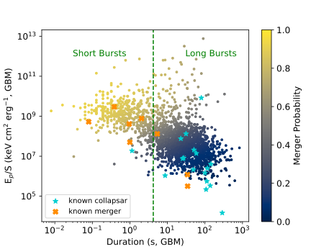
Short vs Long Merger vs Collapsar
Recent discoveries of long GRBs with associated kilonova and short GRBs with associated supernovae complicate the duration separator
Time for new terminology
Multiple prompt and afterglow correlations with physical signatures of progenitor systems
Modified from Nuessle et al. 2024

Slide 19
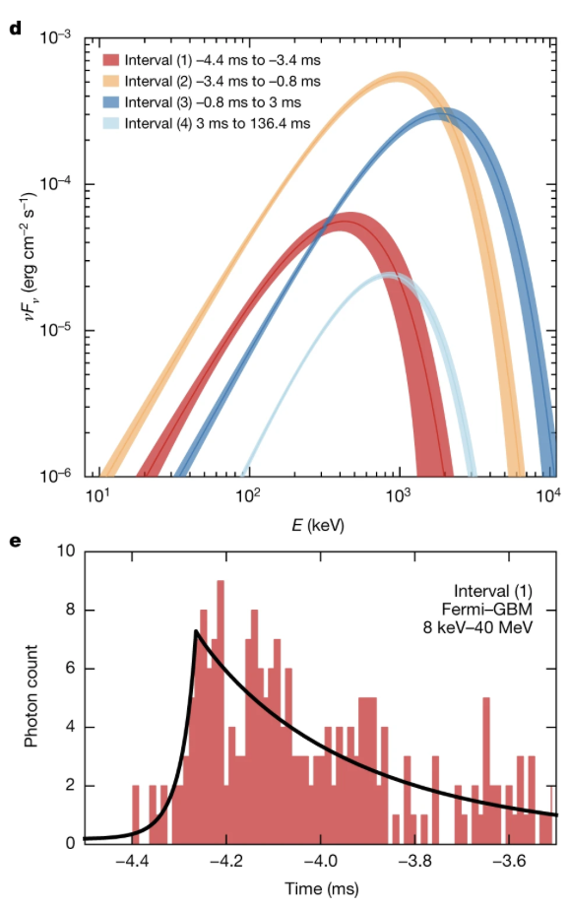
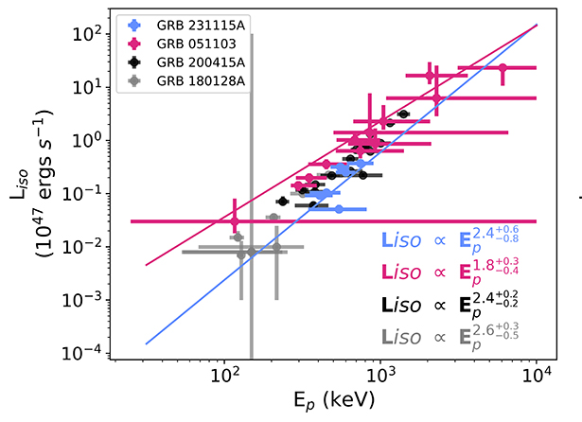
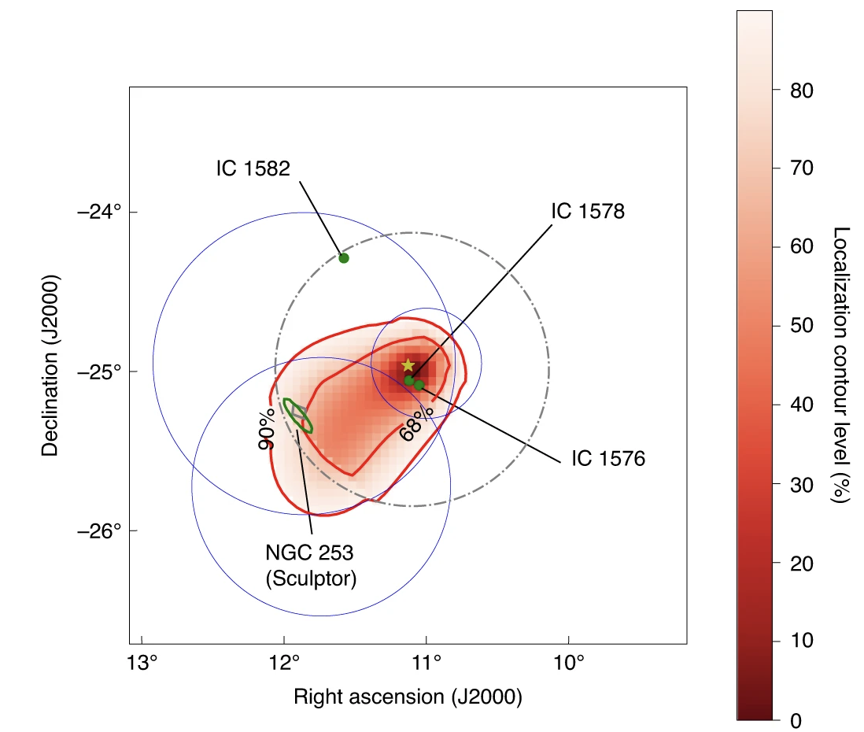
Extragalactic Magnetar Giant Flares as Another Source of Short GRBs
MGFs observed in nearby galaxies look like cosmological short GRBs in gamma rays
~2% of short GRBs observed (Burns et al. 2021)
Short hard spike followed by long (minutes) soft tail
Flux modulated by the spin period of the neutron star
Candidates often identified by proximity to nearby host galaxy
Trigg et al. 2025
Roberts et al. 2021
LAT Collab et al. 2021

Slide 20
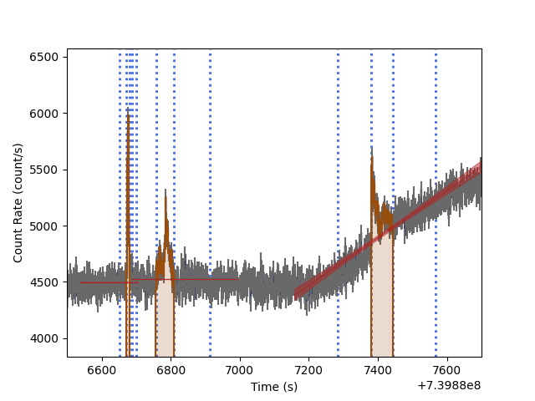
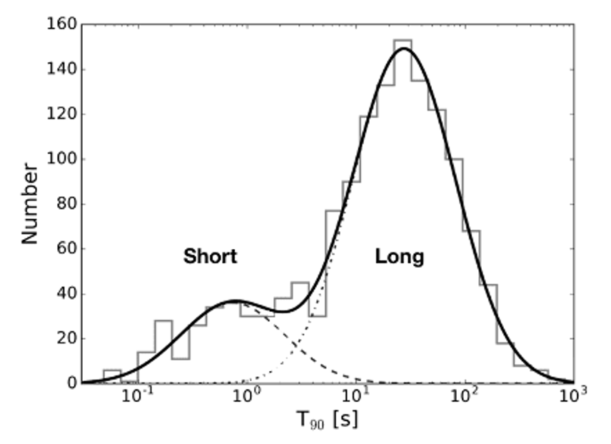
Ultra-long GRBs: tail of the duration distribution or different phenomenon?
Prompt emission persists for thousands of seconds, sometimes with multiple active episodes
They are rare, heterogeneous, and difficult to classify from duration alone
Long integration times make gamma-ray background fitting and Earth occultation crucial
Multiwavelength is often decisive: X-ray plateau, optical SN/KN constraints, host offset
Observational discriminants: host position, supernova evidence, late X-ray behavior, spectral evolution, energetics, and rest-frame duration.
ULGRB Models
Blue-supergiant collapsar
Tidal-disruption-like event
Magnetar engine
Refreshed shocks / fallback

Slide 21
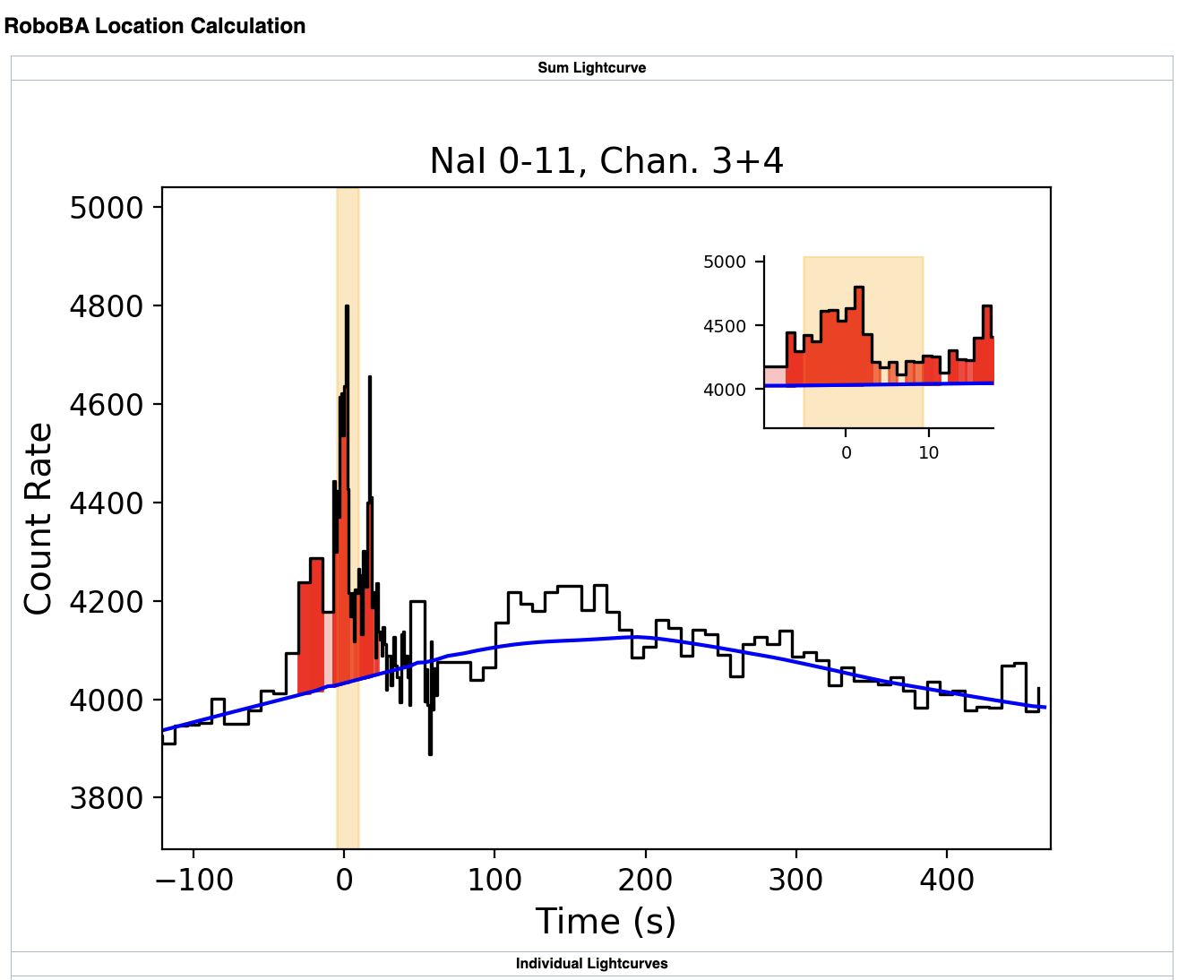
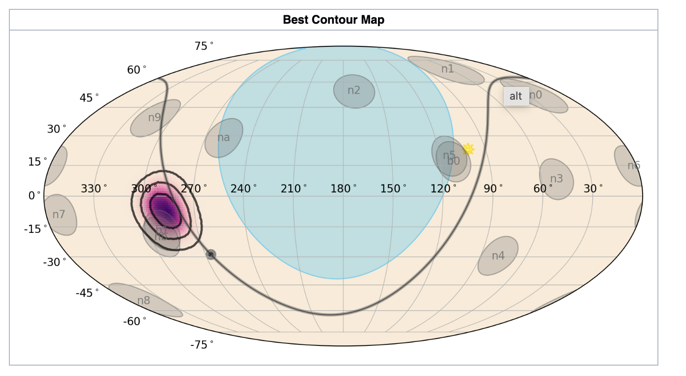
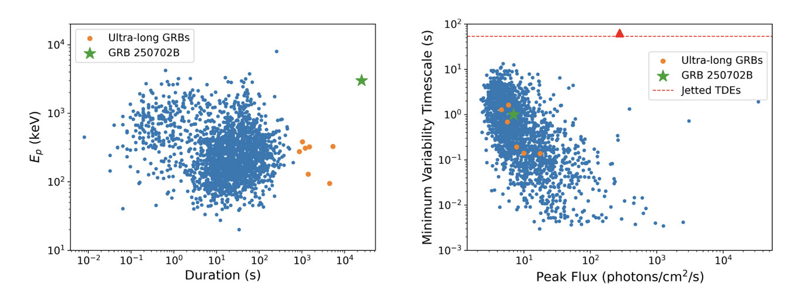
GRB 250702B (D, E): Longest GRB ever identified
Observed gamma-ray duration ≈ 25,000 s; rest-frame duration ≈ 12,500 s → ultra long
Hard spectrum, sub-second rest-frame variability (MVT ~1s, 0.5s rest frame), high total energy
star-forming host at z=1.036
Difficult to explain with ordinary collapsars, compact mergers, or supermassive black-hole TDEs
MVT
Redshift
Model
UL duration
high E_{p}
normal flux and MVT
→compact relativistic engine
≈1 s observed
≈0.5 s rest-frame
z = 1.036
star-forming host
black hole falls
into stripped star
Neights et al. 2026, MNRAS

Slide 22
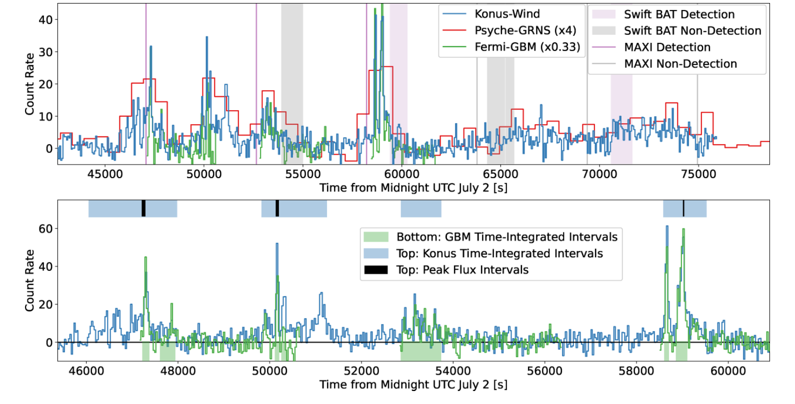
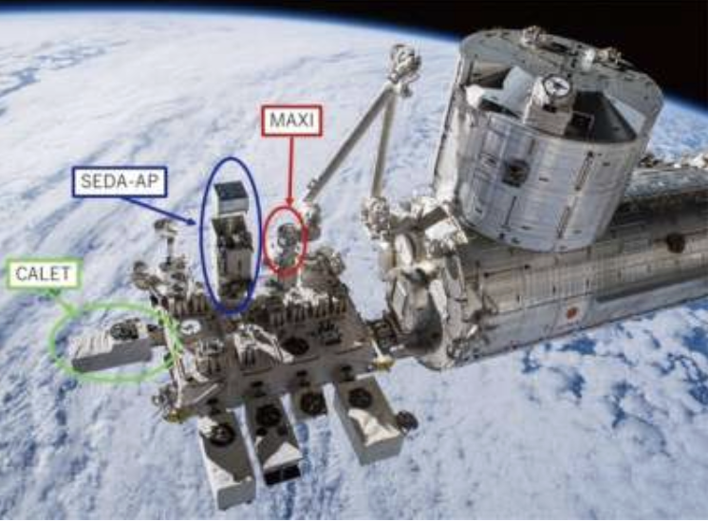
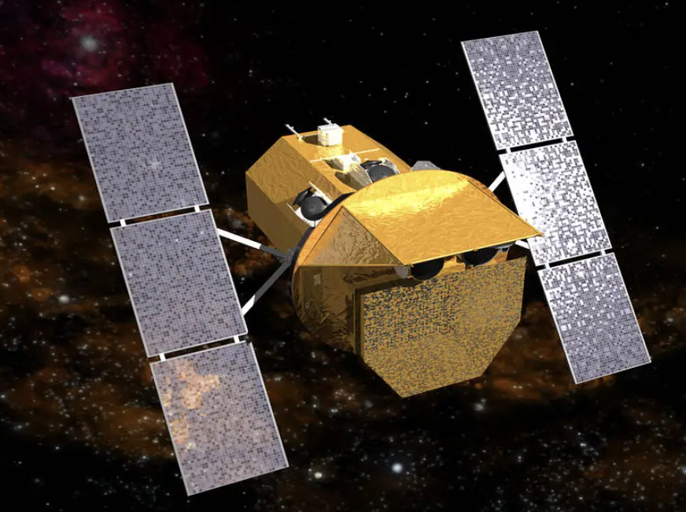
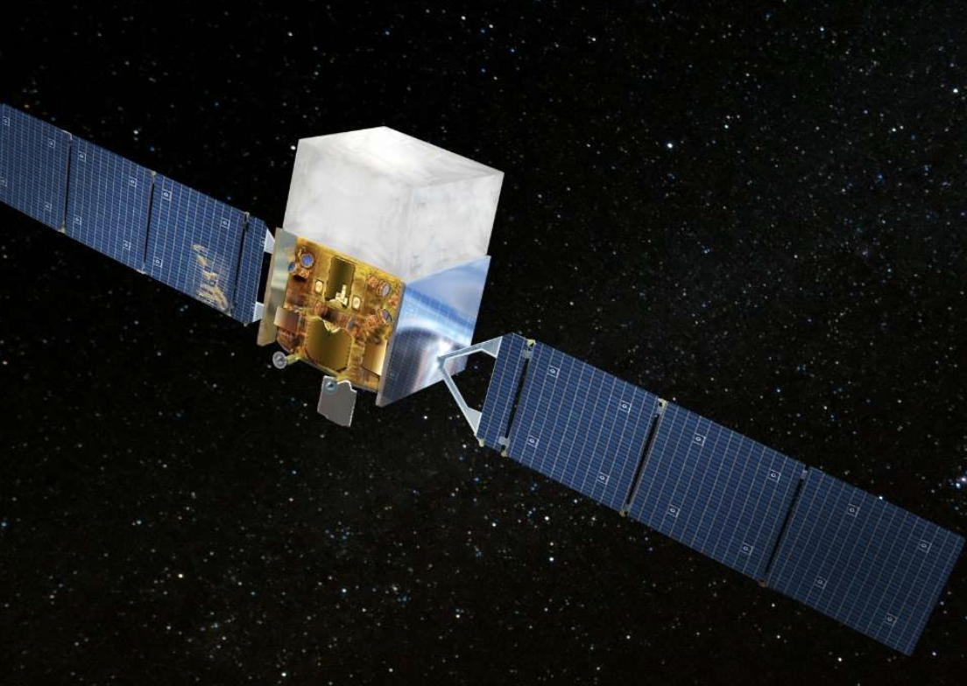
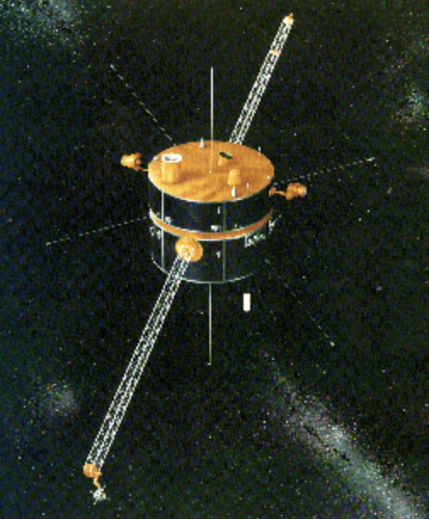
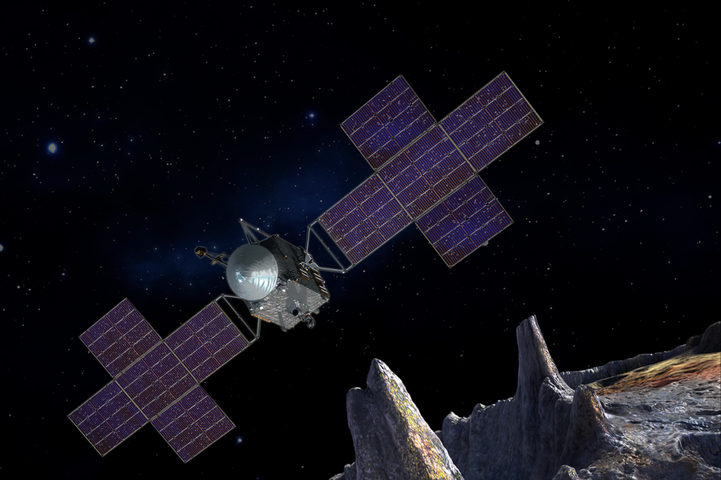
Multi-instrument coverage was essential
Multiple emission episodes separated by quiescent intervals over many hours.
Repeated triggers provide high time and spectral information during bright episodes.
MAXI
Konus-Wind and Psyche-GRNS have stable, distant coverage; Swift-BAT/MAXI help confirm timing.
Swift
Fermi
Konus-Wind: Transient monitor in a Lissajous orbit around the first Lagrange point of the Sun–Earth system at a distance of ∼5 light seconds.
Psyche: Contains a Germanium detector built to determine the composition of the asteroid 16 Psyche.
Neights et al. 2026, MNRAS

Slide 23
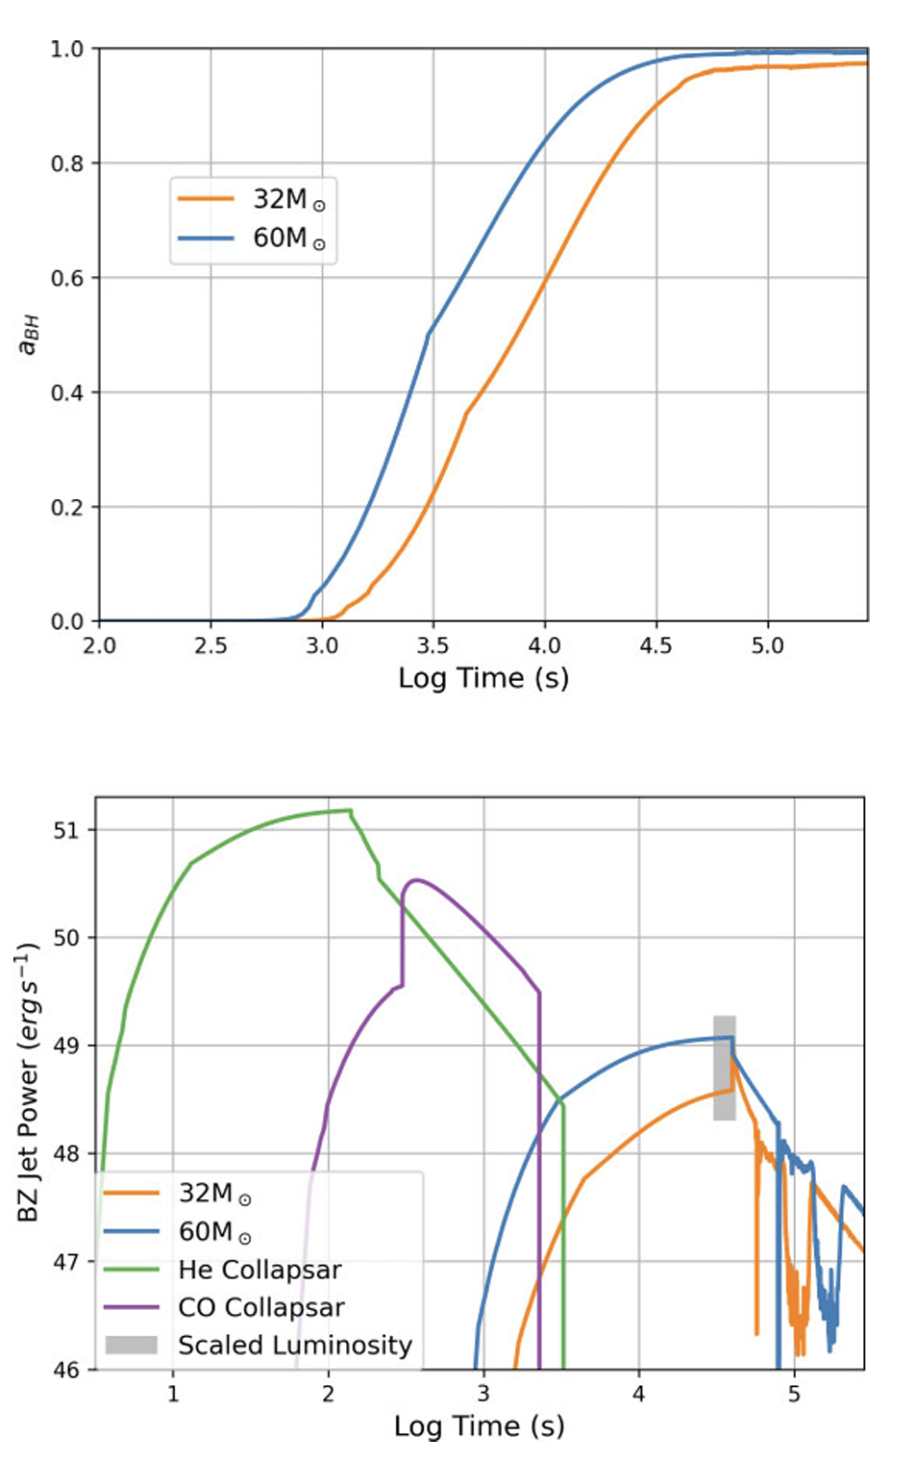
Preferred Picture: A Helium Star Merger
A compact remnant spirals into a stripped helium star during common-envelope evolution
Orbital angular momentum is transferred to the stellar core
A high-angular-momentum disk forms around the black hole and can sustain jet power for many hours
The model naturally links some ULGRBs to collapsars, stripped-envelope supernovae, and stellar-mass gravitational-wave progenitor pathways
Prediction
Follow-up
ULGRBs should trace star-forming regions but may occur in environments less restricted than classical collapsars.
Supernova signatures can be weak or diverse; host offset and deep NIR limits are crucial.
This event shows how all-sky keV-MeV monitoring plus rapid follow-up can reveal new progenitors.
Neights et al. 2026, MNRAS

Slide 24
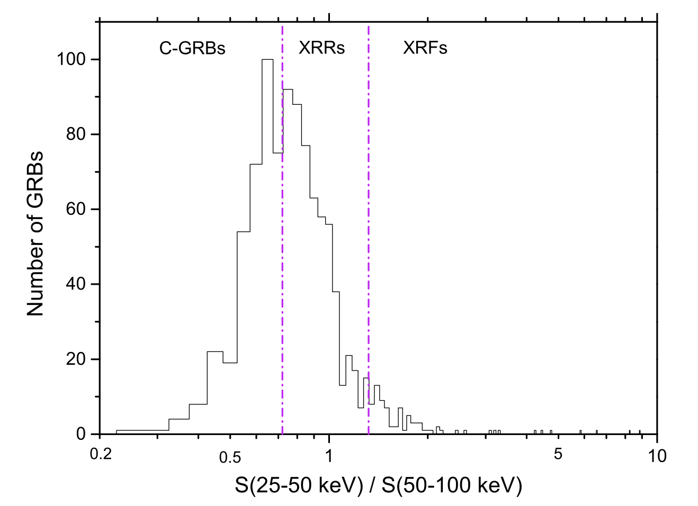
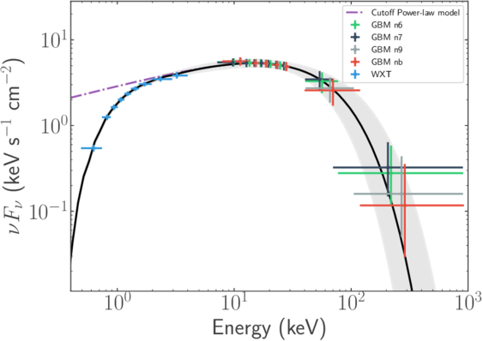
X-ray Flashes, X-ray Rich GRBs, Fast X-ray Transients with SNe
Bi et al. 2018
GRBs that peak at lower energies and are lower luminosity
More dominant prompt thermal component?
No significant differences from classical GRBs in redshift or host galaxies
Causes
  Off-axis
  High redshift
  Continua of jet power and success
Interest recently revived due to Einstein Probe detections
  e.g. EP250108a/SN 2025kg trapped jet (Rastinejad et al. 2025, Eyles-Ferris et al. 2025)
Jiang et al. 2025

Slide 25
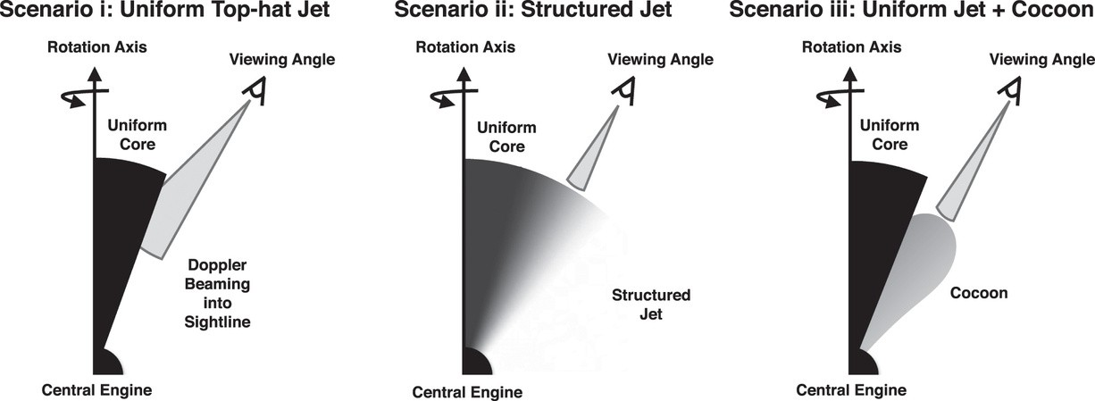
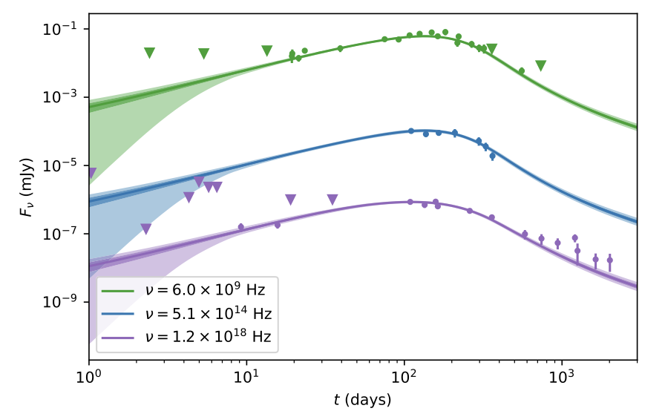
Jet Structure & Viewing Geometry
Jets have structure – top hat was always an over-simplification
Viewing angle and jet geometry depend on the structure of the jet
Does this explain the diversity of GRB observations?
Orphan afterglows + lack of GRB could help with statistical sample
Need more GRBs with well-sampled afterglows
Need late-time radio/X-ray/optical, GW
Abbott et al. 2018
GRB 170817A
Radio
Optical
X-ray
Ryan et al. 2024

Slide 26
How do we answer these open questions in GRBs?
Observations | Prompt Emission Mechanisms | Progenitors | Jet Structure & Geometry
SNe/KNe detections |  | X | X
BNS Mergers with GW+EM |  | X | X
Broad gamma-ray spectra (keV-GeV) | X | X | X
VHE GRBs | X
Accurate GRB localizations (arcsec-arcmin) |  | X | X
Broadband co-detection/follow-up | X | X | X
Afterglow and host spectroscopy (e.g. redshifts, host properties, element formation) | X | X | X
Are we collecting the right observations? What are we missing and what capabilities do we currently have that we must retain?
How to we optimize our observational approaches?
How do we better coordinate?

