Slide 1
Barrier session: Telescopes and data policies
Moderators
  Brad Cenko (GSFC/NASA) & Weimin Yuan (NAO/CAS)
Panelists:
  Anna Bonaldi (SKAO)
  Thomas Wevers (Schmidt Sciences)
  Stefan Immler (NASA HQ)
  Nial Tanvir (University of Leicester)
Topics
  Telescopes
  Coordination
  Policies (access, data/information, publication)

Slide 2
1. Telescopes

Slide 3
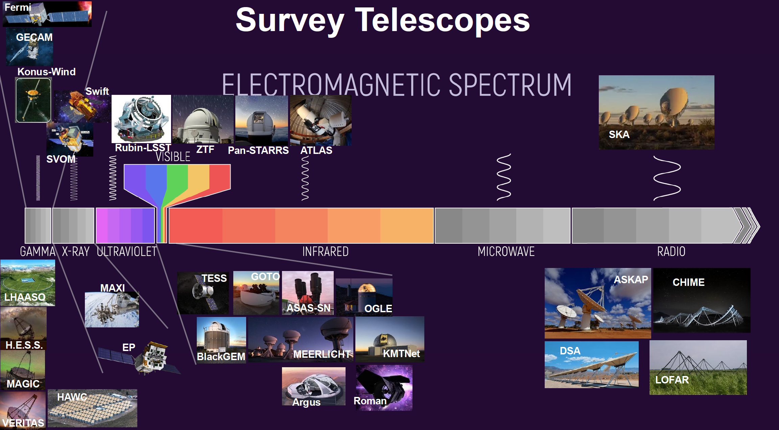

Slide 4
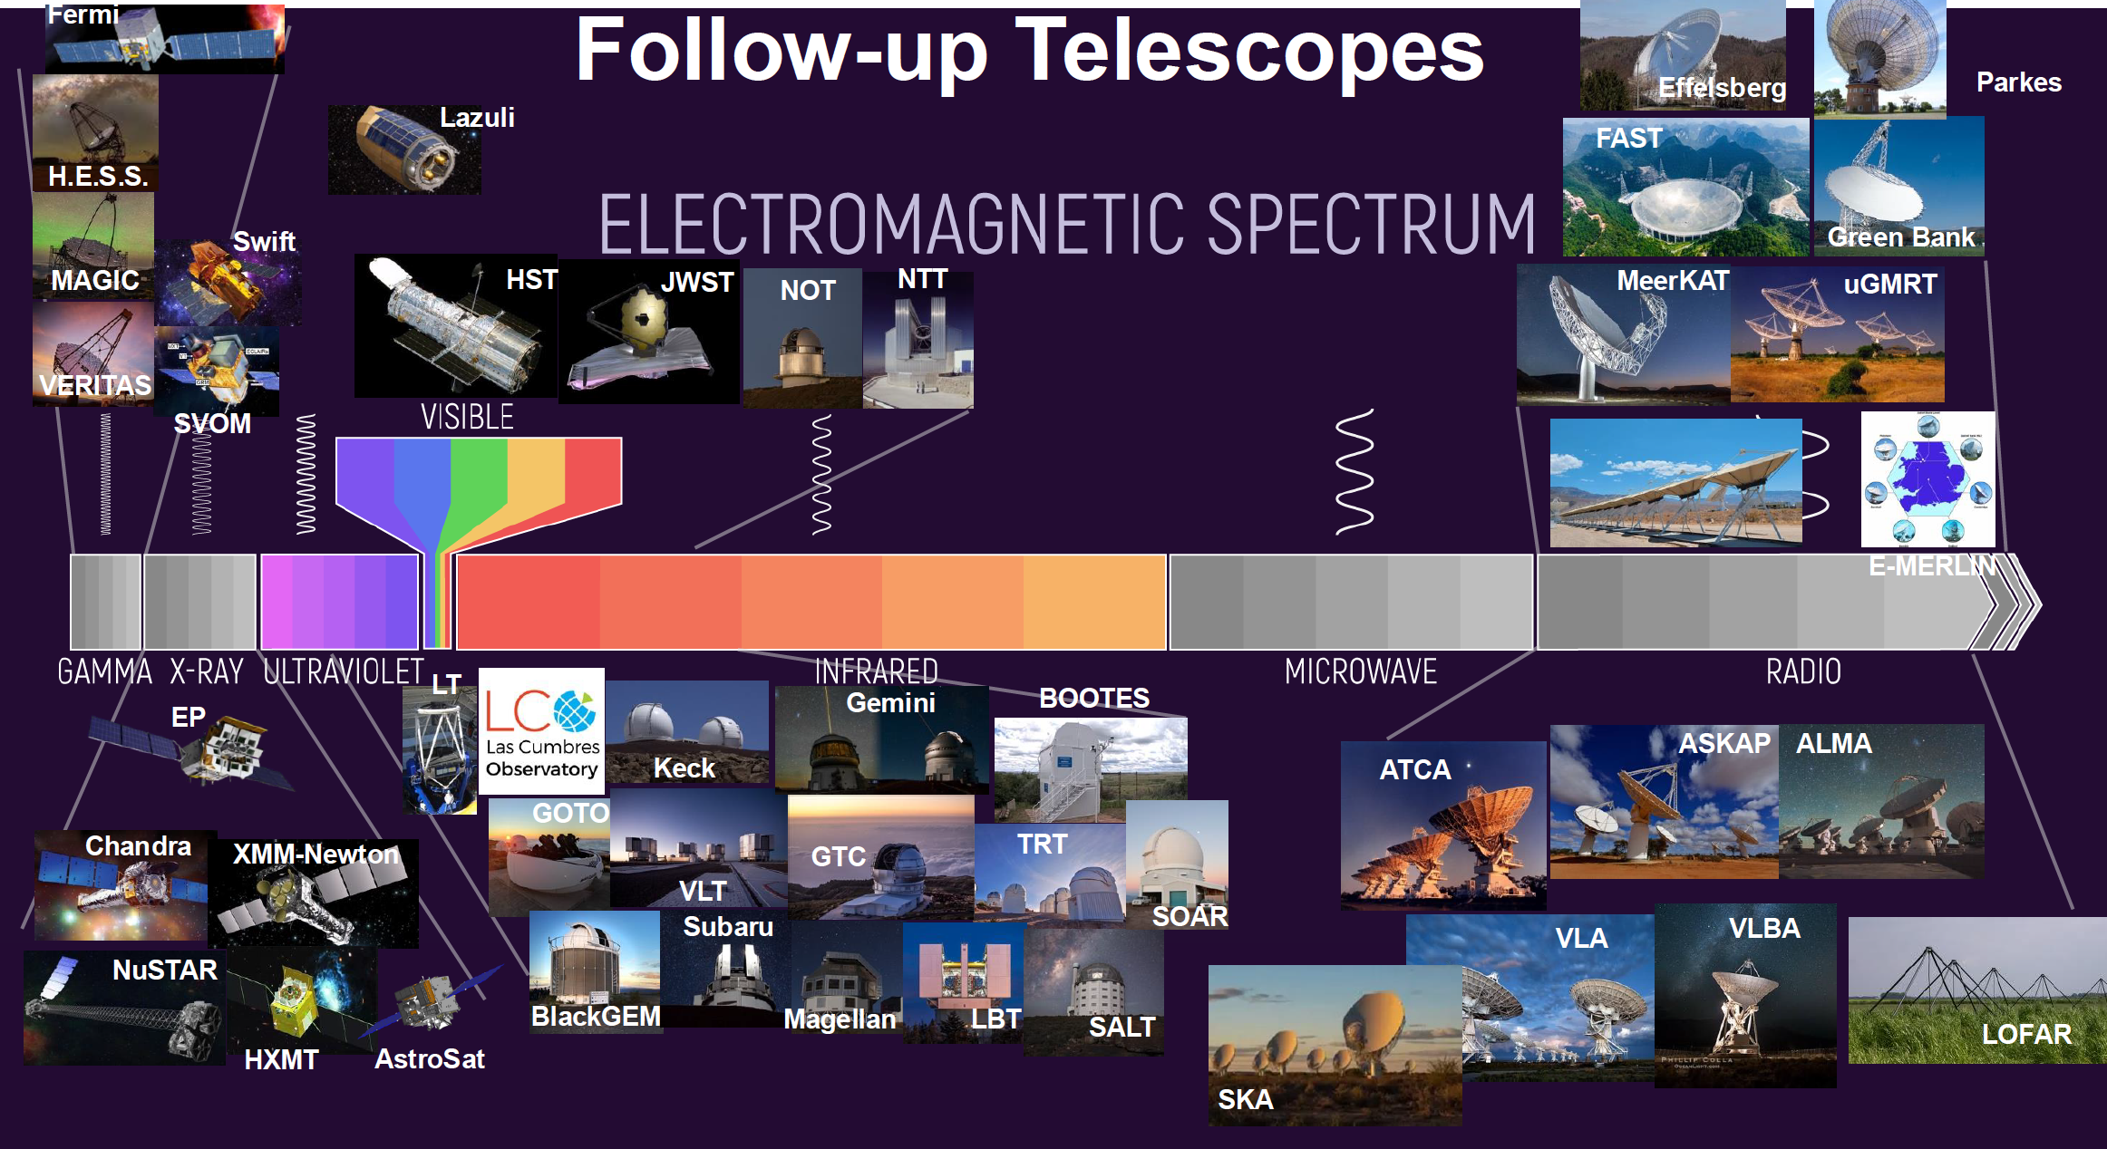

Slide 5
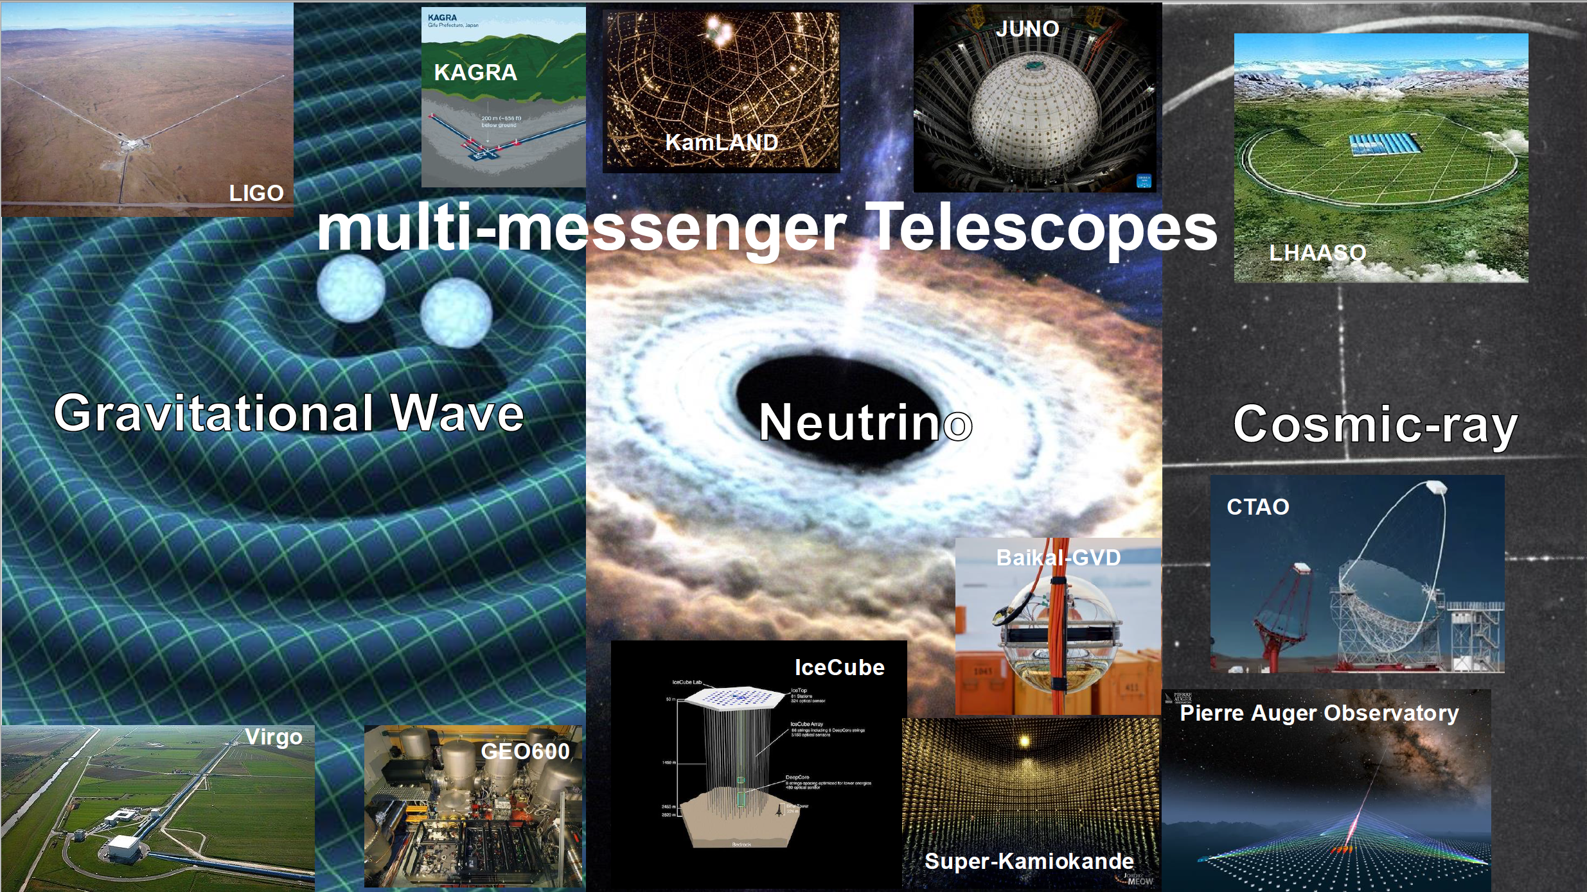

Slide 6
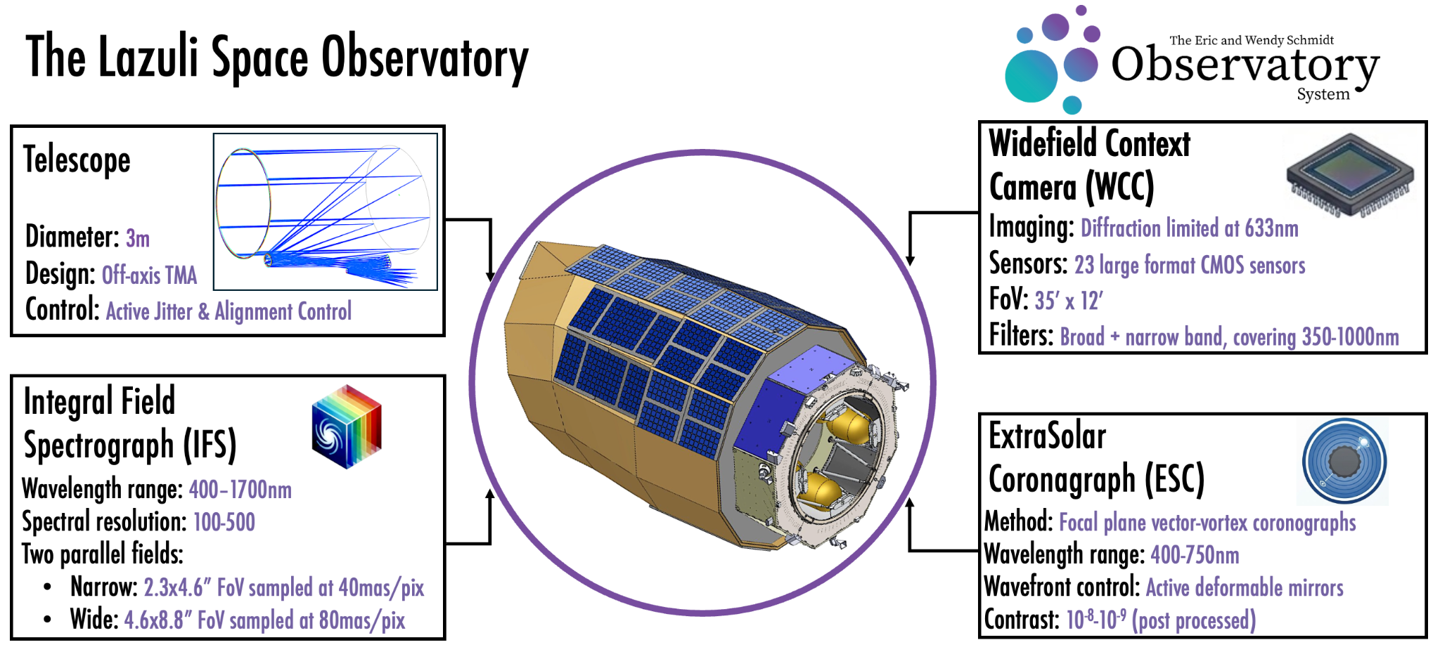
Lazuli Space Observatory Overview
Architecture at a glance
Credit: Lazuli Team
Roy et al. 2026

Slide 7
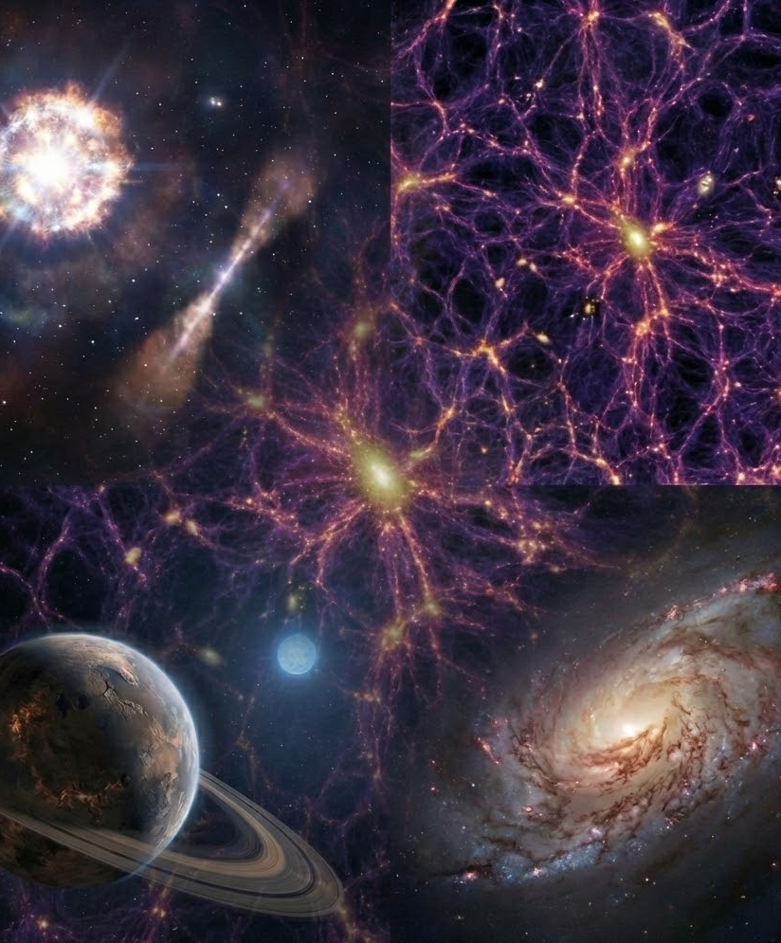
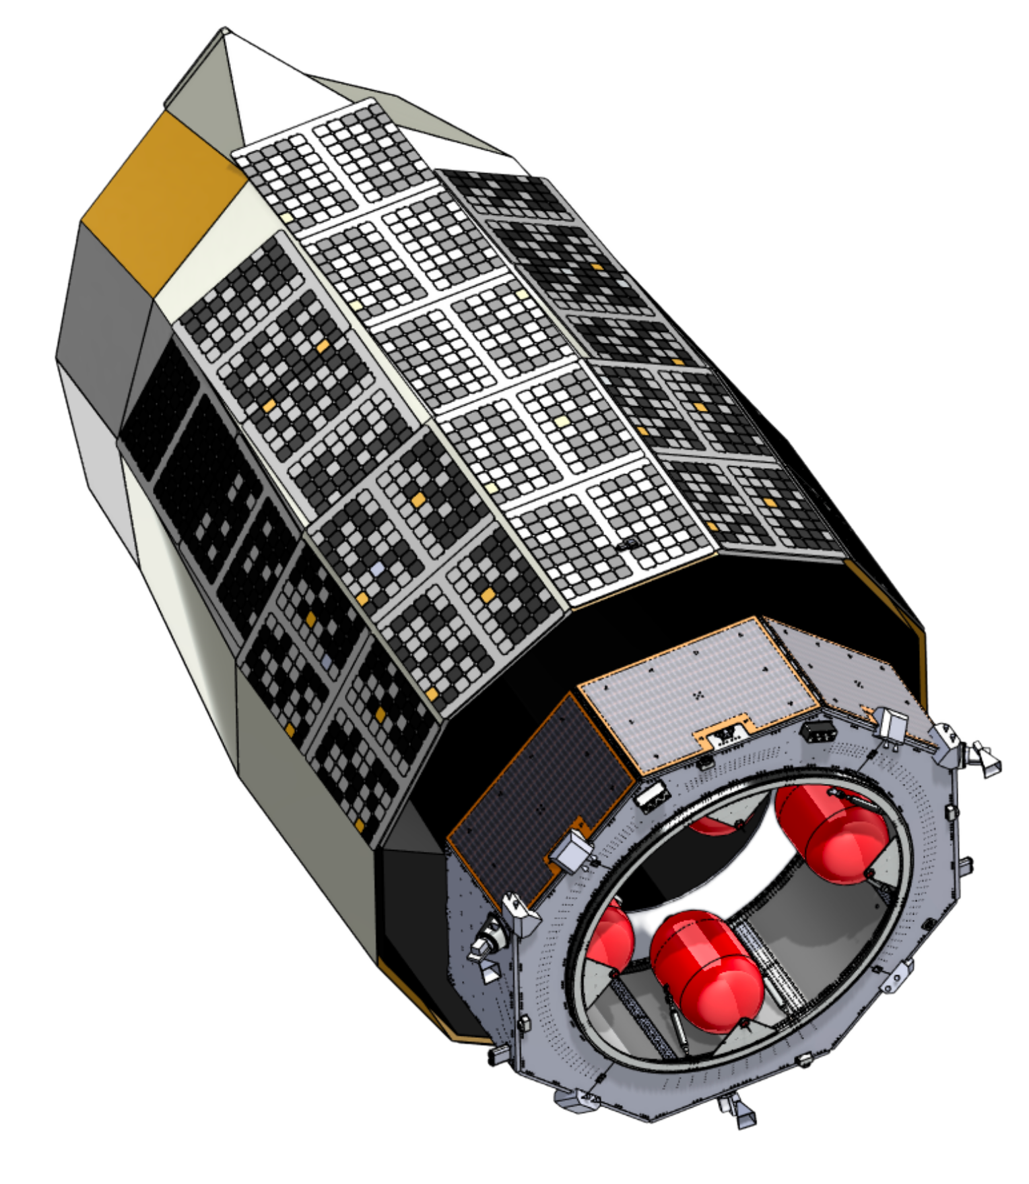
The Lazuli Space Observatory
Scientific Motivation / Observational Gaps
Rapidly responding to a transient universe
→ Discovery rates vastly exceed the availability of space-based optical–NIR characterization on hour–day timescales.
Delivering timely large-aperture optical–NIR capability
→ Lazuli provides a near-term, general-purpose optical–NIR facility aligned with Astro2020 recommendations, enabling science while key questions and synergistic missions remain active.
Exciting for TDAMM astronomy:
sensors Latency < 4hrs (goal: 90 min)
settings_input_antenna Not 1-2x / year, but 10-100x / yr!
Credit: Lazuli Team
Wevers et al. 2026

Slide 8
1. Telescopes
Clear bottleneck: insufficient (spectroscopic) follow-up telescopes
  too many imaging surveys, too little follow-up (e.g. S. Kulkarni)
  already discussed in previous sessions
Do we miss anything important (survey/follow-up) ?
  Spectral coverage
  Instantaneous FoV and cadence:
    soft X-ray not big enough, EP 4pi/11 (WY), others?
  sensitivity:
    MeV gamma-rays (BC), others?
Notes:
For both discovering and follow-up telescopes:
Are the current and soon-upcoming telescopes cover the entire EM spectrum?
Are there any waveband windows suffering from (relatively) poor sensitivity and/or small monitoring FoV or cadence (compared to most part of the EM spectra)?
Or, in which wavebands there is a strong demand to build new telescopes or space missions? MeV gamma-rays?

Slide 9
2. Coordination
1) is coordination for EM telescopes efficient and effective?
Among survey telescopes
  radio (AB)
  optical
  High-energy
    BC initiated one for some high-energy telescopes for GW MM search (BC)
    possibly among Swift-EP-SVOM for FXTs/GRBs (WY)
Between survey and follow-up telescopes
  case examples: Swift (BC), EP (WY), Fermi, optical surveys, others ?
Among follow-up telescopes
  Observing teams are generally “quite good” at sharing information, but observatories could help by making it easier to interrogate their activity. Lots of room for improvement in coordination of time allocation and scientific campaigns.

Slide 10
2. Coordination
2) do we need/how to coordinate EM-MM telescopes?
Gravitational wave - EM.
Existing coordination is reasonable in terms of real-time follow-up, although more information could improve things further. From a higher-level strategic point of view, much room for improvement: would be great if stakeholders could be brought together to develop more creative and coordinated ways of doing multi-messenger science.
Neutrino - EM
UHE gamma-ray & cosmic rays

Slide 11
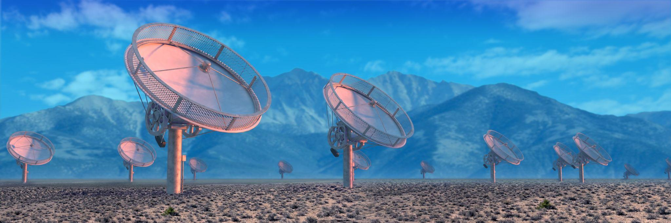
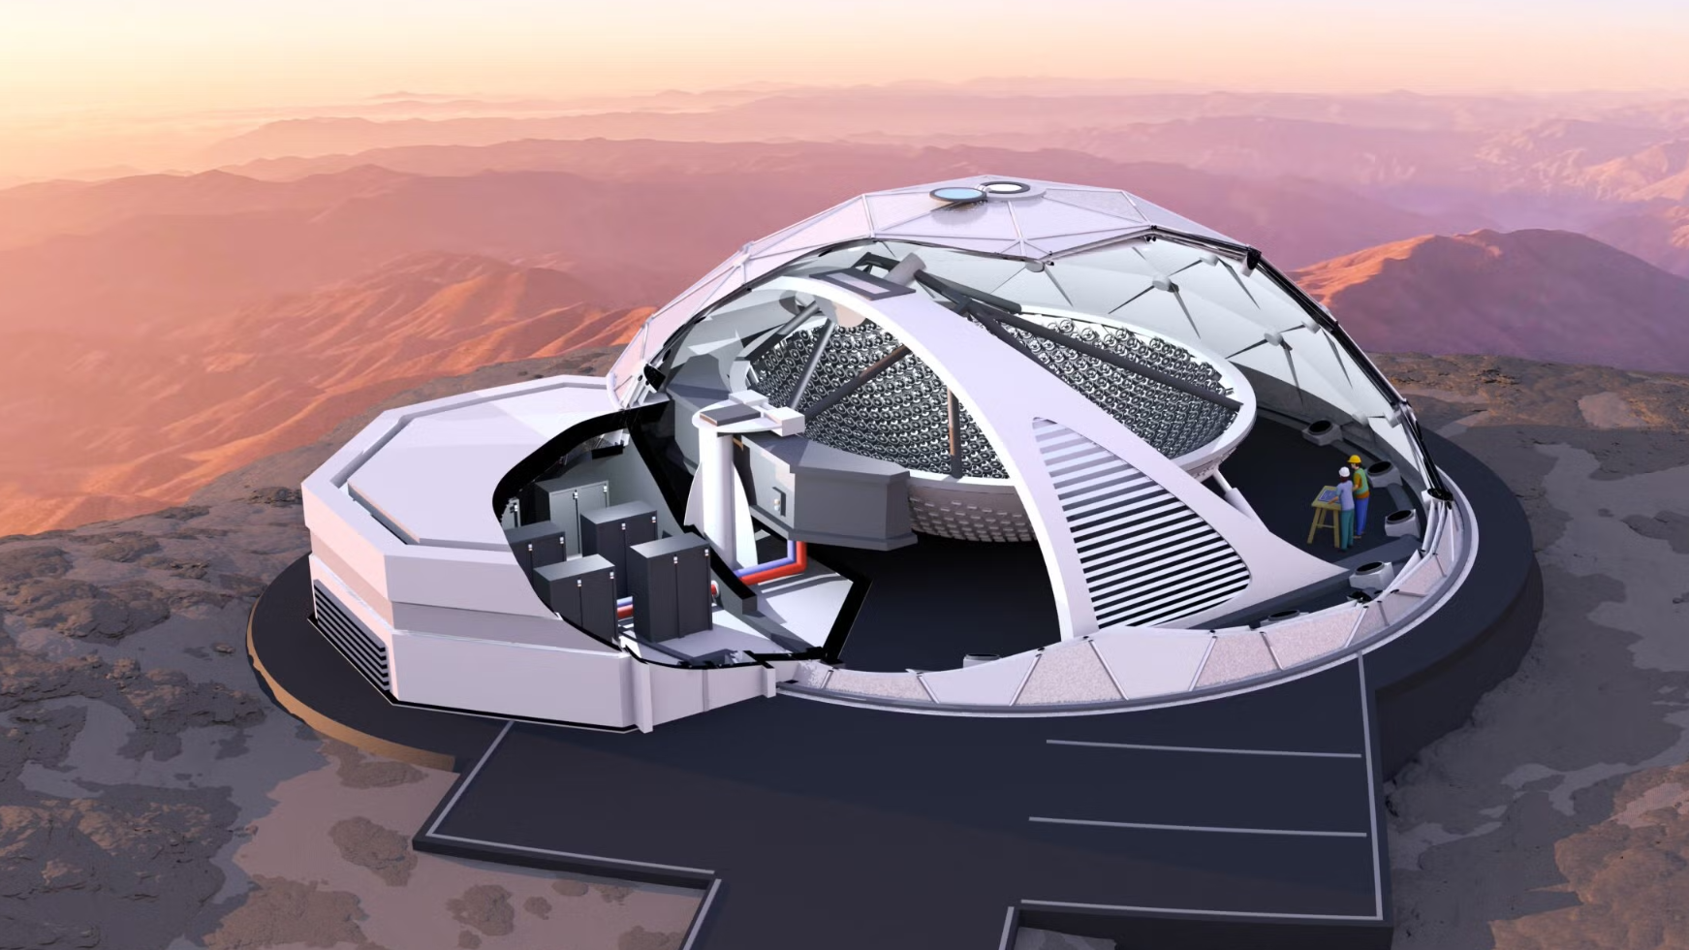
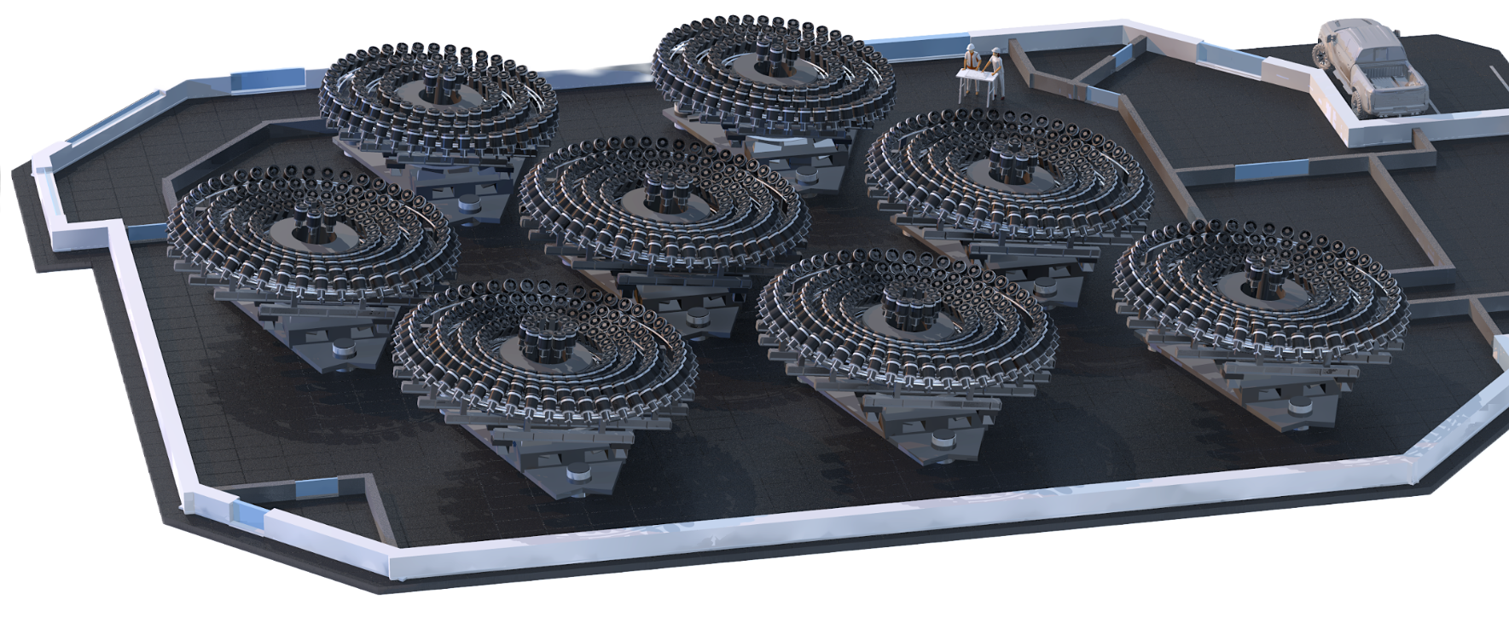
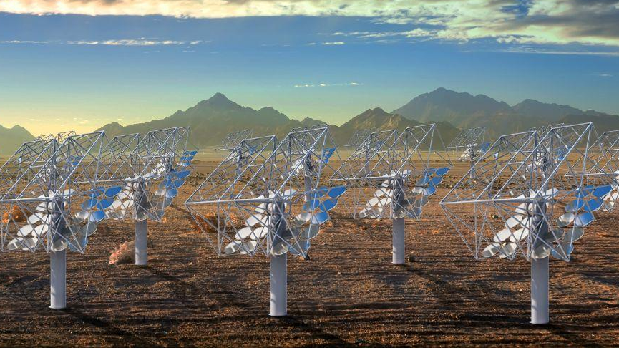

DSA
Argus
LFAST
Lazuli
Ground
Ground
SCHMIDT OBSERVATORY SYSTEM SHARED INFRASTRUCTURE
Time Allocation
Dynamic Scheduling
Operations Coordination
Alert streams
Analysis
Software
Data
Archive
Research Support
Ground
Space
Notes:
The “system” part of it has been particularly exciting
Each is a cutting edge facility
Arecibo, which collapsed in 2020, was a 305-meter single-dish telescope with extraordinary raw sensitivity, but a very limited field of view and no interferometric imaging capability. It excelled at deep targeted observations and planetary radar, but it was not designed for wide-field, high-cadence survey science. The Deep Synoptic Array (DSA) takes a fundamentally different approach: a distributed interferometric array of many smaller dishes operating together as a radio imaging system. This architecture enables arcsecond localization of fast radio bursts and wide-field survey capability, optimized for time-domain discovery rather than single-point sensitivity. Compared to SKA, which is designed for maximal sensitivity and large-scale cosmological surveys over decades, DSA is more focused and operationally agile. DSA can be highly efficient for rapid transient detection and localization, with faster deployment cycles and more flexible scheduling. In that sense, it complements SKA by emphasizing speed, precision localization, and time-domain responsiveness rather than sheer collecting area or ultimate sensitivity.

Slide 12
2. Coordination
3) between agencies/countries, cultures, communities
Barriers exist between different agencies/countries, and different cultural or community backgrounds
How to improve them?
  Could some (small) fraction of time on key facilities be devoted to a shared pool with time awarded by some international TAC process?
Is there a way to improve cooperation between space and ground? A specific problem is advanced commitment of time. Could this be made politically acceptable in form of time swaps?

Slide 13
3. Policies 1) Access
How to manage different access policies of facilities in giving access to telescope time to a wide MW/MM proposing team community?
Should TAC processes be linked or independent for those science cases where multiple facilities are essential?
How is it currently done and what is/is not working?
  case of NASA (SI)
  How SKAO is planning on doing it (AB)

Slide 14
Stefan Immler
Open Science / Open Data at NASA
NASA is committed to Open Science, Data, and Software:
Starting in 2023, all proposals to NASA must include an Open Science and Data Management Plan (OSDMP) that outlines how data/software that is produced is shared, findable, accessible, preserved for long-term access, and released on a clear schedule.
The OSDMP is part of the merit criteria for the evaluation of proposals submitted to NASA
Costs incurred by the OSDMP are allowable costs of proposals
Guidelines for OSDMP are given in:
  Science Mission Directorate policy document (SPD-41A)
  dedicated web sites, and
  NASA offers open science training classes and workshops on a regular basis

Slide 15
Stefan Immler
Exclusive Use Data Periods
… are no longer the norm at NASA. The NASA Astrophysics Division went a step further than NASA’s Science Mission Directorate and established a policy document about exclusive use data:
All mission data shall be released public immediately after calibration and pipeline processing (with limited exceptions for PI-led missions and instrument teams)
Missions can only develop open and unrestricted software
Collaborations with international partners will expect minimum exclusive use periods
There is a waiver process that should be used on a case-by-case basis only and must have a compelling justification (e.g., to protect graduate student thesis)
All peer-reviewed publications are made public with no embargo periods and no pay walls
All science workshops + meetings are help openly to broaden participation
We monitor progress, perform statistical analysis, and publish a yearly report on progress

Slide 16
3. Policies 2) Data/information
information: about transient discovery and follow-up
How to balance proprietary data/information within a consortium vs. strong demands for quick accessibility of time-critical information and data from the community?
Apart from considerations of giving credit to the originators of a program, there is an important issue here of scientific quality and integrity. Fully open and immediately public data pushes groups into rapid publication, potentially at the expense of suitable care in analysis.
How will the agencies and consortium building/operating the instruments get their credits?
Sub-threshold transients could potentially be valuable, but may be large/overwhelming in numbers, and contaminated by spurious sources. How to share their information/data?

Slide 17
3. Policies 2) Data
How to share the data?
Currently available on multiple databases for different facilities /wavelength. Should a global database be instituted? (TW)
If so, which datasets should be in it?

Slide 18
3. Policies 3) Publication
Publication policies from facilities/collaborations: is there any issue or barrier there?
If yes, how to improve?

Slide 19
4. Overall
Is an efficient and effective coordination eco-system needed?
How do we achieve it?

