Slide 1
More than Bytes: Technical and Social Dimensions of Data Lifecycle Management at ESA’s Space Science Data Archives Archives
Rachana Bhatawdekar¹, Christophe Arviset¹, Bruno Merin¹, Guido de Marchi¹, Jos de Bruijne¹, Deborah Baines¹, Arnaud Masson¹, Mark Bentley¹, Hector Perez², and Ignacio Leon²
¹European Space Agency, ²Starion Group for ESA
ADASS XXXV, Gorlitz, Germany, 10/11/2025

Slide 2
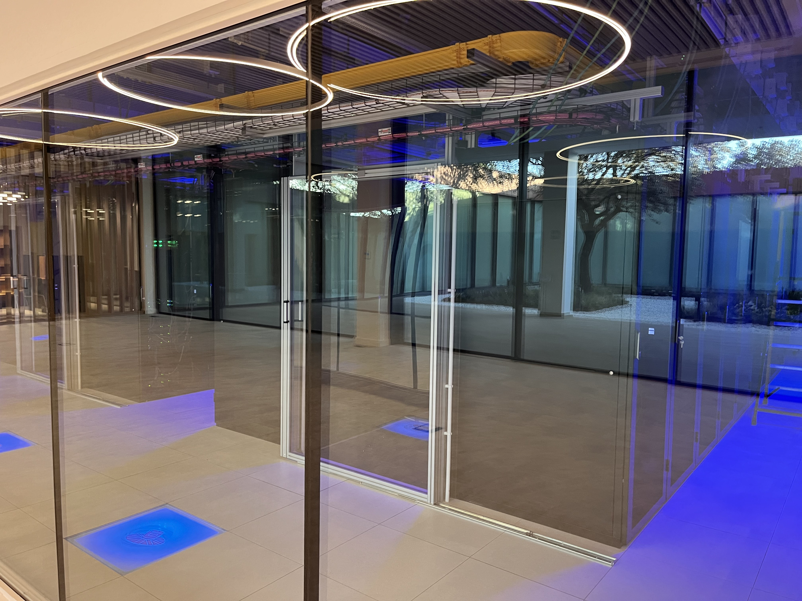
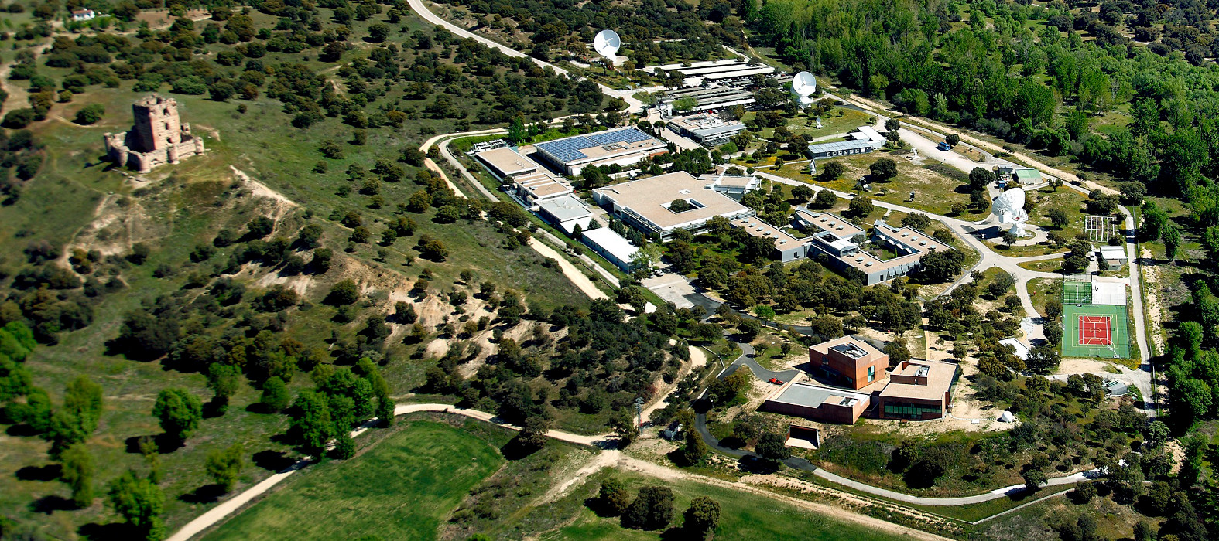
ESAC Science Data Centre (ESDC)
European Space Astronomy Center, ESAC
Villanueva de la Canada, Madrid, Spain
ESAC Science Data Centre (ESDC)
Data Center
https://www.cosmos.esa.int/web/esdc

Slide 3
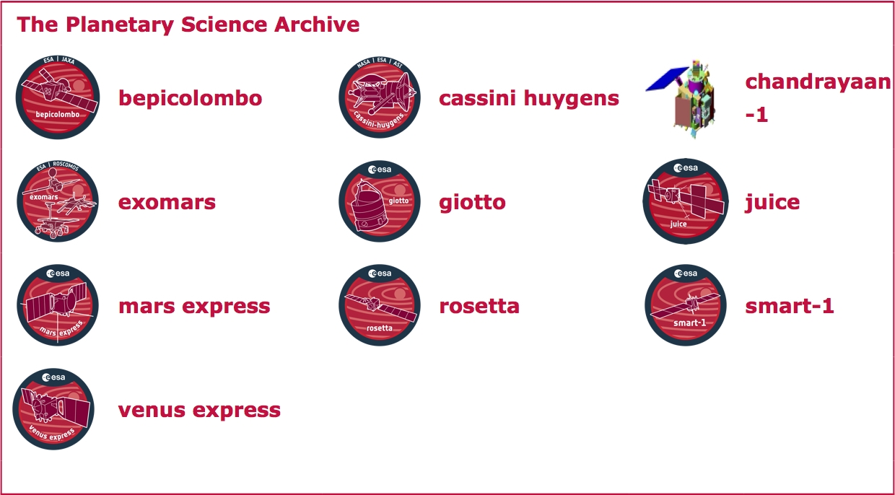
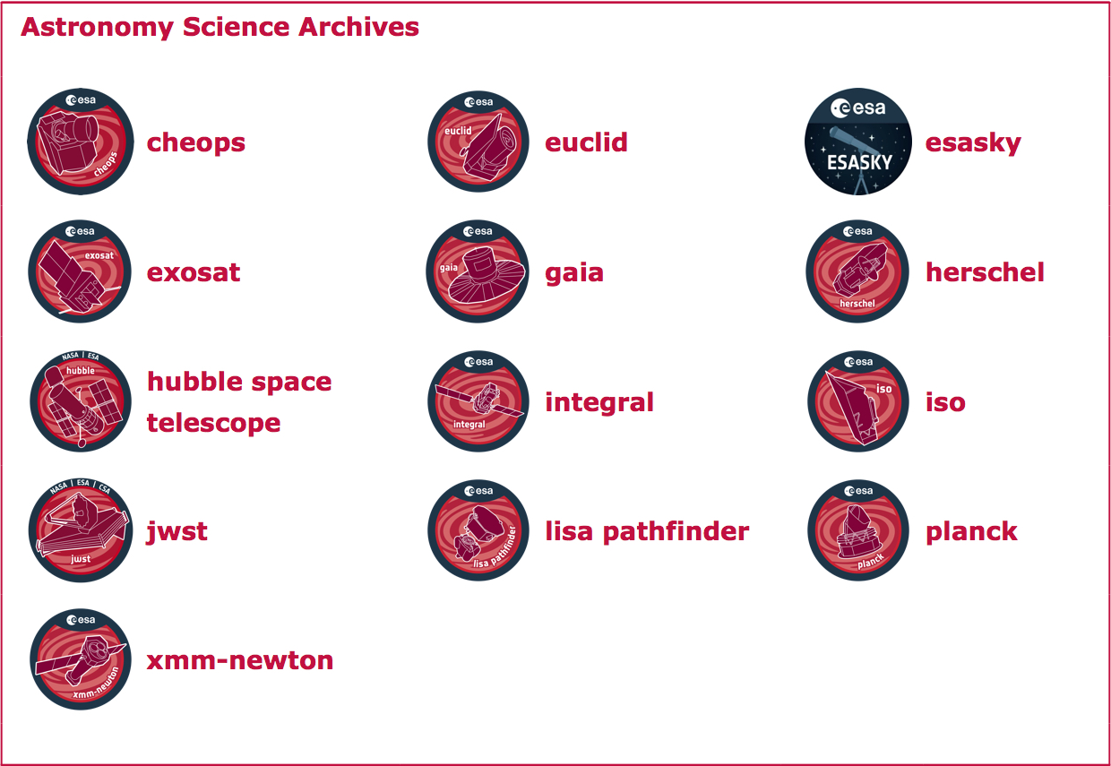
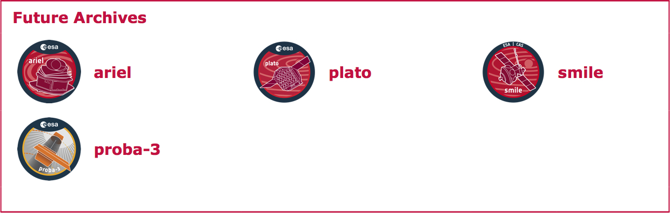
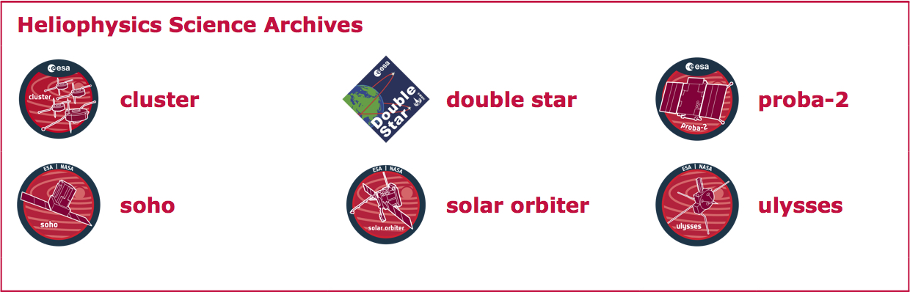
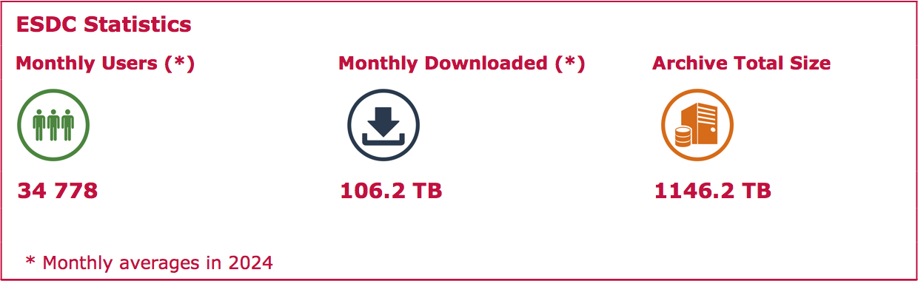

ESDC Archives
Central hub for ESA’s space science missions — Astronomy, Planetary, Heliophysics and Human and Robotic Exploration
Over 30 missions supported; from ISO (1998) → Euclid (2025)
~34,800 monthly users, 106 TB downloaded/month, 1.1 PB total archive size

Slide 4
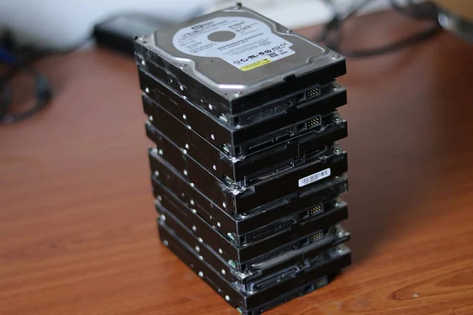
What is an archive really?

Slide 5
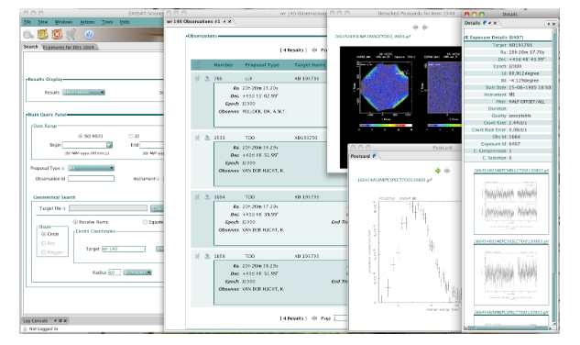
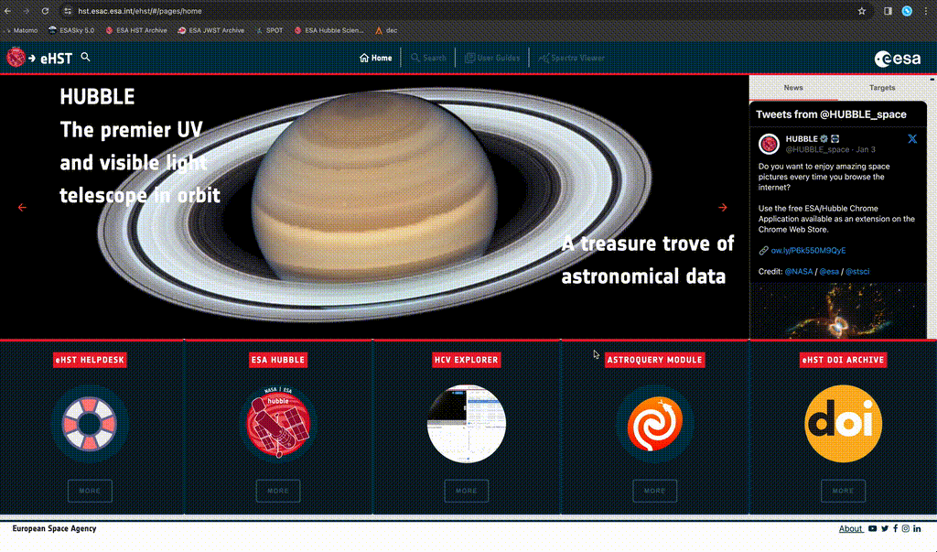

Archives: More than “Just a bunch of disks”
EXOSAT Science Archive
eHST Science Archive
Host, curate, preserve and serve the data
Ensure discoverability and interoperability (GUIs, APIs and VO protocols)
Full data management systems (not just static storage)
Provide tools for discovery, interfaces for access, and visualization services

Slide 6
What is Data Lifecycle Management?
Acquisition
Processing
Access and Distribution
Reuse and Interoperability
Archiving and Curation
Preservation and Evolution
Structured process: from data creation to long-term preservation and reuse
Cradle-to-grave (and beyond) view: from orbital acquisition to decades after mission end
Ensures data remain usable, discoverable, and interoperable over time
For space missions, the data lifecycle management isn’t just a technical process — it’s a long-term responsibility to science
Scientific Data Lifecycle Management

Slide 7
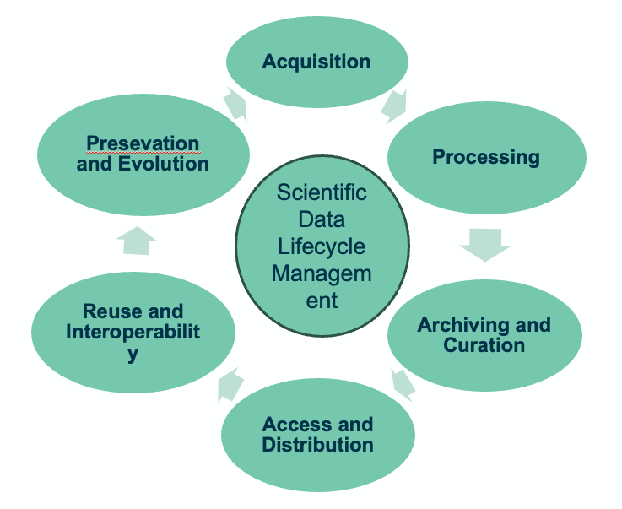

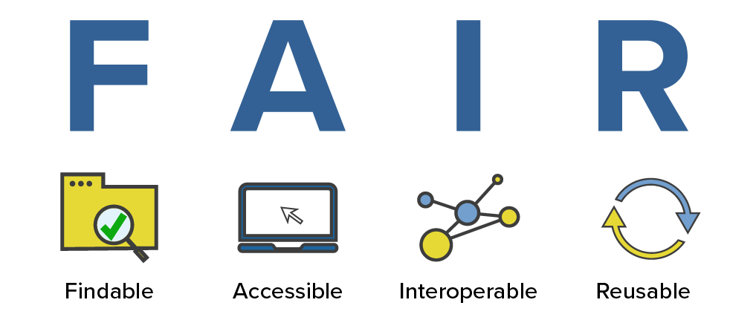
Why Data Lifecycle Management Matters?
• Space missions end — but their data must remain usable for decades
Prevents data loss, obsolescence, and knowledge decay
Ensures preservation, accessibility, and interoperability
Enables cross-mission discoveries and new science long after launch
Integrates FAIR principles (Findable, Accessible, Interoperable, Reusable)
Supports sustainability and efficiency from design to legacy

Slide 8
Two inseparable dimensions of Data Lifecycle Management
Sustainable trusted and FAIR Data Ecosystems
Technical Dimension
(focus: scale, architecture, infrastructure, interoperability and sustainability)
Social Dimension
(focus: people collaboration, policies and governance)

Slide 9
Technical Dimensions
Data growth and scalability (Managing petabyte-scale, multi-mission datasets)
Integrating diverse missions within a unified architecture (Scaling a common framework to support multiple scientific domains)
Enabling interoperability and standards across missions (VO protocols, PDS4, HAPI— ensuring cross-mission and international usability)
Evolving for the future while preserving the past (Building scalable, maintainable, and future-proof archives)

Slide 10
Technical Dimensions
Data growth and scalability (Managing petabyte-scale, multi-mission datasets)
Integrating diverse missions within a unified architecture (Scaling a common framework to support multiple scientific domains)
Enabling interoperability and standards across missions (VO protocols, PDS4, HAPI— ensuring cross-mission and international usability)
Evolving for the future while preserving the past (Building scalable, maintainable, and future-proof archives)

Slide 11
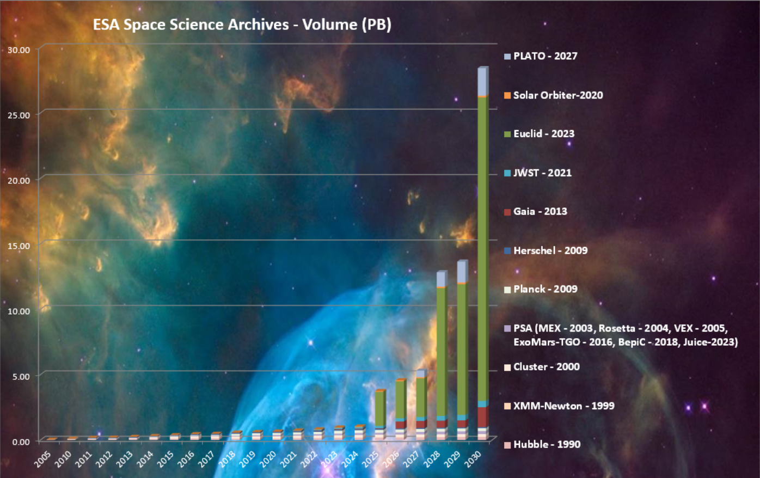
Technical Dimensions
• Data growth and scalability (Managing petabyte-scale, multi-mission datasets)
New “big data” missions require a paradigm shift
From “move the data to the user” towards “move the user to the data” => Science Platforms

Slide 12
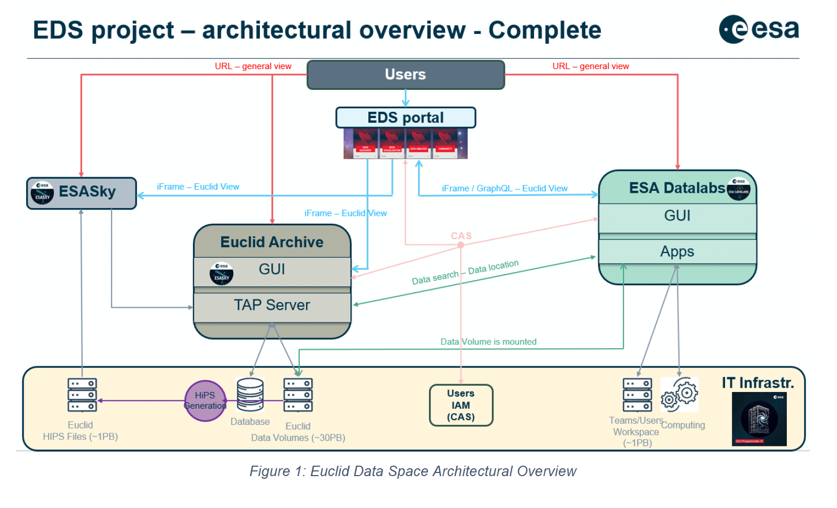
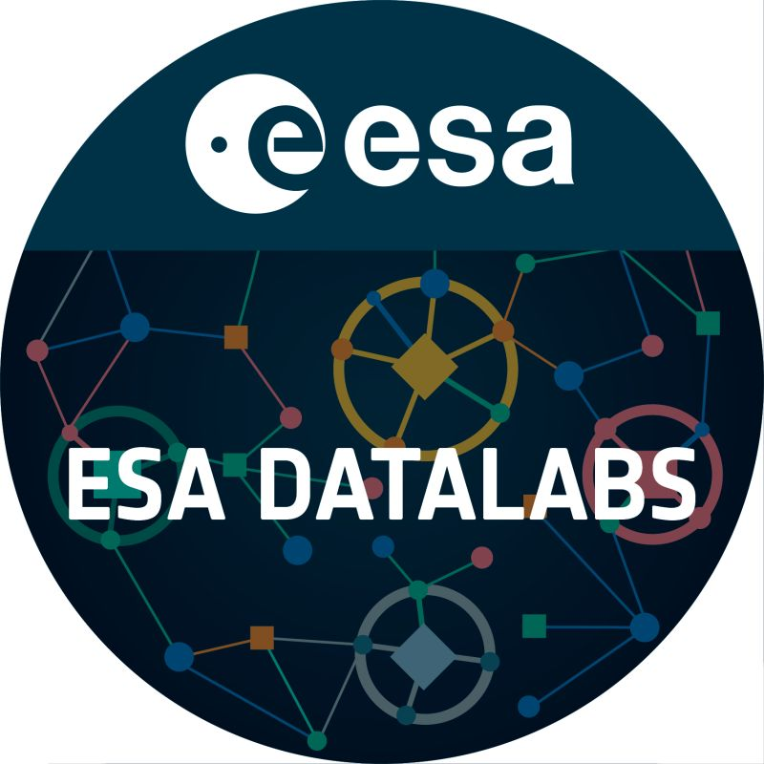

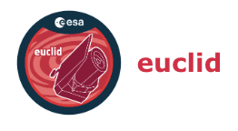
Technical Dimensions
• Data growth and scalability (Managing petabyte-scale, multi-mission datasets)
ESA Datalabs - our multi-mission science platform platform
Euclid Data Space (EDS) Portal – being developed for the Euclid mission
EDS version 1.0.0 released!
https://euclid.dataspace.esa.int
Sandor Kruk’s talk -> Nov 12 9AM

Slide 13
Technical Dimensions
• Data growth and scalability (Managing petabyte-scale, multi-mission datasets)
Integrating diverse missions within a unified architecture (Scaling a common framework to support multiple scientific domains)
Enabling interoperability and standards across missions (VO protocols, PDS4, HAPI— ensuring cross-mission and international usability)
Evolving for the future while preserving the past (Building scalable, maintainable, and future-proof archives)

Slide 14
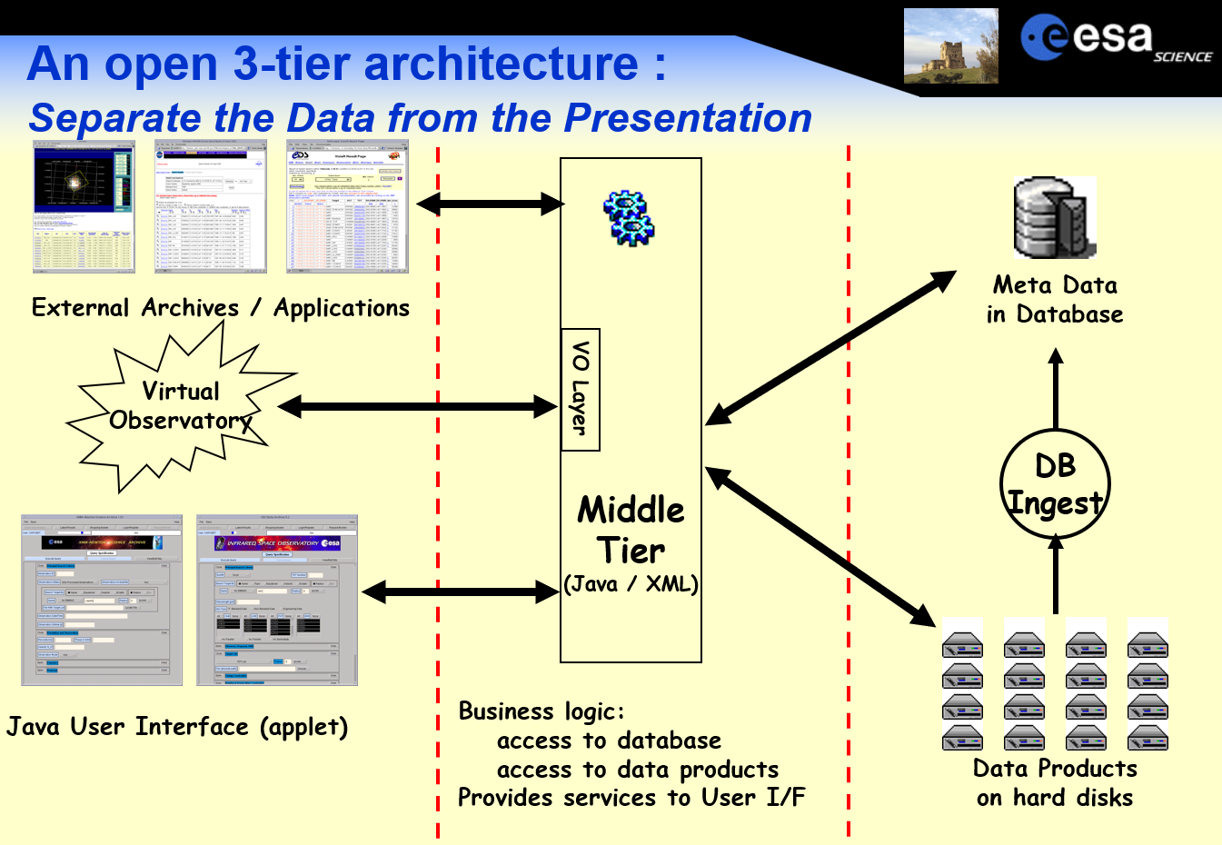
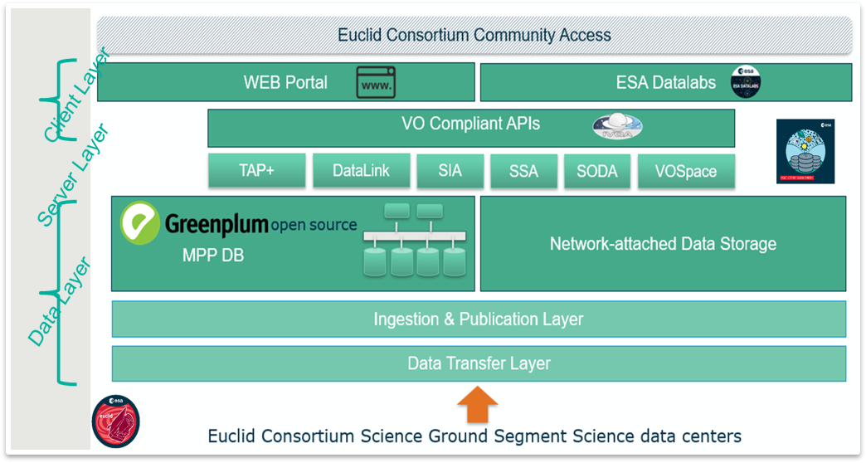
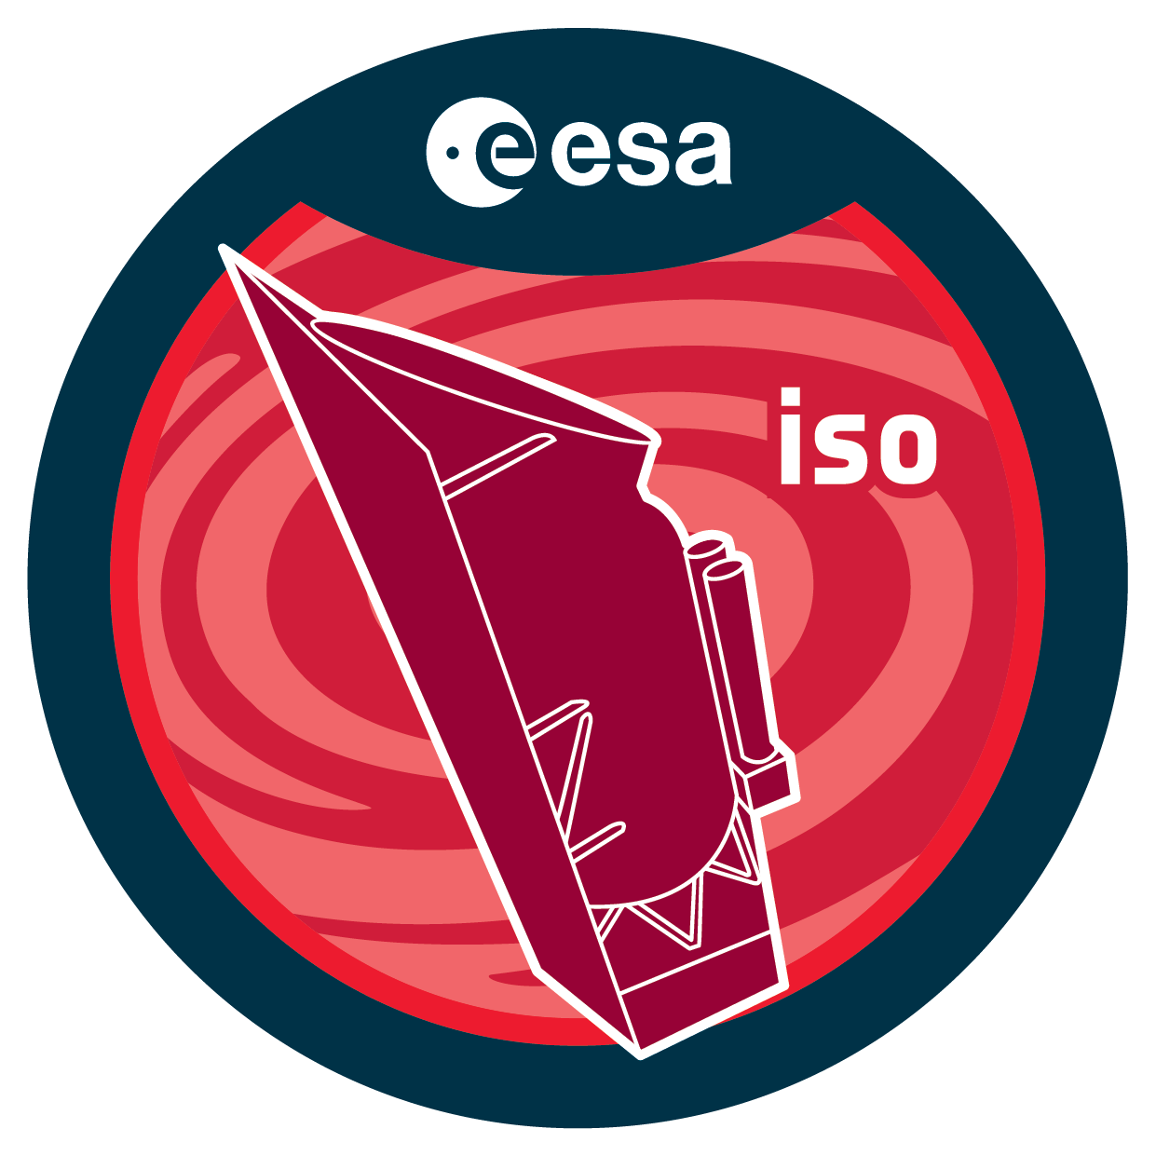
Technical Dimensions
• Integrating diverse missions within a unified architecture (Scaling a common framework to support multiple scientific domains)
2002
Stable 3 tier Architecture ​
Migration of individual layer to new technologies​
From VO-layer towards VO-built-in​
Easier interoperability (Astropy, ESASky, ESA Datalabs)​

Slide 15
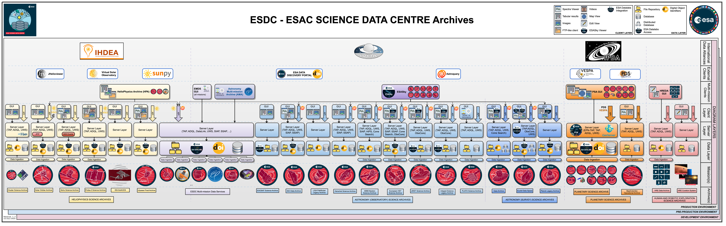
Technical Dimensions
Integrating diverse missions within a unified architecture

Slide 16
Technical Dimensions
Integrating diverse missions within a unified architecture
ESDC Multi-mission Data Services (EMDS)

Slide 17
Technical Dimensions
• Data growth and scalability (Managing petabyte-scale, multi-mission datasets)
Integrating diverse missions within a unified architecture (Scaling a common framework to support multiple scientific domains)
Enabling interoperability and standards across missions (VO protocols, PDS4, HAPI— ensuring cross-mission and international usability)
Evolving for the future while preserving the past (Building scalable, maintainable, and future-proof archives)

Slide 18
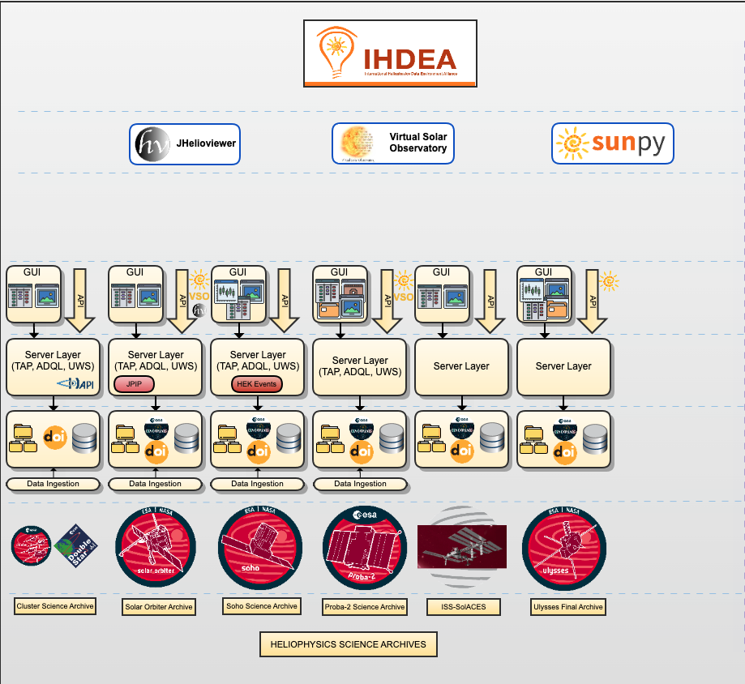
Technical Dimensions
• Enabling interoperability and standards across missions (VO protocols, PDS4, HAPI— ensuring cross-mission and international usability)
Standards live in the server layer (TAP, SIAP, SSAP, HAPI…)
Enable cross-mission and international usability
Support scientific cross-matches and multi-mission analyses
Complement client-layer interfaces (GUIs, APIs, ESASky)

Slide 19
Technical Dimensions
• Data growth and scalability (Managing petabyte-scale, multi-mission datasets)
Integrating diverse missions within a unified architecture (Scaling a common framework to support multiple scientific domains)
Enabling interoperability and standards across missions (VO protocols, PDS4, HAPI— ensuring cross-mission and international usability)
Evolving for the future while preserving the past (Building scalable, maintainable, and future-proof archives)

Slide 20
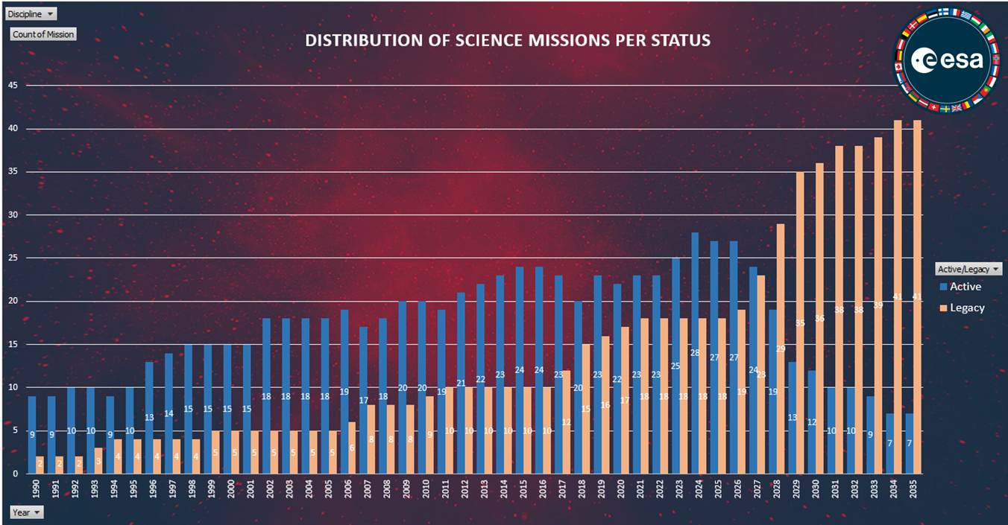
Technical Dimensions
Evolving for the future while preserving the past (Building scalable, maintainable, and future-proof archives)

Slide 21
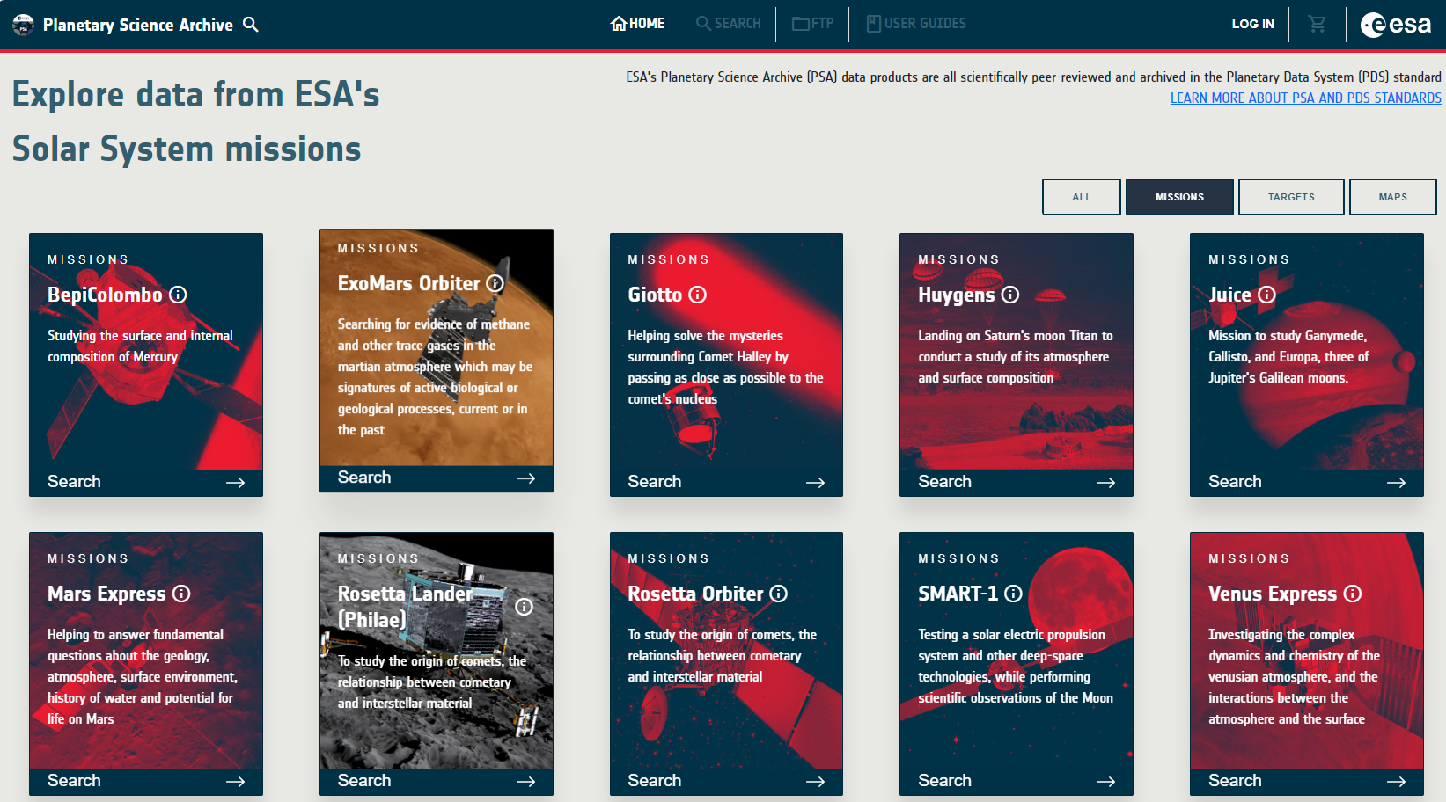
Technical Dimensions
Multi-mission archives
Planetary Science Archive (PSA) – https://psa.esa.int

Slide 22
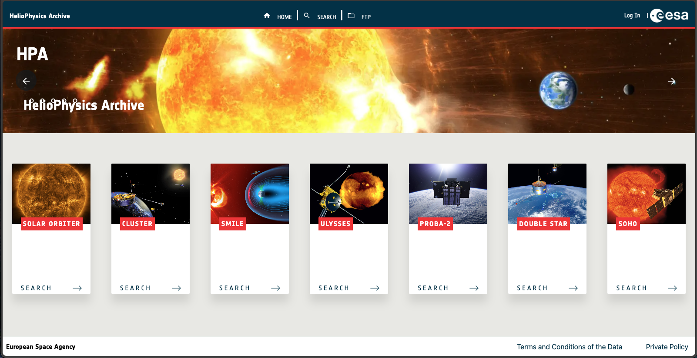
Technical Dimensions
Multi-mission archives
Heliophysics Archive (HPA) – https://hpa.esa.int

Slide 23
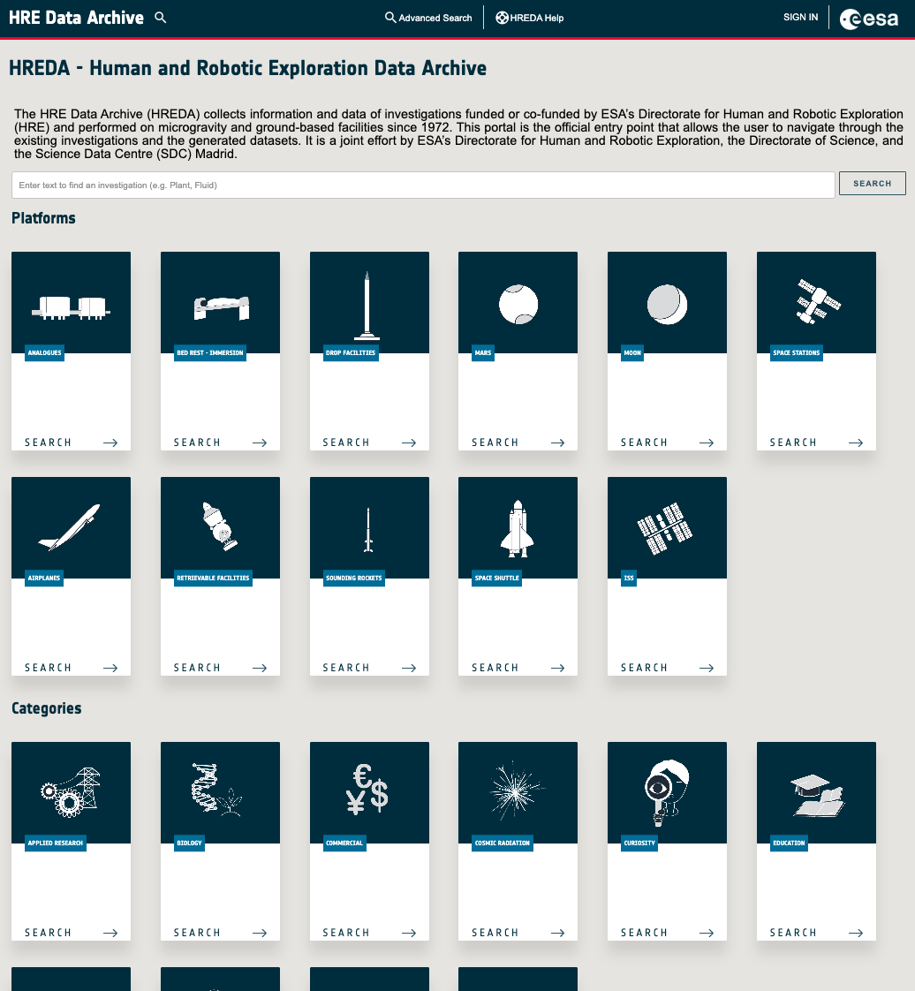
Technical Dimensions
Multi-mission archives
Human and Robotic Exploration Data Archive (HREDA) – https://hreda.esac.esa.int/
Heliophysics Archive (HPA) – https://hpa.esa.int

Slide 24
Technical Dimensions
Multi-mission archives
Astronomy Multi-Mission Archive
Human and Robotic Exploration Data Archive (HREDA) – https://hreda.esac.esa.int/
Heliophysics Archive (HPA) – https://hpa.esa.int

Slide 25
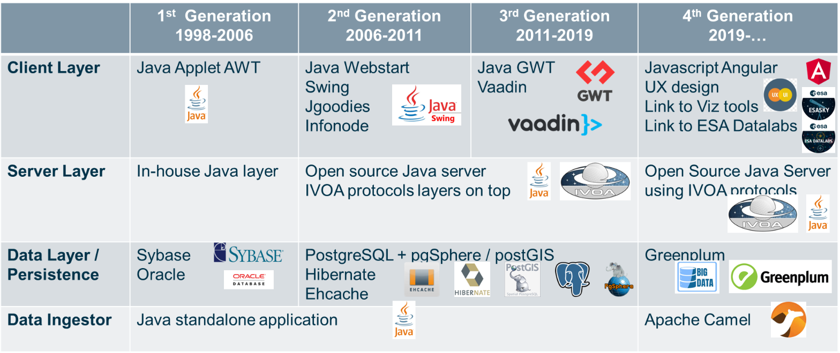
Technical Dimensions
Technology Evolution

Slide 26
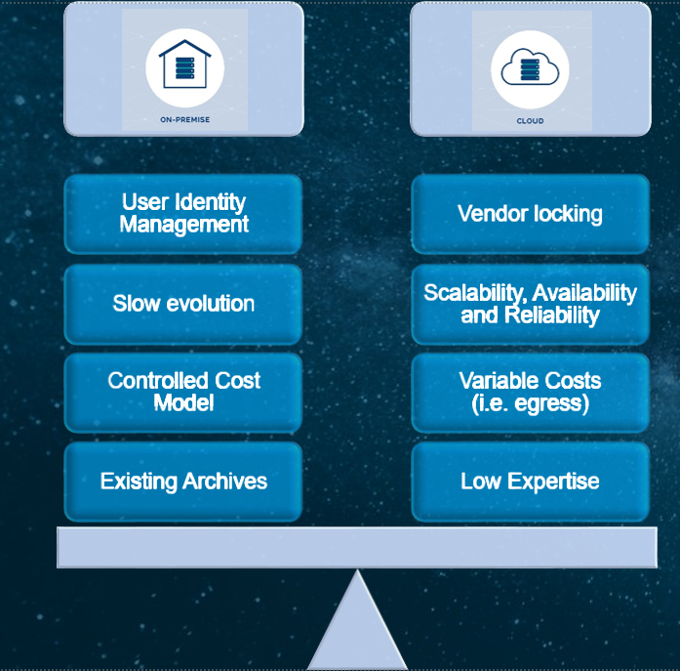
Technical Dimensions
• Archives on premise or in the cloud
• Migrating all archives and EDL into the cloud needs to be thought through with care, i.e. proprietary and public data, identity management, colocation of storage and compute, …
Requires expertise and planning to do it right
Some clear advantages for immediate availability, scalability and reliability
Egress costs remain a question with respect to cost model. We want our archives to be used as much as possible, and we also need a controlled cost model
ESA as a European Institution will go towards European cloud providers.
* The term “Cloud” is being used generically to represent a scalable supercomputer infrastructure (either based on Cloud technology or not)
ESA Datalabs and Archives Cloud Study Project (EDACS)

Slide 27



Technical Dimensions
• Responding to unplanned technology shifts
2019 ESDC adopts Greenplum
2024–ESDC launches assessment of alternatives
2024 - Broadcom closes open-source version — dependency revealed
Future - Modular, sustainable architecture — lessons learned
Technical sustainability is not only about selecting the right software, but it is also about ensuring that the ecosystem can adapt when external conditions change!

Slide 28
Technical Dimensions
Data growth and scalability (Managing petabyte-scale, multi-mission datasets)
Integrating diverse missions within a unified architecture (Scaling a common framework to support multiple scientific domains)
Enabling interoperability and standards across missions (VO protocols, PDS4, HAPI— ensuring cross-mission and international usability)
Evolving for the future while preserving the past (Building scalable, maintainable, and future-proof archives)

Slide 29
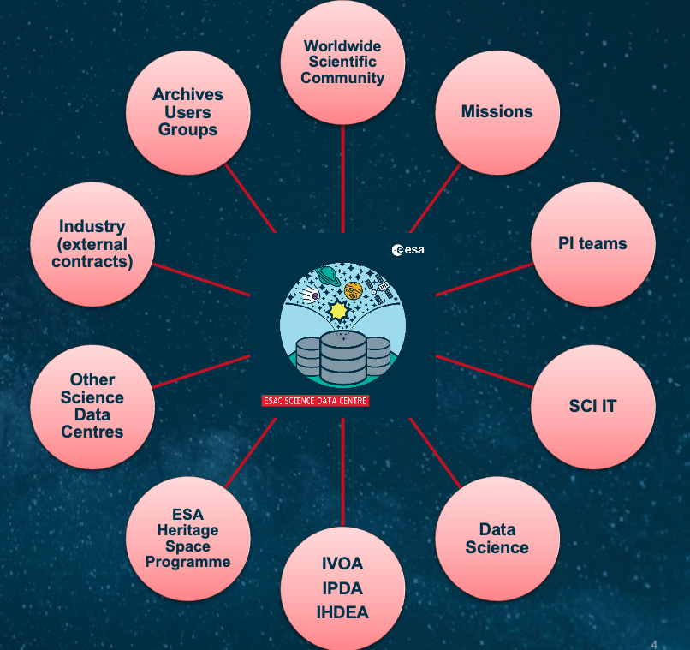
Social Dimensions
Cross-agency collaboration – through international partnerships (IVOA, IPDA, IHDEA,) coordination with NASA, JAXA, CSA/NSSC, and partner centres like CDS, STScI/MAST, LINCC, SPACIOUS, and mission-specific collaborators (e.g. DZA for Gaia, IPAC for Euclid).
Policies and governance – through policies and governance, ESA defines how its science-data can be accessed, cited, and shared responsibly
Knowledge continuity and expertise retention – Preserving institutional know-how as missions transition into legacy phases
Empowering the scientific community – Enabled through user-friendly interfaces, helpdesks, workshops, and the Archives User Group, ensuring user feedback directly shapes system evolution.
Open science and transparency – Promoting accessible, standards-based, data sharing across international archives.

Slide 30
Take away messages
Data lifecycle management is essential: Managing space mission data from acquisition to long-term preservation ensures usability decades into the future
Technical and social dimensions go hand in hand: Scalable, interoperable systems and policies, governance, and collaboration together enable sustainable archives.
Archives are active enablers of science: Beyond storing files, they provide discovery, access, and integration tools for cross-mission research.
Planning for the future is critical: Platforms like EMDS, multi-mission archives, and technology evolution strategies help balance innovation with maintainability
Open standards enable interoperability: By using protocols like TAP, HAPI.. ESDC ensures mission data can be consistently accessed, shared, and integrated across international archives
Lessons extend beyond ESA: The approaches and experiences gained here can inform the design of future astronomical and interdisciplinary data infrastructures.

