Slide 1


Testing Complex Scientific Software: Key Challenges and Effective Strategies
Sandra Castro (ESO)
Akeem Wells (NRAO)
and the CASA Team

Slide 2
Outline
What is CASA?
CASA Early Challenges
Effective Strategies for Testing
CASA New Challenges
Lessons Learned

Slide 3
CASA is being developed by an international consortium of scientists and software engineers based at the National Radio Astronomical Observatory (NRAO), the European Southern Observatory (ESO), the National Astronomical Observatory of Japan (NAOJ), and the Joint Institute for VLBI European Research Infrastructure Consortium (JIV-ERIC), under the guidance of NRAO.
CASA is the official data processing software for ALMA, VLA, Nobeyama 45m and frequently used for other radio telescopes (EVN, GMRT, etc.).
For more detailed information on CASA, see the talk by Bjorn Emonts today at 14:00

Slide 4
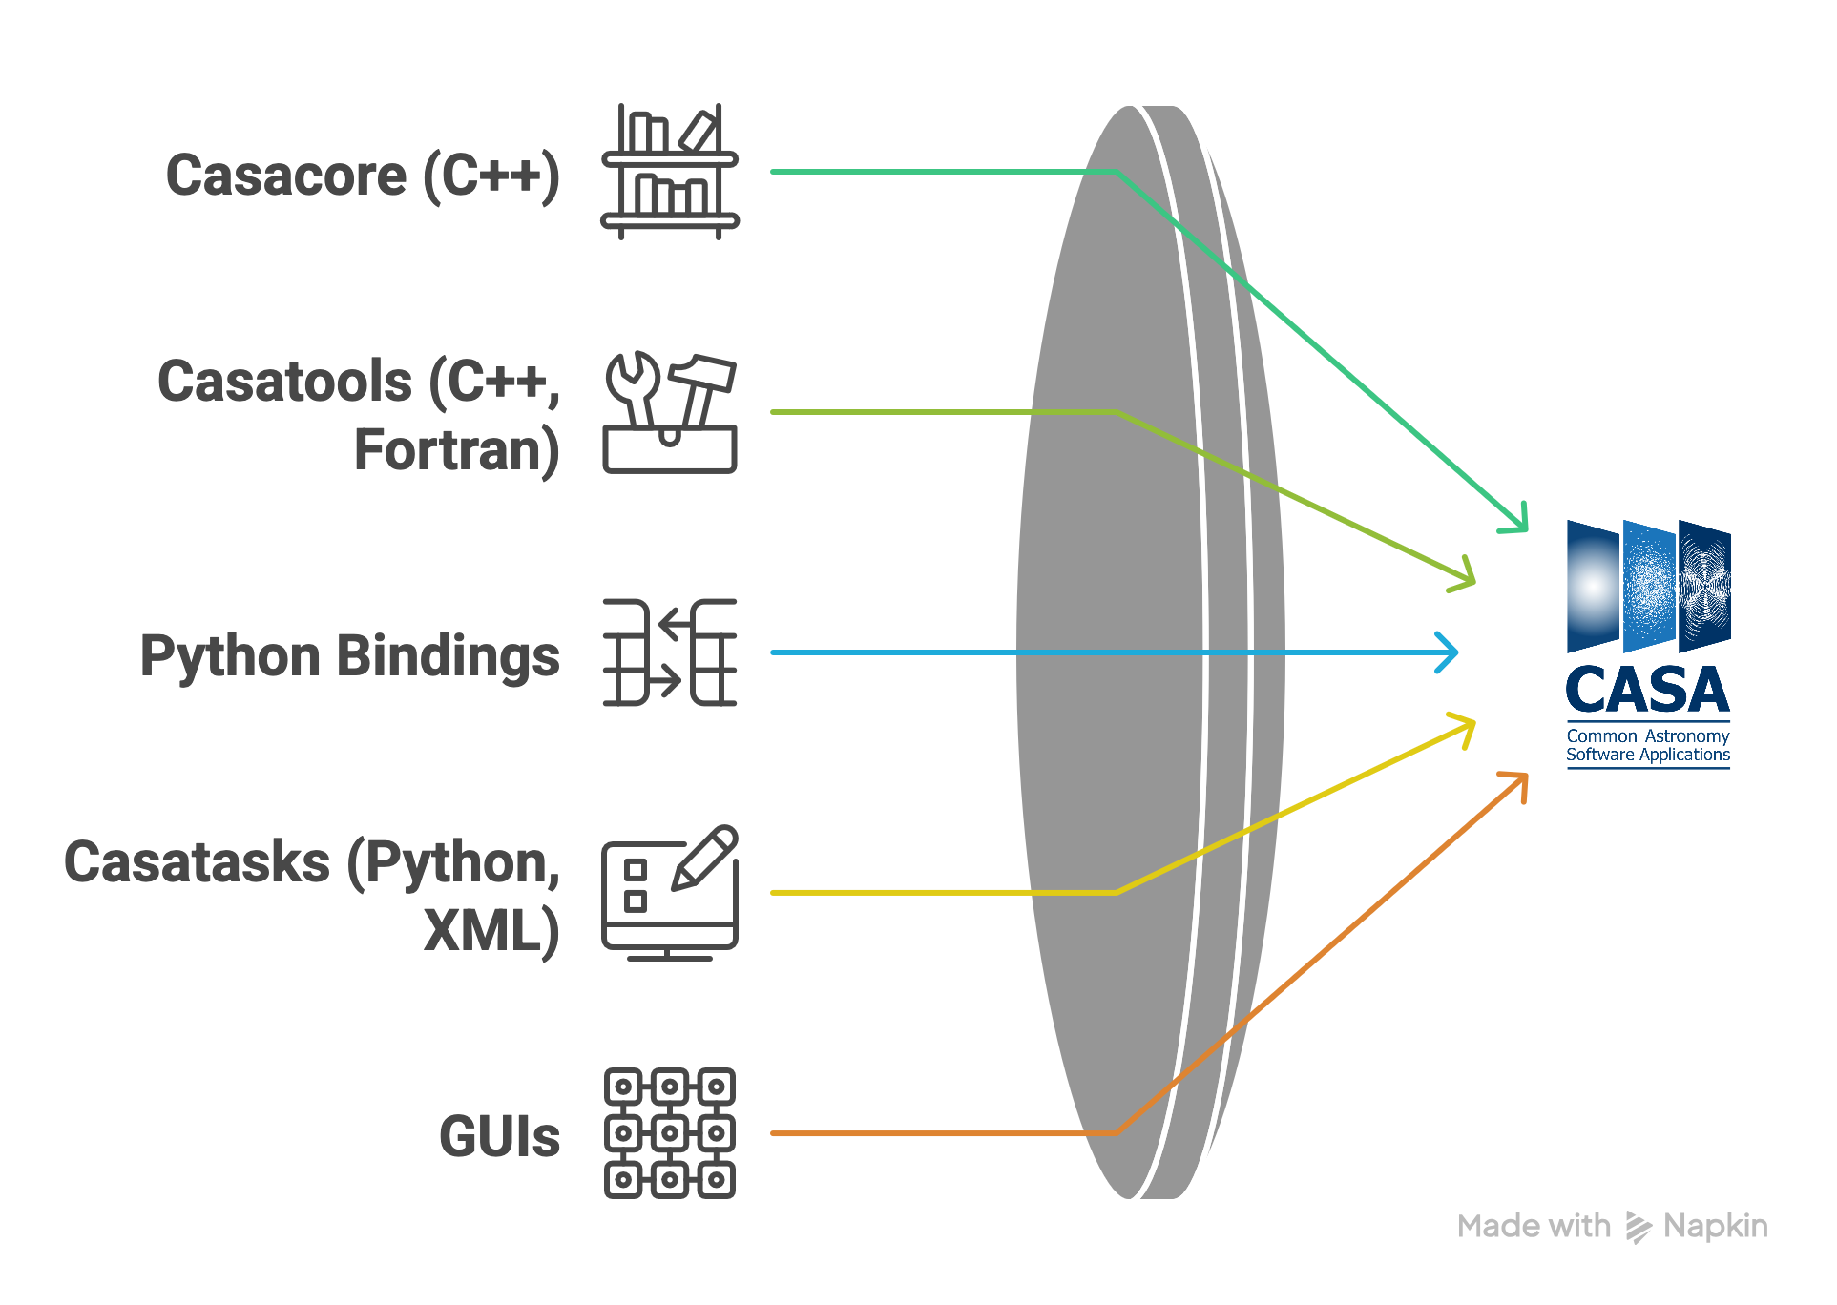
CASA and Pipeline Packages
pipelines
CASA Reference
PASP, 134, 114501
DOI: 10.1088/1538-3873/ac9642

Slide 5
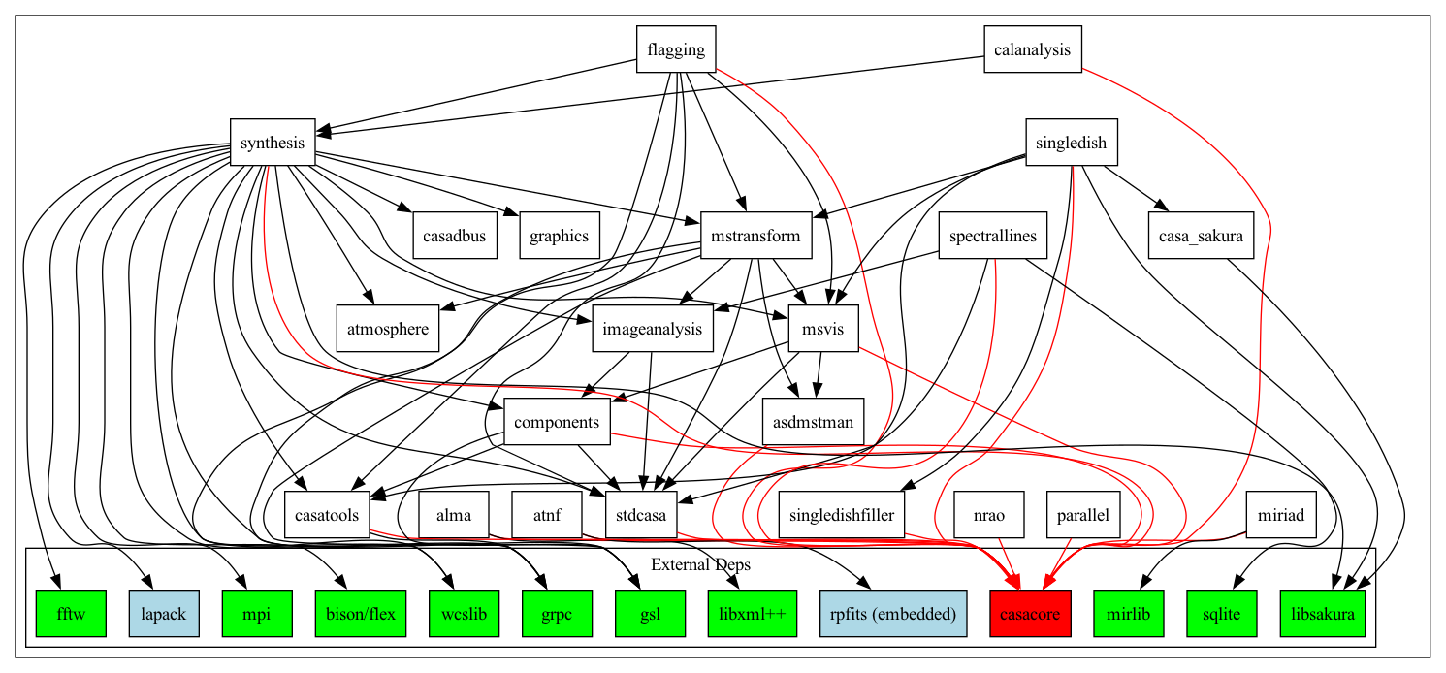

Slide 6

CASA Early Challenges

Slide 7
1 – Heavy Annual Release
ALMA Pipeline Cycle expected an annual release of CASA, used for the operations at the ALMA Observatory.
Each annual CASA release contained mixed stakeholder features, infrastructure changes, maintenance bugfixes, occasional dependency updates.
Difficult to debug if issues occurred after the release.
Difficult to revert version to previous year.
STRESS!!!

Slide 8
2 – Lack of Trust from Stakeholders
Validation tests by stakeholders would find trivial bugs in the code
Unclear information on what code was tested by CASA
Fear of any changes introduced to the code
Doubts about the quality of the CASA code

Slide 9
3 – Unclear Test Coverage of Code
Automated tests existed but…
Lack of collective information about automated tests in CI
  what is being tested?
  when is it tested?
  how is it tested?
Main operational mode lacked test coverage
PR tests needed review

Slide 10
Effective strategies for testing that worked for CASA

Slide 11
1- Redefined the Development Process
Introduced and enforced a verification phase at the end of development
Science Requirements
Development
and
Documentation
Verification
Validation
Core software engineering stages that fall entirely within the CASA team
Notes:
Requirements:
Usually written as feature requests, algorithms, or problems to solve – Metrics are often not defined up front - Based on ‘best possible outcome’ after experimenting with a solution. - Independent analyses are sometimes available, but not always.

Slide 12
2- Added Verification Phase
Infrastructure Development
Added Status=Verifying in JIRA
Provided test utility package for development
Optimized automated tests for branch development (JIRA mapping)
Developed CI configuration for JIRA
Weekly group meetings
Strong CASA Leads relation
Presentations to team and stakeholders
Improved communication
Notes:
CASA uses the full workflow provided by Atlassian, using Bitbucket, Bamboo, Confluence and JIRA.

Slide 13
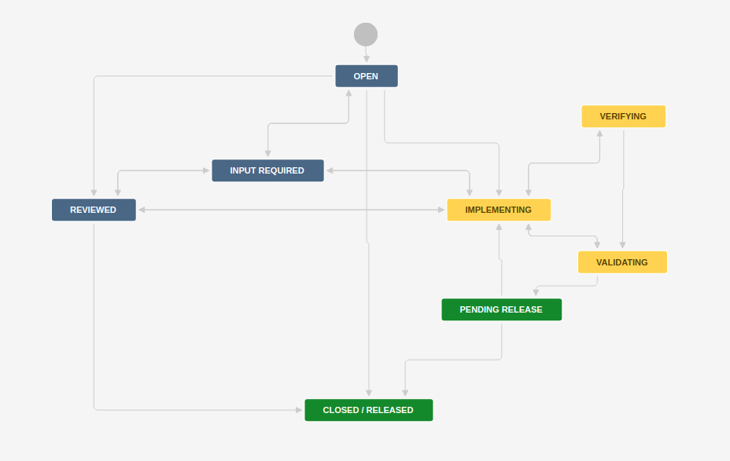
3- Boosted CI Tests in JIRA
automatically run all tasks and tools tests for full verification. On demand, special tests.
map JIRA components to tests, executed automatically for each push.
on-demand manual tests by validators/stakeholders
Notes:
Catch bugs during development and not after!

Slide 14
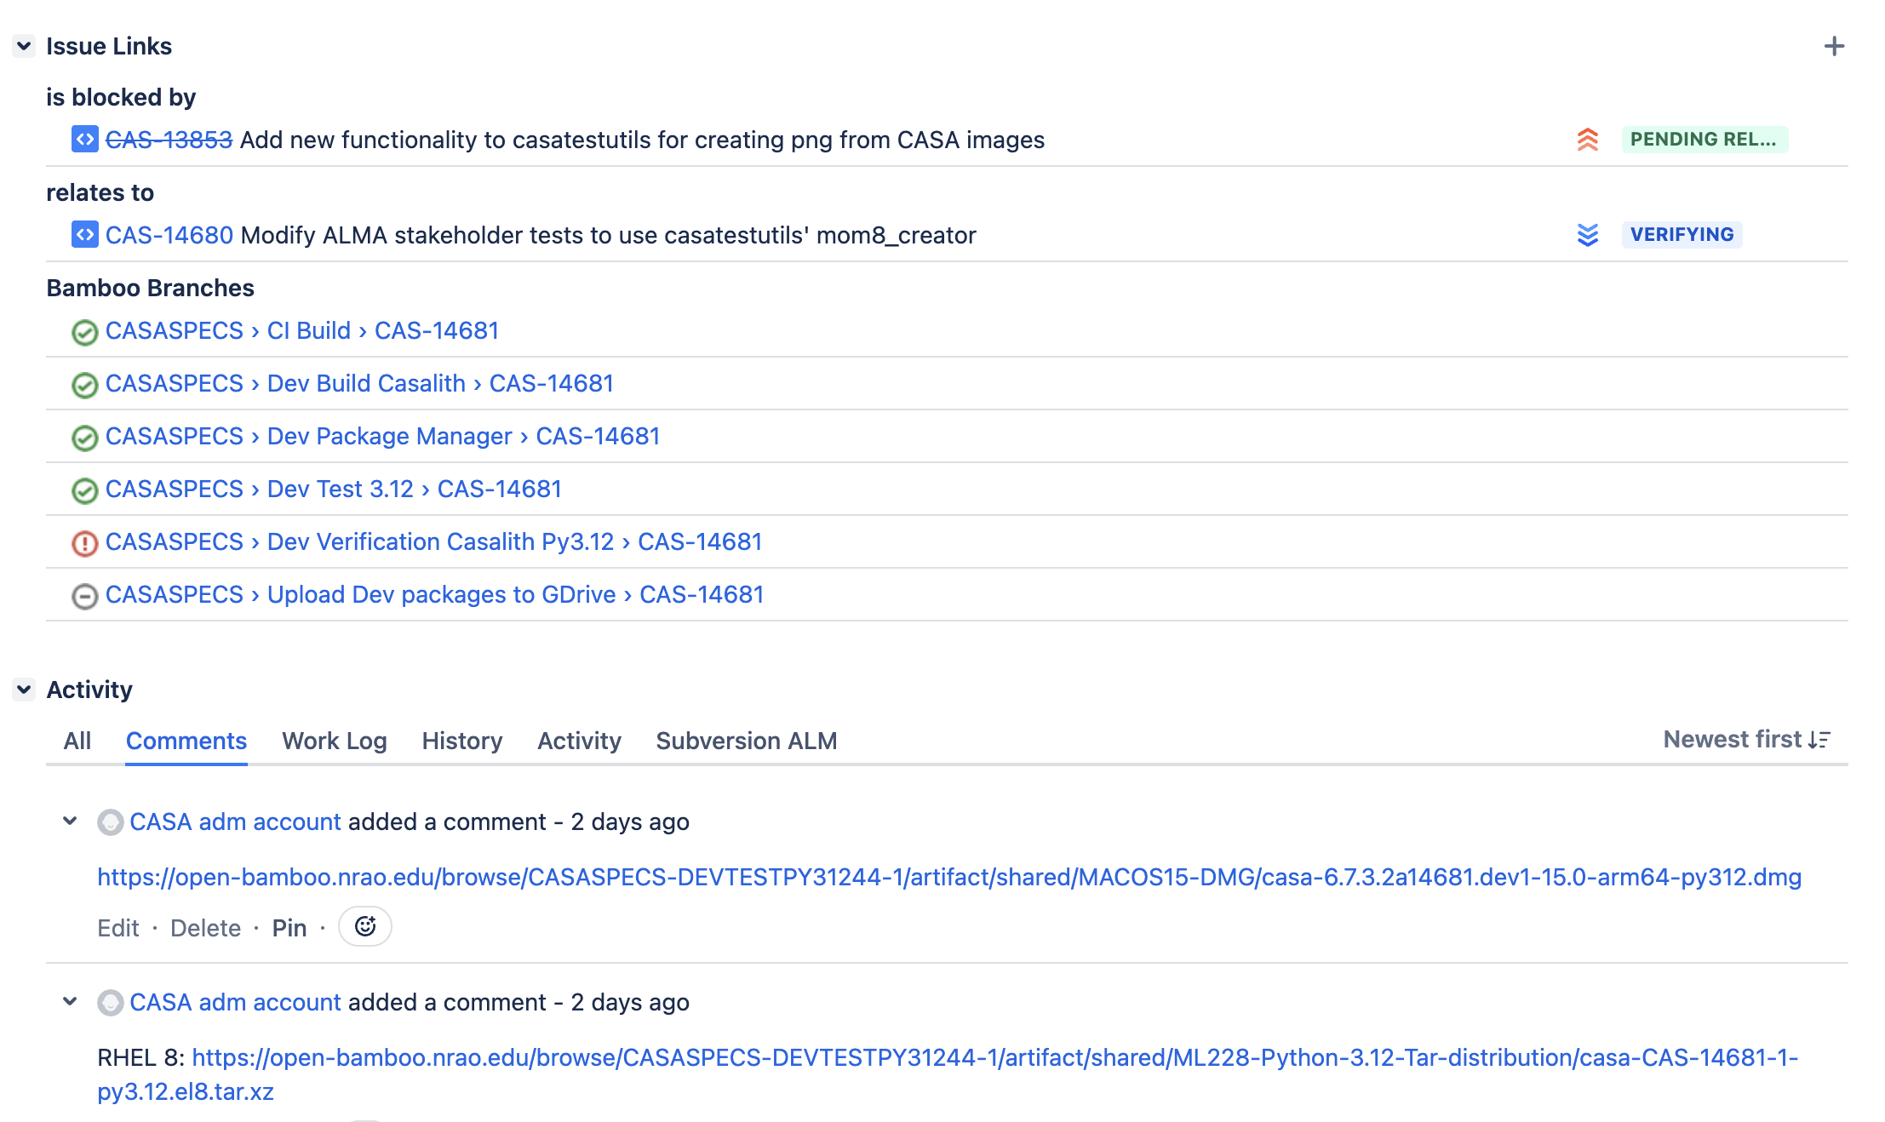
3- Dev Packages available in JIRA
Avoid the “it works for me” from development team
Bamboo automatically creates packages of dev branches and publishes to JIRA.
Single source of truth in Bamboo.
Packages are also used by stakeholders during validation testing.
Notes:
add extra large figure in next slide, linked from this one when clicked

Slide 15
4- Increased Test Coverage
Increased coverage of public functionality (tasks and tools)
Added more test cases to main tasks (prioritized test development)
Added serial and MPI tests for parallelized tasks (mainly imaging task → tclean)
Added benchmark performance tests for main tasks (Airspeed Velocity – ASV)
Added stakeholder tests

Slide 16
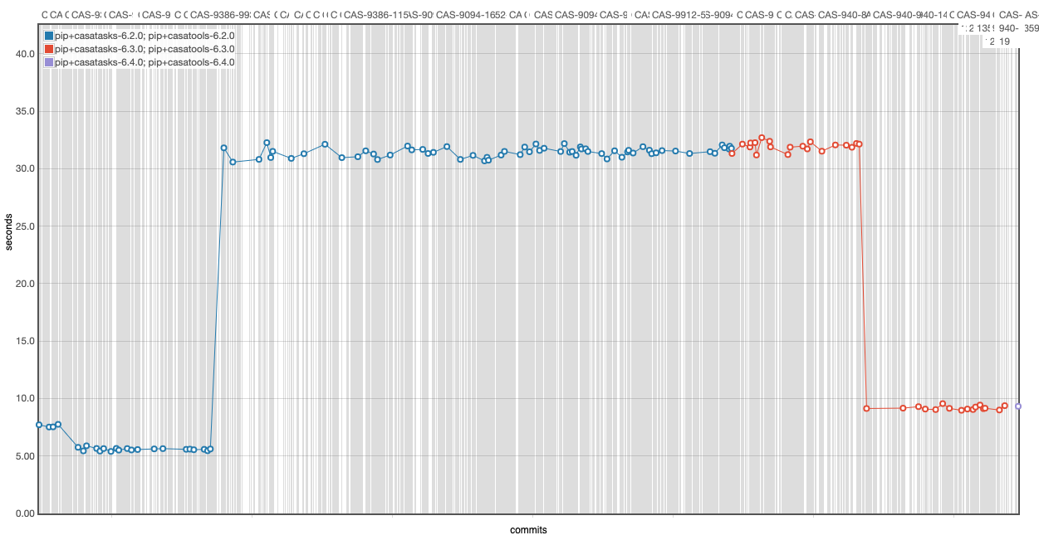
4- Increased Test Coverage – ASV Benchmark Tests
In 6.2 cycle, pipeline reported that flagdata was 4x slower than in 6.1.1
slowdown in 6.2.0.43
fixed in 6.3.0.23
Performance tests showed issue .... and fix afterwards.

Slide 17
5- Improved Trust from Stakeholders
Created the Stakeholder Tests
The most important use-cases defined by the stakeholder who provided data and scripts.
Verification team: discussed requirements, references for comparisons, sub-selection of data to lower runtime.
Tests were validated by stakeholders, added to CI, used for feature and main branch verification.
Side-effects of code changes for one stakeholder can be verified for other stakeholders. Common code is particularly prone to this.

Slide 18
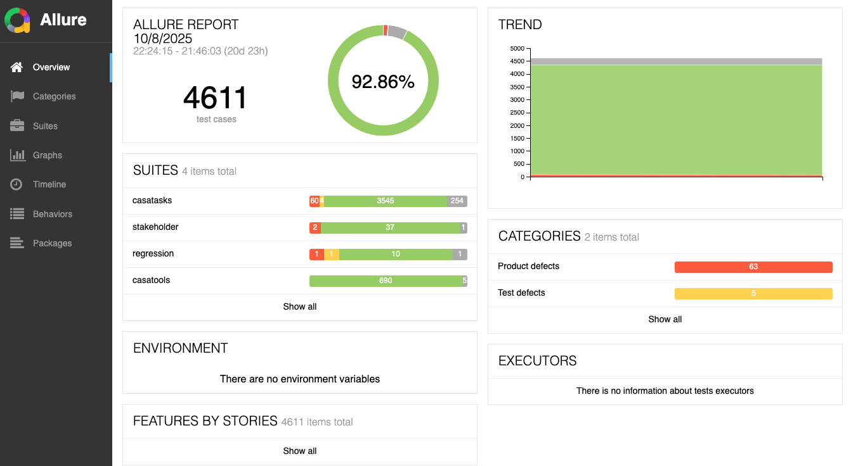
CASA Tests Allure Reports

Slide 19
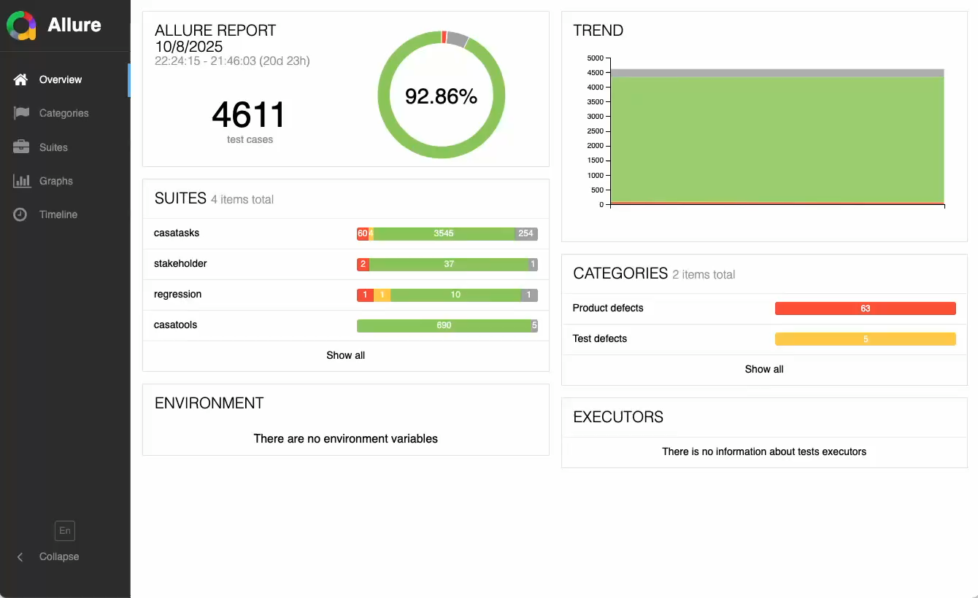
CASA Tests Allure Reports

Slide 20

6- More frequent releases
CASA moved to quarterly releases.
A few CASA releases for general users during the year and CASA+Pipeline annually for pipelines (e.g. ALMA operations).
Avoided flood of features and bugfixes on the same single annual release
Pre-release packages available for download anytime.
Reduced “release stress”.

Slide 21
CASA New Challenges

Slide 22
Too many tests, too long to run
Automated Tests Run Time in Bamboo: main branch
~4600+ test cases executed multiple times for each build
concurrent plans with concurrent jobs on Dockers if possible
limited available host runners for stakeholder tests
Matrix of multiple OSs and multiple Python versions
Most optimized for single Python:
  Max (job(Plan1, Plan2, PlanN)) + Max(job(Stk1, Stk2, StkN)) ~ 32 hours

Slide 23
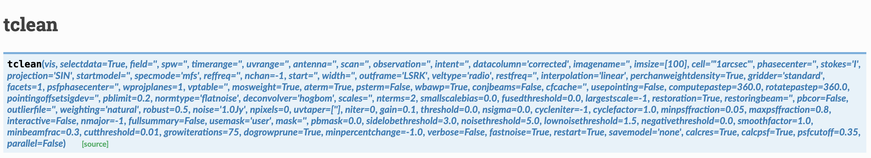
Task tclean: a continuous challenge for testing
94 parameters
needs use-case testing instead
stakeholder tests appropriate for this task

Slide 24
Build System and Coverage Reports
In the current state, the coverage reports are not reliable
CASA’s cmake build system includes files that are not used, and those lines are considered when creating the reports
Need to refactor the build system to get more accurate coverage numbers
for the Flagging module
Coverage including all files: Lines 36%, Functions: 29%
Coverage including only used files: Lines 66%, Functions: 70%

Slide 25
Lessons Learned

Slide 26
Random Tips...
Not all tests are useful!
Check redundancy of tests; review tests; cleanup tests
Use coverage reports to guide test development (to add and remove)
Provide template for test development; it helps maintenance of tests
Keep runtime down*
Multiplicity of OSs and other dependencies only when/where needed
IaC to help adding/migrating test plans

Slide 27
Starting from Scratch – RADPS Test Strategy
Radio Astronomy Data Processing System (RADPS)
development led by NRAO, in collaboration with ESO and NAOJ.
low-level tests
test in layers
start from the bottom
catch issues during development
track low-level math
unit
component
integration
build trust from the beginning

Slide 28
Thank you! scastro@eso.org
CASA readthedocs
CASA ASV Benchmark Tests – casabench

