Slide 1



Performance Profiling and Monitoring of Data Central Ingestion System
Sam Huynh (AAO, Macquarie University)
Notes:
Hi I’m sam huynh from australian astronomical optics at macquarie university. In this talk, I will cover how I found and removed a bottleneck from Data Central’s Ingestion System, the tools I used to find it, and the importance of good profiling and monitoring of any system.

Slide 2
State of Surveys
Surveys wanting to release a larger data set with a variety of files
From the expected:
Spectra
Catalogues
IFS
Becoming more common
Pipeline results and logs
Additional plots and analysis files
Sam Huynh (AAO, Macquarie University)
Notes:
At Data Central, we get requests from survey teams to host and serve out their data. We’ve seen over time the data sets are getting larger and larger. Survey teams for their data releases are wanting to release larger data sets. Not just more spectra, larger catalogues and IFS but additional data products like pipeline results and additional plots and analysis.

Slide 3
Background into Data Central’s Ingestion Process
Technologies used by Data Central
Django
Celery
PostgreSQL
Docker
For each spectra file, catalogue, IFS file and imaging file, we create a record to allow users to find, access and reuse data from a defined interface.
These records are created by Celery tasks, stored in PostgreSQL and served out to users by a Django website.
Within the Celery tasks, FITS keywords are checked, catalogue tables parsed, WCS checked and so on…
In a recent addition, miscellaneous files are treated as ‘blobs’ so there is still a record created. Only a simple check of file size is done.
Sam Huynh (AAO, Macquarie University)
Notes:
At Data Central, we use Django Celery Postgres and Docker to serve out data to the community. When survey teams give us their data, our ingestion system creates records for each spectra file, catalogue, IFS file and imaging file that users can find and access. For parallelisation, these records are created by celery tasks and put into a Postgres database which users access through our Django website. We do a lot of checks in the celery tasks to make sure these data products are useful to the community. Quite recently, we added miscellaneous files to support additional data products into the ingestion system. We aren’t as strict on these files - only that the file exists and the file size matches what we expect it to be.

Slide 4
The problem?
For one data release with a large spectra data set and large set of miscellaneous files:
Ingesting the spectra data set would take roughly 2 days
Ingesting the miscellaneous files would take a week (if not more!)
Why would ingesting files take such a long time if the only check done is a file size check?
Sam Huynh (AAO, Macquarie University)
Notes:
For a recent data release, I came across a problem. This data release has millions and millions of spectra and even more miscellaneous files. The spectra data set would take roughly 2 or 3 days to ingest. But strangely the miscellaneous files would take much longer. At least 1 week. So the question is why? Why would ingesting the miscellaneous files take so long if the only check done is a file size check?

Slide 5
Diagnosing the problem
We are creating a lot of records, we should check if the database is blocked somewhere…
-- check for blocked queries in PostgreSQL
select pid,
usename,
pg_blocking_pids(pid) as blocked_by,
query as blocked_query
from pg_stat_activity
where cardinality(pg_blocking_pids(pid)) > 0;
-- view running queries in PostgreSQL
SELECT pid, age(clock_timestamp(), query_start), usename, query
FROM pg_stat_activity
WHERE query != '<IDLE>' AND query NOT ILIKE '%pg_stat_activity%'
ORDER BY query_start desc;
Equivalent queries exist for other databases systems
Findings: No blocked queries but queries to find IDs being repeated over and over!
But where are these queries made?
Sam Huynh (AAO, Macquarie University)
Notes:
I got curious and looked at the database. I thought a lot of records were going to be created for this dataset which might bottleneck the system. Databases usually have some mechanism to find what queries are running and if they are blocking other queries. For postgres, there are system tables which you can query to show the state of the system. There is also an extension pg_stat_statements which you should use since this records query planning and execution statistics. The two queries on the screen I have ready to copy from my notes if I need to see whats running on Postgres databases. One for looking at blocked queries and one for looking at running queries. From these queries I can see If there is a lot of blocking, If there are a lot of queries running, How long queries are running. What I found was, there wasnt much blocking in the database but there was a lot of querying for id’s that we want to put into the records for ingestion… So the next question… where are these queries made.

Slide 6
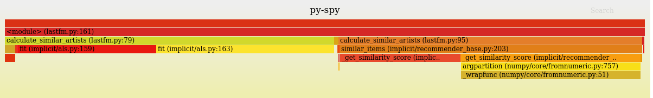
py-spy with my little eye
https://github.com/benfred/py-spy
py-spy creates flame graphs of your python program visualising which lines of code take the most CPU time. This is done by sampling your python program to get the stack trace.
py-spy record -- python program.py
Flame graphs: https://github.com/brendangregg/FlameGraph
Sam Huynh (AAO, Macquarie University)
Notes:
To find where the queries were made, I used a little tool called py-spy. py-spy is a profiling tool which looks at a python program’s stack periodically to create a flame graph which shows you how much time your program is spending in each function call. All you need to do is run py-spy record with your normal python program invocation. What you get out is a flame graph. So in the example flame graph on the py-spy github, roughly half of the time spent in calculcate_similar_artists was doing fitting, and another half calculating the similarity score.

Slide 7
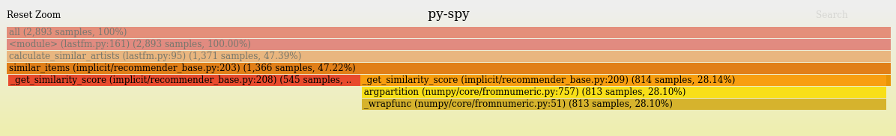
The graphs are interactive!
Hovering over a rectangle displays the times a function was in the python stack trace sample
Clicking on a rectangle zooms in so you can see more information. E.g. percentage of samples, function calls
Sam Huynh (AAO, Macquarie University)
Notes:
A nice thing about these graphs is that they are interactive so you can see how many times py-spy saw your program running a function. You can also click on a function call to zoom in on that function.

Slide 8
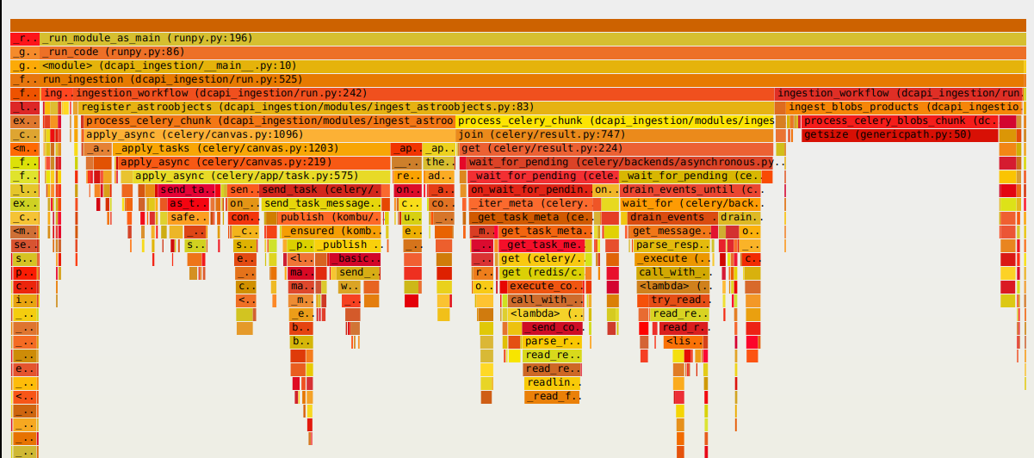
Flame graph after optimising
After removing redundant code, ingesting all miscellaneous files takes roughly 8 hours instead of a week!
Sam Huynh (AAO, Macquarie University)
Notes:
So what I found was there was some queries hitting the database which would scan tables for ID’s which we reuse multiple times. Caching these queries instead reduced unnecessary load on the database and improved performance significantly. Instead of taking at least a week to ingest, all miscellaneous files took roughly 8 hours.

Slide 9
Some things to know about py-spy
Run against already running code (except in Docker and k8s environments), no need to modify your code to profile
In Docker and k8s environments, SYS_PTRACE capability is required to run which means redeployment is necessary. See https://github.com/benfred/py-spy#how-do-i-run-py-spy-in-docker for more info
py-spy will profile CPU. For memory profiling, use the standard tracemalloc module or other memory profiling modules on PyPI
Aside: even running a memory profiler for a short time can give you hints into memory leaks
Sam Huynh (AAO, Macquarie University)
Notes:
Some thing you should know about py-spy
You dont need to make any modifications to your existing code. You can run the py-spy record command and it just works. There is a caveat though in that if you are running python within a docker container or kubernetes environment, you’ll need to add the SYS_PTRACE capability. It’s likely you wouldnt be running with this enabled so you’ll have to redeploy your docker or kubernetes environment to make this work.
The github readme for py-spy has more information about this and more information about how py-spy works so you should check it out.
Since py-spy is just reading the stack traces, its only useful for CPU profiling. If you want to profile for example memory, there are other tools like the standard tracemalloc module and plenty more on PyPI. There was a memory issue I wouldn’t have caught and fixed if I didn’t receive notifications about a kubernetes pod rebooting due to a memory leak. Even running the memory profiler for a short time showed me where the memory leak was occurring.

Slide 10
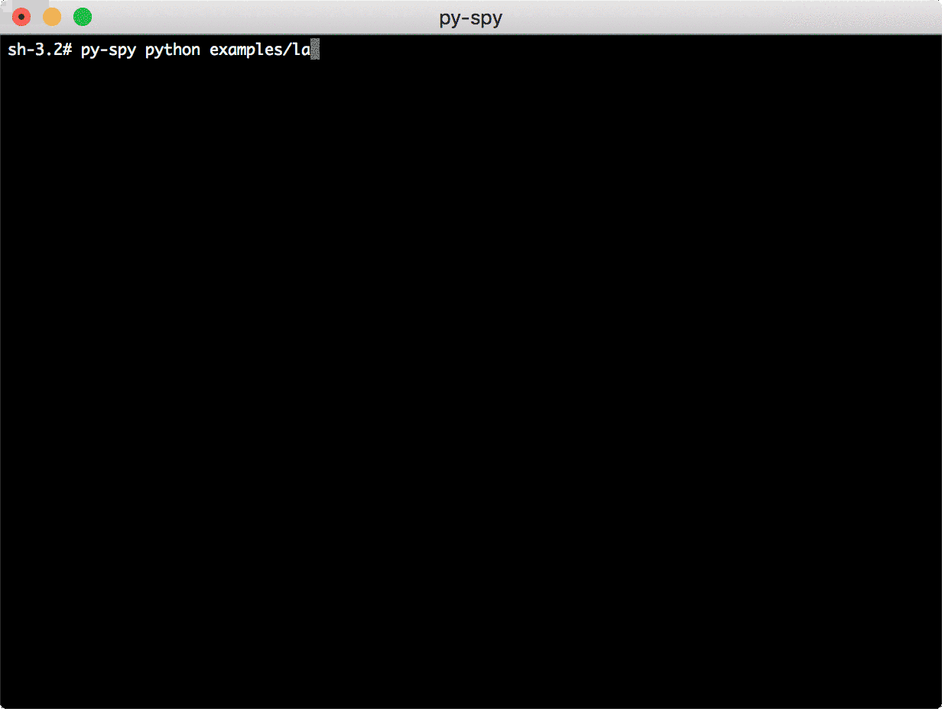
View program execution while the program is running
py-spy top –pid pid gives a live updating view of your python program
py-spy dump –pid pid outputs the current program stack
Root privileges are usually required for attaching to existing processes
sudo py-spy top/dump ...
Sam Huynh (AAO, Macquarie University)
Notes:
You might remember when i introduced pyspy that you execute your program normally with pyspy record in front. Sometimes you are already running your program say in production. Instead of redeploying to record and get a flame graph. You can get a live view with py-spy top. Py spy will do the same thing but look at the stack trace of the program you passed and give you live view of what is taking the most CPU time. Another useful command is dump which will sample the program once and give you the stack trace. You may need to run with sudo to let pyspy inspect other processes

Slide 11
Further work
There are definitely some more optimisations to be made in our code.
With the increasing size of survey data, it is worth spending time to ensure we have measurements of our code.
We can use this to:
Verify an optimisation results in performance increase
Compare changes due to input size scale
Ensure a change does not result in performance regression
Sam Huynh (AAO, Macquarie University)
Notes:
Going back to Data Central’s ingestion system. There are definitely more optimisations that we can make. Especially with longer running systems, it’s worth having an idea about how your system is performing. Profiling is one way, logging and metrics is another way. Given data volumes are only going up, this only become more important. Eventually we will reach the point where we need to make optimisations because the code is inefficient or we are making tweaks to make the most out of hardware. Having previous profiling results on hand can help us verify the optimisations we make actually result in a performance increase, we can see if our code scales well, and also if new additions don’t cause performance regressions.

Slide 12
Key points
Don’t optimise in the dark
Profiling gives you insights into which chunks of code are causing the program to slow down
Some execution time might be spent for general overhead which you can’t control
There might be other reasons why a program is slow e.g. limited hardware resources
Profiling can help you spot problems before they become problems
Don’t optimise prematurely
Profiling is not the hammer for every nail
Logging and metrics can help you find other problems
Sam Huynh (AAO, Macquarie University)
Notes:
Before I wrap up, some key things to take away.
Optimising without reasons to is a no go.
Yes you can see bits of code taking a while to execute on testing. But this might be a small overhead which you can’t control. When you run on larger inputs, you might see that other bits of code don’t scale well which is what you should be optimising. It might be that there are network and hardware limitations that you are working against.
That being said, profiling can help you spot problems before they become problems. By changing input size, you can see how well a
Profiling is just one tool to help you diagnose problems. Logging and metrics can help you find other problems. Good logging with a good search system can help you find issues with weird input which wouldn’t be caught with a profiler.

Slide 13
Thanks!
Sam Huynh (AAO, Macquarie University) sam.huynh@mq.edu.au
Notes:
And that’s it for my talk. If you have any questions feel free to send me an email which at the bottom of this slide. Thanks and enjoy the rest of the conference!

